Slide 1




Slide 2
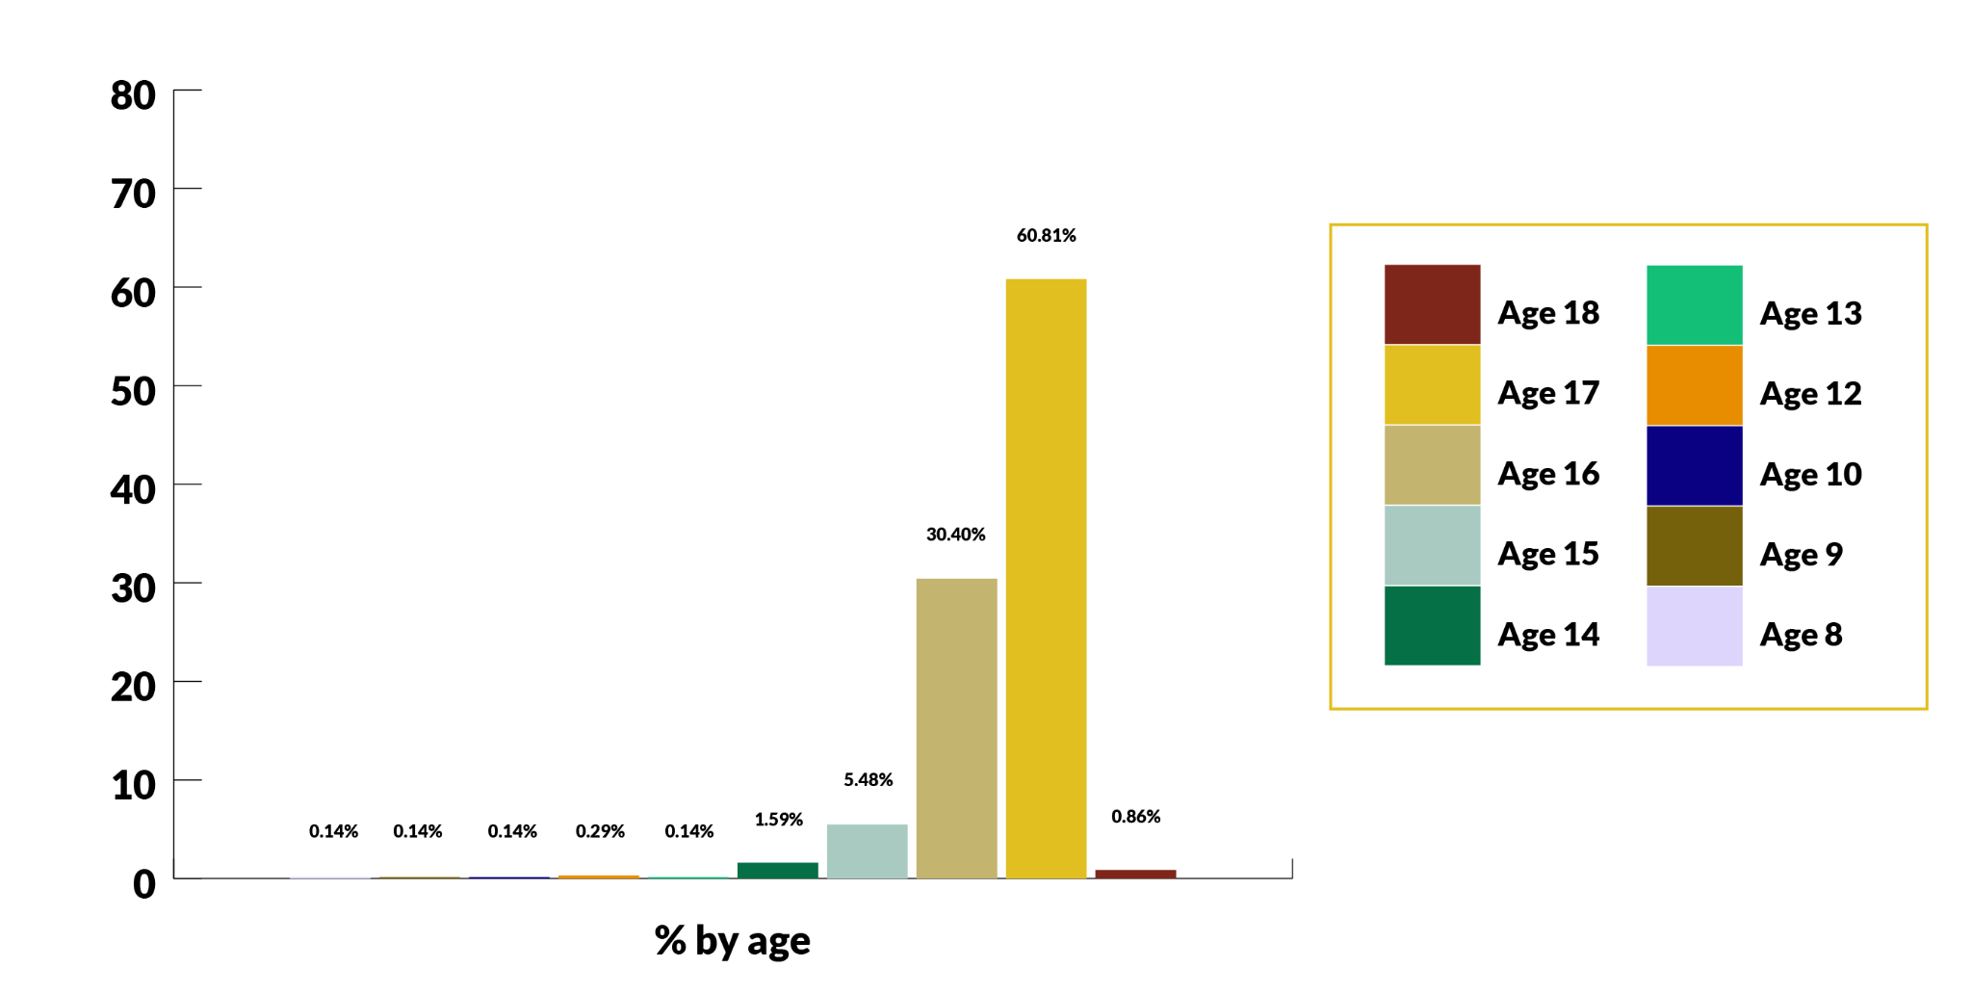
Understanding the need
There are currently 838 refugee children being looked after by North West authorities.
Majority aged between 15 and 17

Slide 3
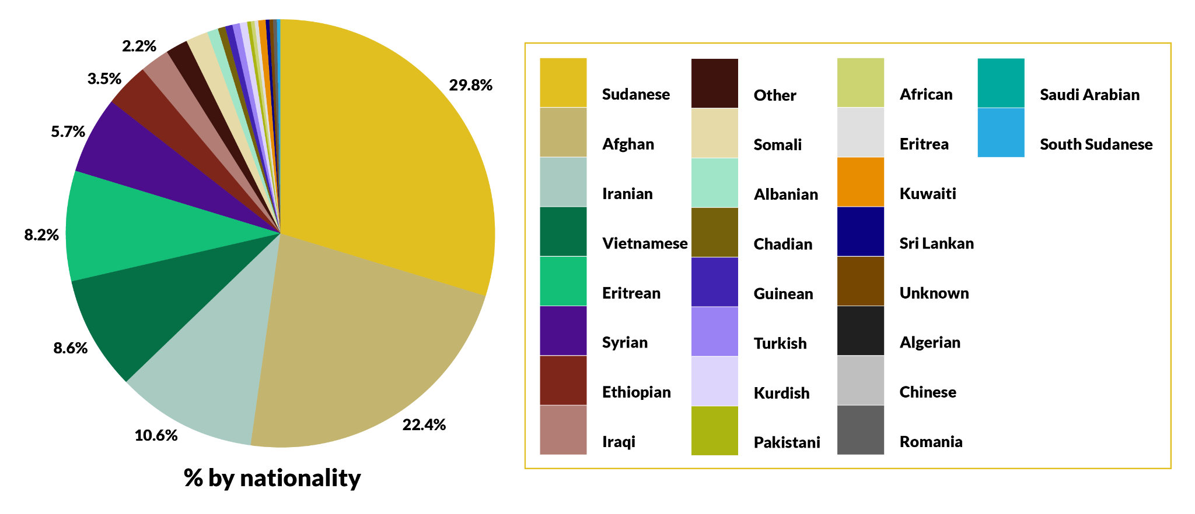
Understanding the need
Children % by nationality Dec 2024

Slide 4
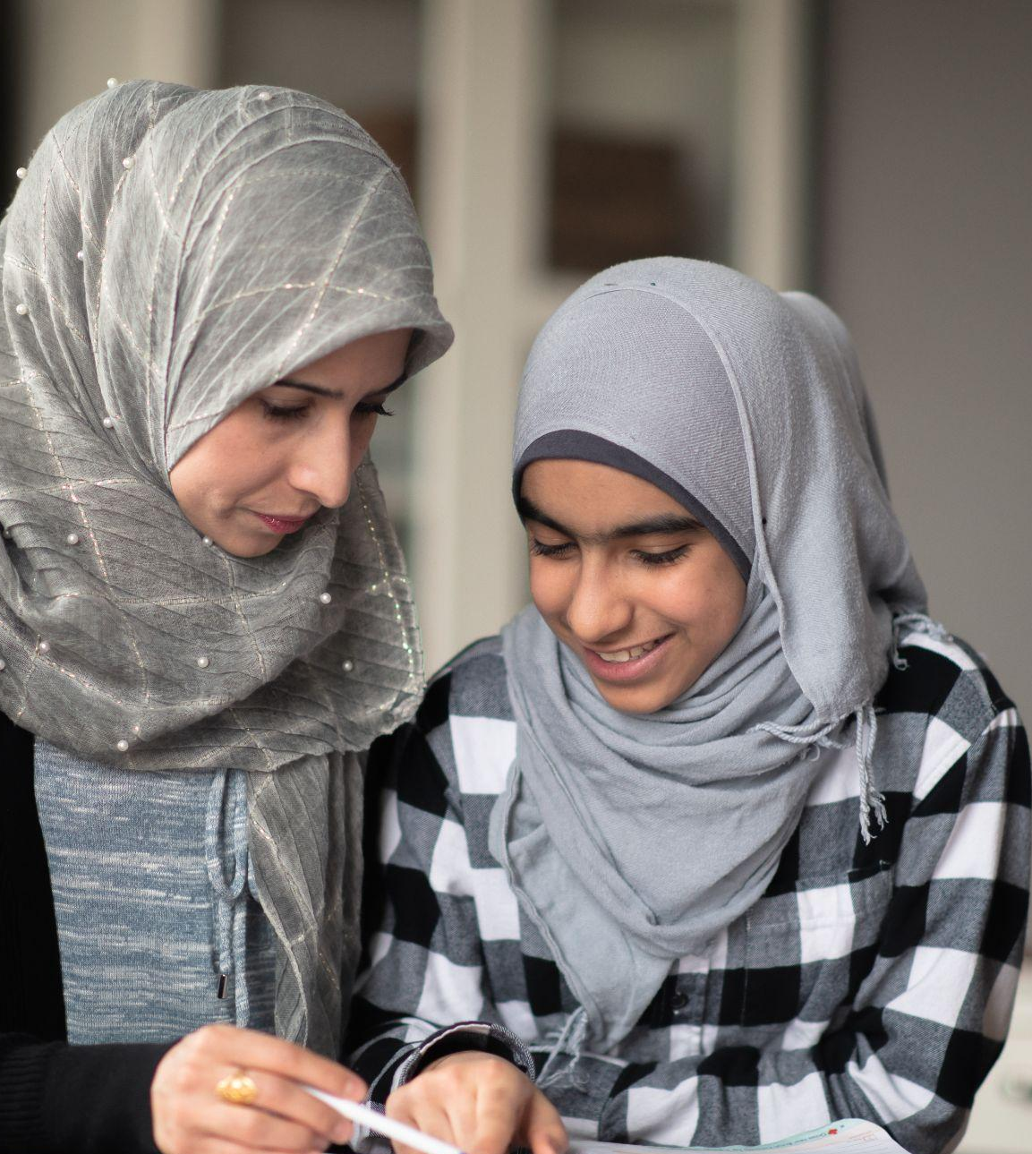
Children’s Placements
Majority of the children (536) are placed in supported accommodation/ semi independent living
81- Local authority in house placements
(foster placements and supported lodgings hosts)
  Of these, 3 Authorities have 45 placements together.
  The remaining 21 Authorities have 36 places between them, which means LAs can do more to bring more specialised carers that meet the specific needs of this cohort of children.
Refugee children wait of up to 55 days to find a home.
10 days provided under the National Transfer Scheme (NTS) to find homes for children.

Slide 5

Experiences Of Forced Displacement
Refugee children are some of the most vulnerable young people that will come into Local Authority care. They are often alone, in an unfamiliar place and are likely to be surrounded by people who do not speak their first language.
They are unlikely to have had a settled childhood.
Some may have experienced abuse, trafficked, been involved in child sexual exploitation, been exposed to war or other turmoil, all of which can result in trauma.
Long, dangerous journeys, lost childhood.
The asylum process itself can be stressful and difficult and so they will need support around this.

Slide 6
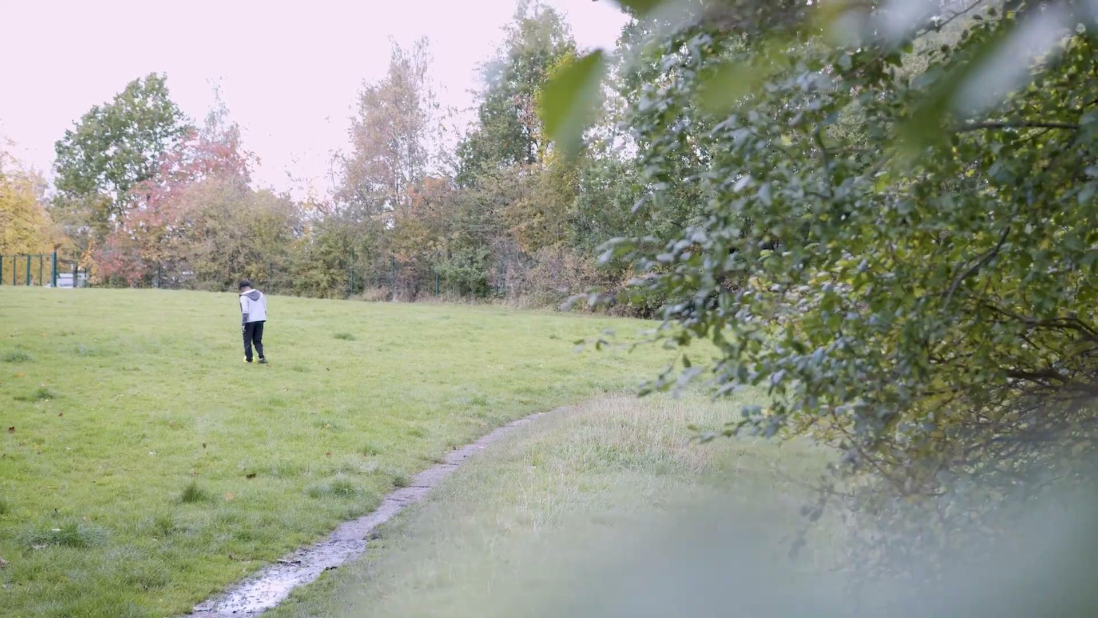
A Refugee Story

Slide 7
Need for Placements
Local Authorities are expecting more young people to seek asylum in the UK, yet there is a shortage of foster carers in general especially foster carers to cater for the cultural needs of those children for example those whom faith is an important part of their identity and want to be able to relate and practice their religion freely and comfortably.
And yet we know from carers who that provided homes to refugee children how rewarding it is …
"It’s the best job that I’ve done. It’s so personal the difference you make in the children’s lives and to their future – it’s amazing.” Roseman, foster carer.

Slide 8
Support Available to Carers
Support of professionals
Support from a range of professionals- social workers, therapists and other professionals from your initial enquiry and throughout your fostering journey.
Training
Journey and experiences of Unaccompanied Children (International Organisation of Migration (IOM)
Good practice in caring for migrant children who arrive in the UK- Immigration Social Work Services
Country-specific information sessions (IOM)
Health Information Sessions
Understanding the Children's Asylum Process(Legal)
How to speak to learners of English- English Unlocked
Working with an interpreter
Other
RSMP website
Local Authority fostering support groups

Slide 9
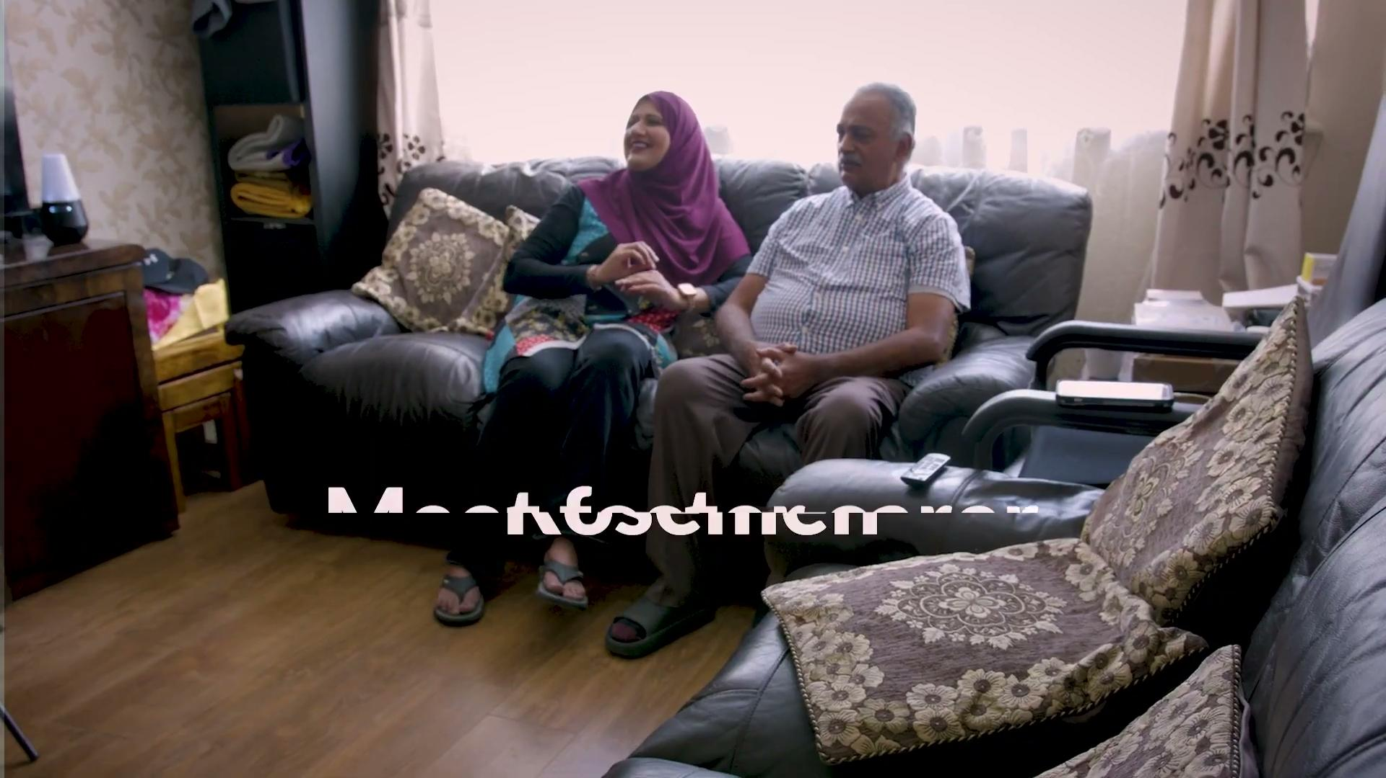
A Carer’s Story

Slide 10
How you can support
Learn
Take a look at all our key messages and share with others via word of mouth or as part of your comms to raise understanding and awareness
Be an Ambassador!
Now you know more about refugee children and fostering we’d like to invite to be ambassadors for this important work and spread the word in anyway you can!
We will send an email to everyone who registered for the event with further information that you can easily copy and paste into your communications. We really appreciate your support in activating your networks for this important campaign.
Speak
Speak to colleagues, family and friends about the Safe Space in a New Place campaign
Share
Send a tweet or post on your social media
Add information to your newsletters about this campaign and encourage your networks / other to share it on their platforms
Invite
The team to any events you are holding we’d love to speak or have a stand
Talk to us
Get in touch with the team if you want to help in other ways or if there are ways in which your organisation can amplify this work

Slide 11
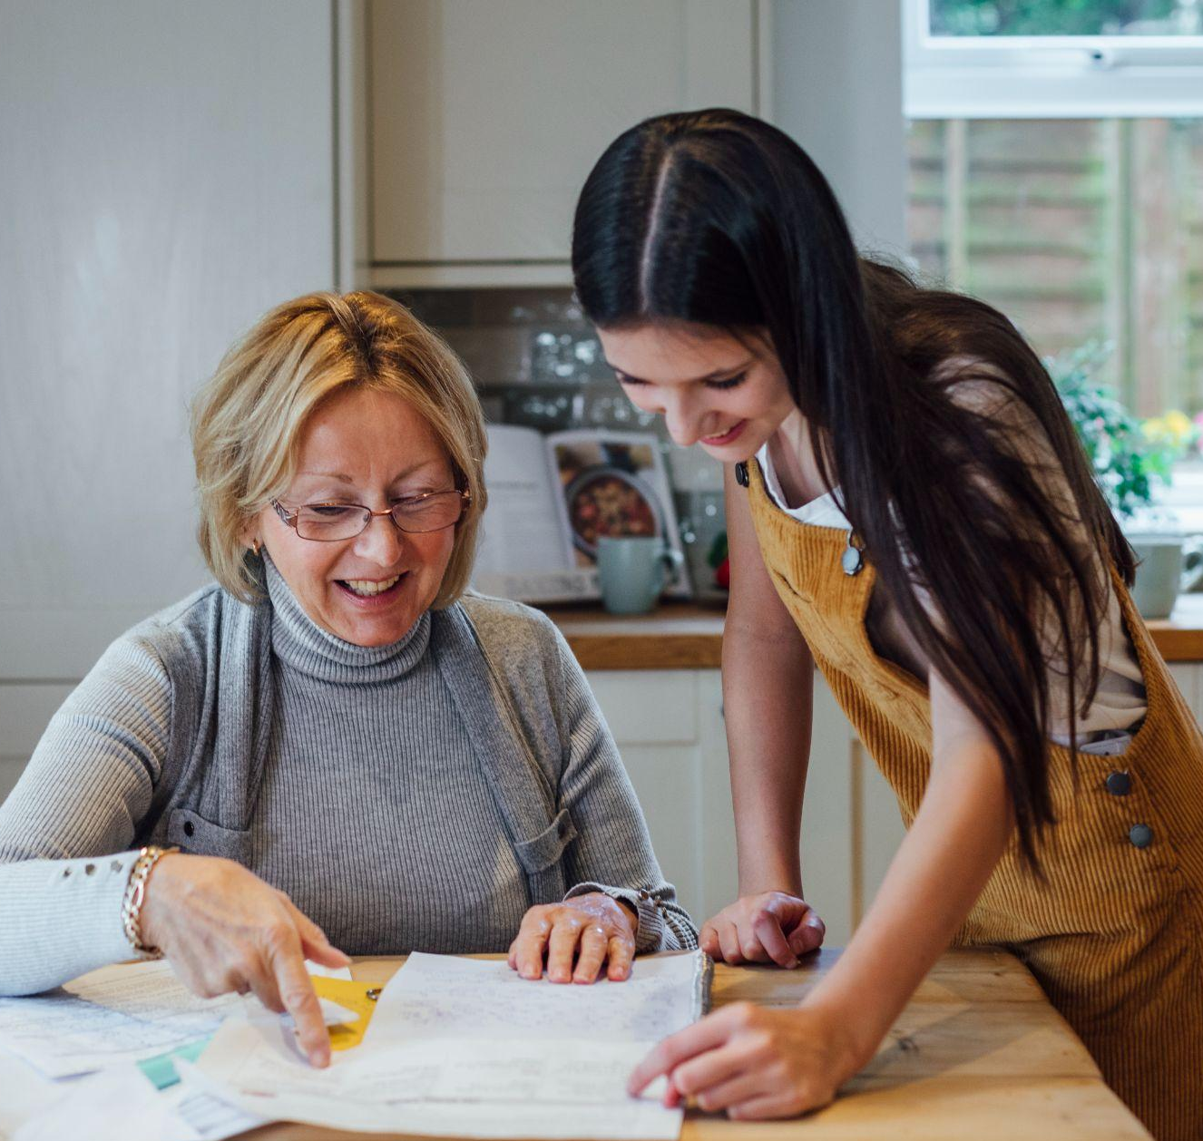
Contact Details
Further enquiries email
the UASC Project Manager:
Fatouma.Sanyang@manchester.gov.uk
Website
northwestrsmp.org.uk
Thank you

