Slide 1

Working Smarter with AI and IA
How Intelligent Automation and Artificial Intelligence Are Already Helping Us Work Better

Slide 2

Who I Am and Why I’m Here
Name: David Cunliffe
Role: Intelligent Automation Lead, Digital & Innovation
What I Do:
  Lead our work on automating repetitive, rule-based tasks
  Explore safe, practical uses of AI to support staff and services
  Collaborate with teams across the council to modernise processes
Why I’m Here:
  To show how automation and AI are already working for us
  To explain how to use these tools safely
  And to invite you to get involved — responsibly!
Find Me At:
  David.Cunliffe@westmorlandandfurness.gov.uk
Notes:
I'm David, and I lead the Intelligent Automation work here at Westmorland and Furness.
My job is to help teams make their processes better — sometimes faster, sometimes easier, always more reliable.
Lately that’s meant a lot of work on robotic process automation, and more recently we’ve started looking at how we use AI — safely, securely, and in a way that benefits our staff and residents.
Today I’m wearing both hats: showing you what’s possible, and helping you understand the boundaries we all need to work within.

Slide 3
What We’ll Cover Today
🧠 Mythbusting the Hype
What AI and IA really are – not what the headlines say.
🤖 Meet Our Digital Helpers
Introduction to IA and AI, what they do, and how they differ.
🎬 Real-Life Examples
Automation and AI already in use across the council.
🔐 Safe and Smart AI Use
What the GenAI Policy means for you.
🗳️ Get Involved!
Audience interaction and how to bring your ideas to us.
Notes:
Here’s how we’re going to spend our time together.
We’ll kick things off with some mythbusting, introduce our IA and AI digital helpers, look at real examples already running today, and then spend a bit of time on what the council’s AI policy means for you.
We’ll wrap up with something interactive and hopefully leave you with a few ideas – or maybe even a bit of inspiration.

Slide 4
AI or IA? – True or False
Notes:
"Alright, let’s kick things off with a quick quiz — just to see how much AI and IA knowledge you’re already carrying around."
"We’re going to use a tool called Slido — you’ll see a code or QR code on screen. Just grab your phone, tablet, or open a browser tab and go to slido.com, then type in the event code."
"Once you're in, you’ll see a series of True or False questions appear — all about AI and Intelligent Automation."
"Answer each one as we go — some are straightforward, some are tricky. And don’t worry, this isn’t a test — it’s just to get us thinking, and maybe clear up a few misconceptions."
"Ready? Let’s go — here comes your first question.“
"Right — quiz done!”
[pause for leaderboard or manually announce winner]
"Now, while we go through the answers, I’d like you to also think about your own questions — anything you’re still unsure about, curious about, or even suspicious of when it comes to AI or automation.“
"We’ve got the Slido Q&A open now — you can type questions in anytime, and we’ll come back to them at the end of the session."

Slide 5
AI or IA? – True or False
“Artificial Intelligence learns from every conversation I have with it.” ❌
“Intelligent Automation can follow a set of instructions again and again, perfectly.” ✅
“We already use AI in the council.” ✅
“You can freely give AI tools sensitive data if it’s helpful.” ❌
“IA replaces people.” ❌ (It supports them)
“AI tools are only for tech experts.” ❌
“You might already be using AI without knowing it.” ✅
Notes:
“AI learns from every conversation I have with it.” ❌
"This one trips people up. Chatbots like ChatGPT don’t learn from your chat — they use something called context, but their training is frozen until OpenAI updates the model. Real-time learning like that would be a major security risk!“
“IA can follow a set of instructions again and again, perfectly.” ✅
"Exactly. That’s the heart of Intelligent Automation — it runs a script or follows a flowchart of decisions. Great for tasks that need doing the same way every time.“
“We already use AI in the council.” ✅
"True! You might not see it every day, but AI is being explored for tasks like minute-taking, summarising feedback, and helping write content. We’re piloting these tools safely and ethically.“
“You can give GenAI tools sensitive data if it’s helpful.” ❌
"Big red flag here. Even if it seems convenient, you mustn’t paste personal or confidential info into public GenAI tools. That’s covered in our policy — it’s a potential data breach.“
“IA replaces people.” ❌
"Nope — it supports people by taking on low-value, repetitive work. In our experience, IA frees staff to focus on the bits that need judgement, empathy, or creative thinking.“
“AI tools are only for tech experts.” ❌
"False again. These tools are built to be accessible — many are built into everyday software like Word or Teams. If you can write an email, you can use Copilot.“
“You might already be using AI without knowing it.” ✅
"Absolutely. If you’ve used Microsoft Copilot, spell-check, summarisation in Teams, or even web search previews — that’s AI quietly working in the background."

Slide 6
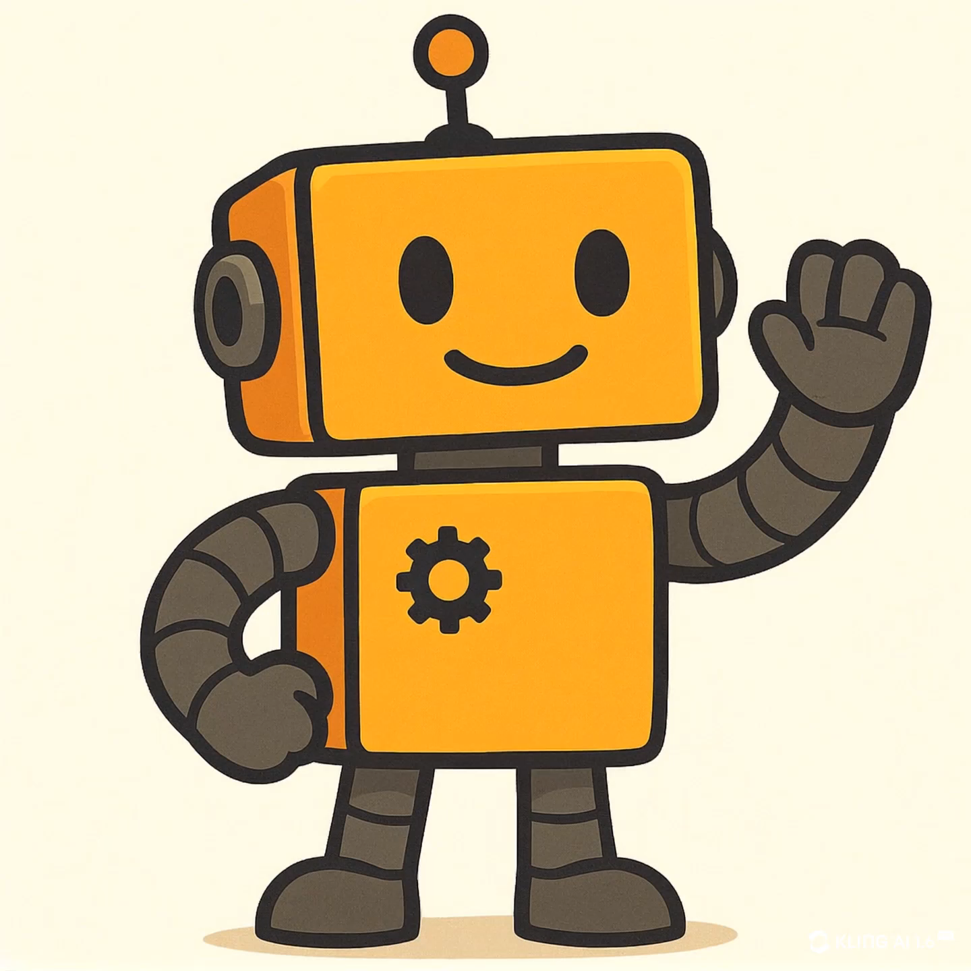
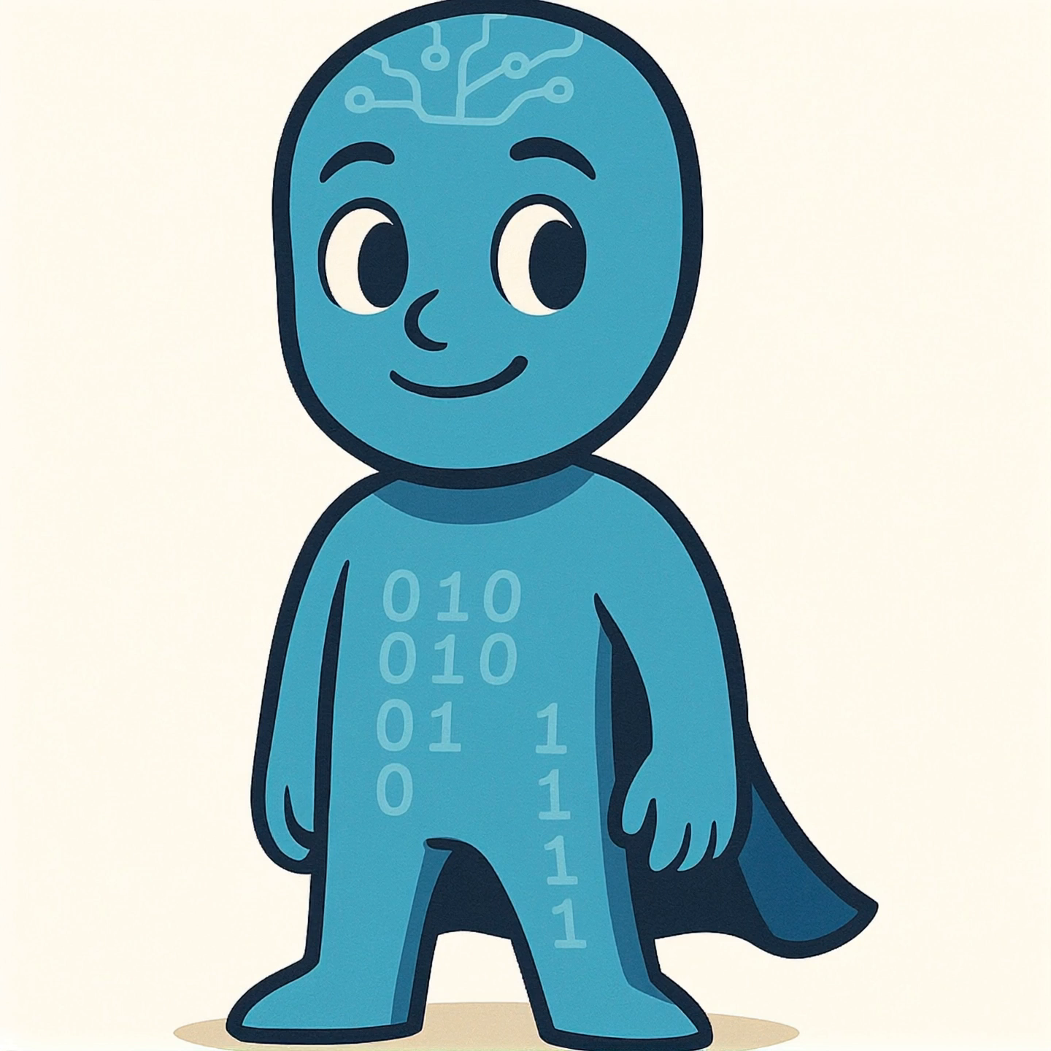
AI vs IA: What’s the Difference?
AI – Artificial Intelligence
IA – Intelligent Automation
Simulates aspects of human intelligence (e.g. language, reasoning, vision)
Uses machine learning and large data sets
Can generate text, summaries, images, etc.
Is probabilistic, not rule-based
Needs oversight, governance, and careful use
Automates structured, repetitive, rule-based tasks
Uses logic and business rules
Can mimic what a person does on a screen
Doesn’t “learn” – it does what it’s told
Already widely used (e.g. invoice processing, data entry)
Notes:
So let’s break it down clearly — what exactly is the difference between Intelligent Automation and Artificial Intelligence?
Start with Intelligent Automation, or IA.

Slide 7
AI vs IA: What’s the Difference?
AI – Artificial Intelligence
IA – Intelligent Automation
Simulates aspects of human intelligence (e.g. language, reasoning, vision)
Uses machine learning and large data sets
Can generate text, summaries, images, etc.
Is probabilistic, not rule-based
Needs oversight, governance, and careful use
Automates structured, repetitive, rule-based tasks
Uses logic and business rules
Can mimic what a person does on a screen
Doesn’t “learn” – it does what it’s told
Already widely used (e.g. invoice processing, data entry)
Notes:
Start with Intelligent Automation, or IA. This is sometimes called robotic process automation, and it’s the kind of automation we already use in the council. IA is great at following rules — exactly, reliably, and without getting tired. If a task is repetitive, structured, and happens the same way every time, that’s where IA shines. Think of it as a really fast, really reliable digital assistant doing the same thing every day.
Now compare that to Artificial Intelligence, or AI.

Slide 8
AI vs IA: What’s the Difference?
AI – Artificial Intelligence
IA – Intelligent Automation
Simulates aspects of human intelligence (e.g. language, reasoning, vision)
Uses machine learning and large data sets
Can generate text, summaries, images, etc.
Is probabilistic, not rule-based
Needs oversight, governance, and careful use
Automates structured, repetitive, rule-based tasks
Uses logic and business rules
Can mimic what a person does on a screen
Doesn’t “learn” – it does what it’s told
Already widely used (e.g. invoice processing, data entry)
Notes:
Now compare that to Artificial Intelligence, or AI. This is a broader set of technologies that includes things like machine learning and natural language processing — what lets tools like ChatGPT generate text, or summarise meeting notes, or suggest the next sentence in an email. AI doesn’t follow rules — it learns patterns and makes probabilistic guesses. That makes it more flexible, but also less predictable. It needs checking and oversight.
Here’s a good way to remember it:
IA is about following instructions.
AI is about interpreting or generating data.
And when you combine them? You get smart systems — like automation that kicks off when an AI tool flags something interesting. That’s where we’re heading in the future.

Slide 9
AI vs IA: What’s the Difference?
AI – Artificial Intelligence
IA – Intelligent Automation
Simulates aspects of human intelligence (e.g. language, reasoning, vision)
Uses machine learning and large data sets
Can generate text, summaries, images, etc.
Is probabilistic, not rule-based
Needs oversight, governance, and careful use
Automates structured, repetitive, rule-based tasks
Uses logic and business rules
Can mimic what a person does on a screen
Doesn’t “learn” – it does what it’s told
Already widely used (e.g. invoice processing, data entry)
Notes:
Here’s a good way to remember it:
IA is about following instructions.
AI is about interpreting or generating data.
And when you combine them? You get smart systems — like automation that kicks off when an AI tool flags something interesting. That’s where we’re heading in the future.

Slide 10
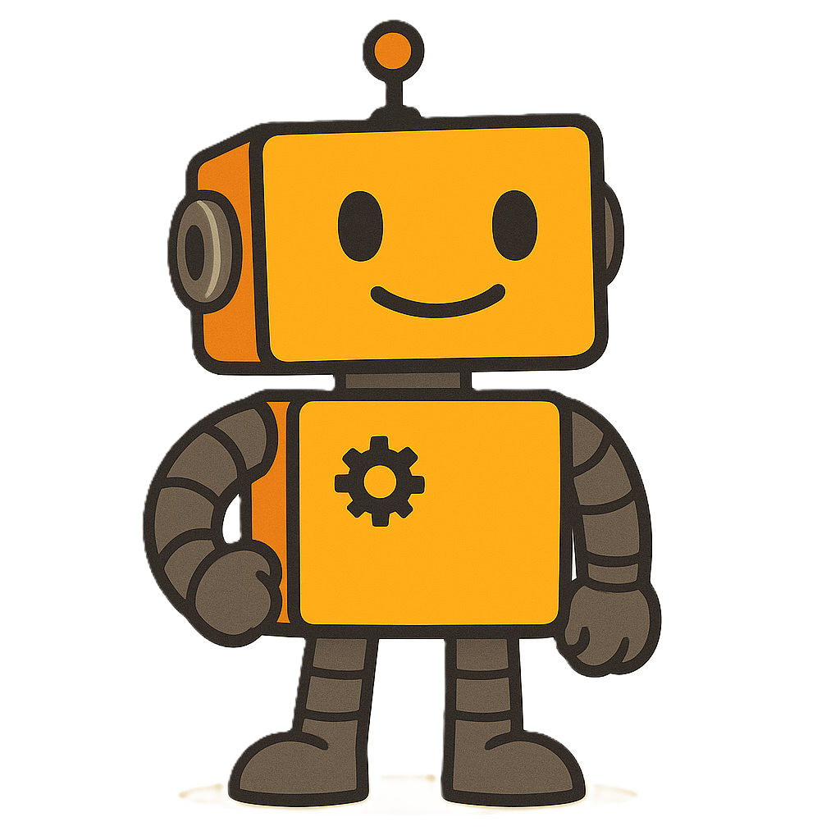
Intelligent Automation at Work
Slipped Invoices
Before IA:
  8 full-time staff in Cumbria County Council managing invoice records
  Manual handling of scanned paper invoices
  Full-time effort just to manage physical pages and data entry
After IA:
  First automation allowed 4 staff to redeploy to urgent work in the P2P team
  Further IA removed the need for physical handling and scanning
  Now (two versions later), the digital worker:
    Handles more entries into E5 than ever before
    Has avoided printing over a pallet of temporary paper records
    Works continuously, accurately, and paper-free
Notes:
"This is one of our best examples of Intelligent Automation in action — the Slipped Invoices process."
"Six years ago, in Cumbria County Council, we had 8 people working full time to process and log invoice details. It was intensive, manual, and entirely reliant on paper."
"The first automation replaced the core of that task — and we were able to redeploy four people to more critical parts of the Purchase to Pay team where the need was greater."
"Then we went further. We tackled the paper-handling stage — one full-time role dedicated to scanning and sorting documents. The second round of IA removed that completely."
"Now, in Westmorland and Furness, the third generation of that automation is running — and it’s doing more invoice entries into E5 than ever before, entirely paper-free."
"To give you a sense of impact — we’ve saved the equivalent of over a pallet of paper that used to be manually handled, scanned, and filed. That’s not just efficiency — it’s transformation."

Slide 11
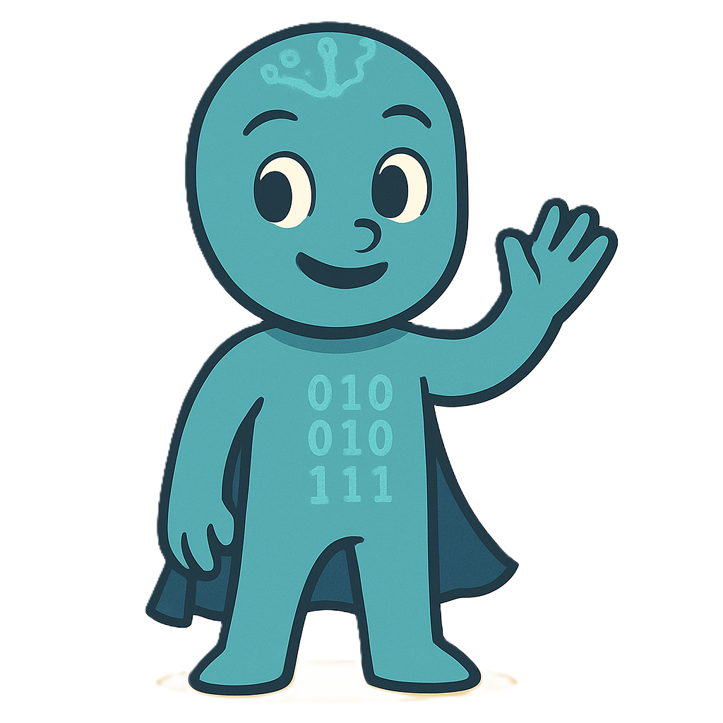
AI in Action: The Journey Has Begun
What’s Already Here
AI is already part of tools we use every day:
  Email security scanning and network threat detection
  Website search engines using learning algorithms
  Image recognition and keyword tagging tools
What’s Coming Next
We now have a Generative AI Policy in place
Governance and guidance are ready
We’re preparing for pilot projects using:
  Microsoft Copilot (Word, Outlook, Teams)
  Generative AI tools for summarisation and support
All uses will be guided by ethics, privacy, and security.
Notes:
Let’s be real about where we are with AI — because the reality is more interesting than the hype.
We’re already using AI — though not always in the headline-grabbing ways you might expect. It’s quietly working behind the scenes: detecting phishing emails, flagging unusual network traffic, powering smarter search on our websites, and tagging content.
But when people think of AI these days, they’re often thinking about tools like ChatGPT or Microsoft Copilot — Generative AI. That’s the kind of AI that can summarise, suggest, or generate content.
We’re not using those tools at scale just yet. But — and this is important — we’re ready. We have a policy in place. We have governance ready. We’re working with ICT and Service teams to set up safe, responsible pilots.
It’s a deliberate, careful start — because when we do use these tools, we want to do it right.

Slide 12
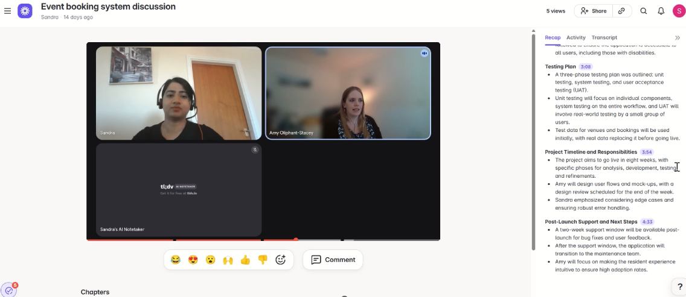
AI on the Horizon: Tools We’re Watching
Notes:
"Let’s take a look at some tools we’re actively watching — they’re not in use here yet, but they give a great flavour of what we’re preparing for."
"Loom captures meetings and produces summaries — a bit like what Copilot will offer inside Teams."

Slide 13
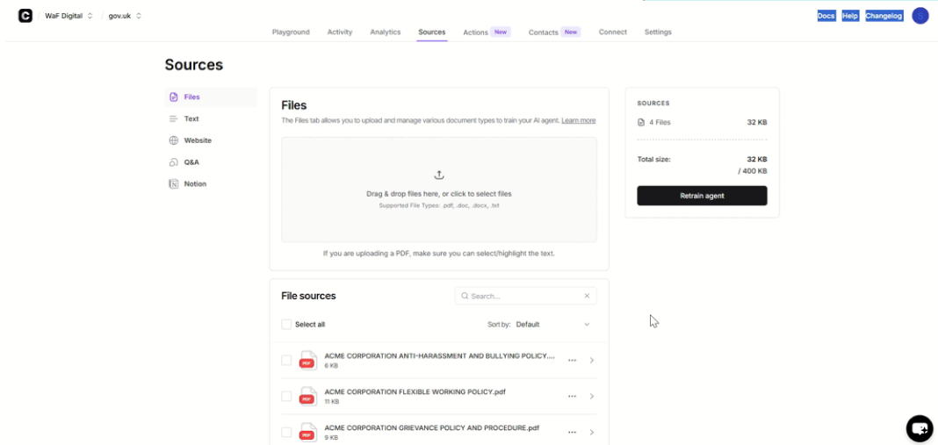
AI on the Horizon: Tools We’re Watching
Notes:
"Chatbase lets you build a chatbot or document assistant in minutes — the kind of thing that could turn a long policy PDF into a helpful assistant."

Slide 14
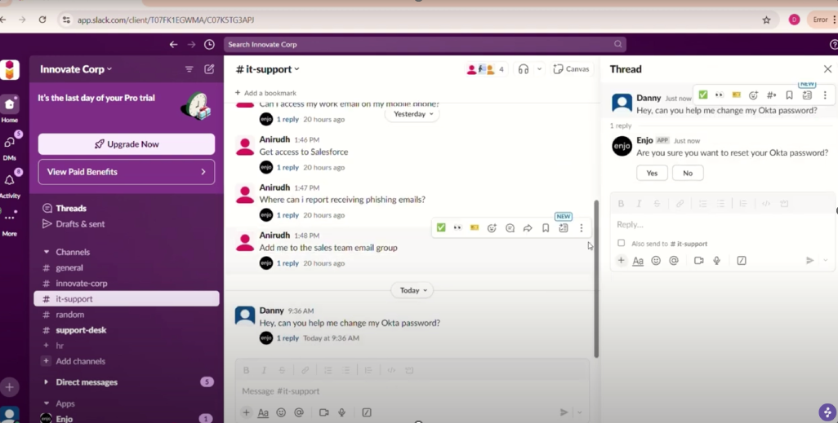
AI on the Horizon: Tools We’re Watching
Notes:
"And Enjo is an AI helper that lives right inside Teams or Slack — it can pull together information, answer internal questions, or even trigger workflows."
"We’re not endorsing these tools yet — but we’re watching, and we’re ready to trial similar ones when the time is right."

Slide 15
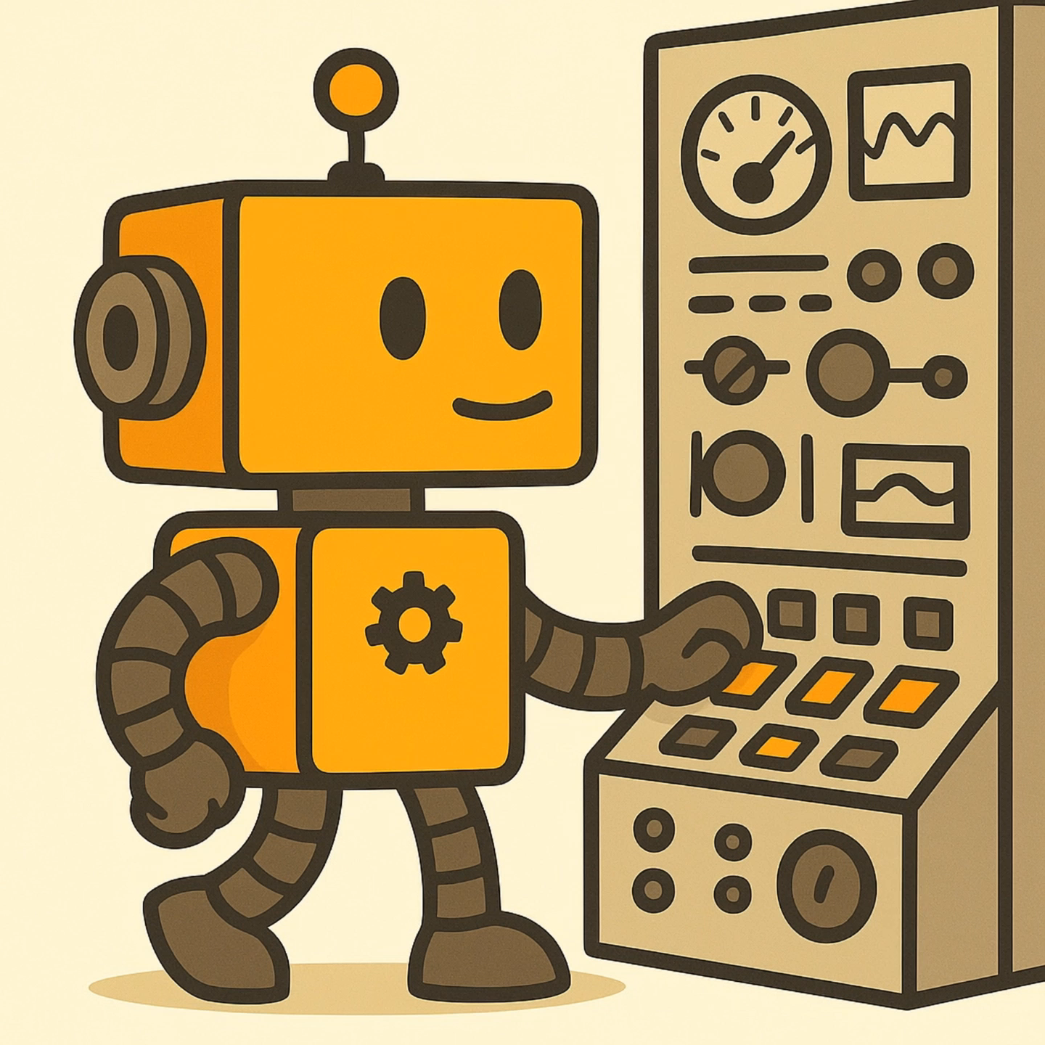
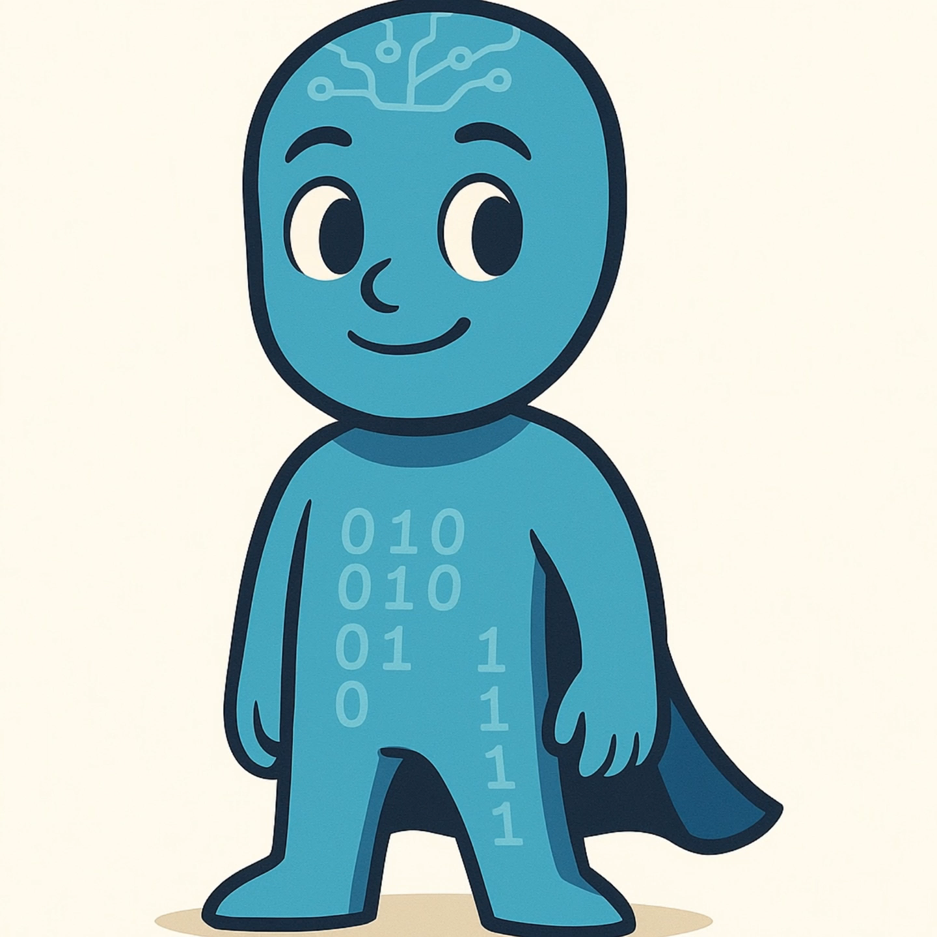
What’s the Impact?
✅ IA – What We’ve Delivered
  🕒 Thousands of staff hours saved across finance and support teams
  📄 Over a pallet of paper eliminated from Slipped Invoices alone
  🔁 Processes run reliably 24/7 – no missed steps, no fatigue
  👥 Staff redeployed to higher-value work, not replaced
🚀 AI – What’s on the Horizon
  🧠 Smarter summaries, suggestions, and insights
  🧩 Embedded support in tools you already use (e.g. Word, Outlook)
  🔐 Guardrails already in place: policy, governance, and support
Notes:
It’s worth pausing here and asking: what’s the actual impact?
With Intelligent Automation, we’ve already delivered major time savings, improved consistency, and helped teams focus on more meaningful work. You’ve seen the Slipped Invoices example — we’ve not only saved a literal pallet of paper, we’ve created capacity where it was badly needed.
And we’re not stopping there. The governance work we’ve done around AI — the policy, the risk management, the preparation — means that when the next generation of tools do roll out, they’ll be safe, useful, and staff-first.
IA is already delivering. AI is coming — and when it does, we’re ready to get the same kind of results: smarter working, not harder working.

Slide 16
Using GenAI Safely: What You Need to Know
✅ Key Messages from the Policy:
Use AI tools mindfully — no sensitive data in public chatbots like ChatGPT for work tasks
Never enter personal, confidential, or sensitive data
You are responsible for checking and correcting AI output
Always disclose AI-generated content where appropriate
Ask if unsure – speak to Digital Innovation or Information Governance
Notes:
"Now that we’ve seen what’s possible, let’s talk about how we keep it safe.“
"Our Generative AI Policy was introduced in February and gives clear, practical rules for using tools like Copilot, ChatGPT, and other GenAI systems.“
"Here are the key headlines:
Use only tools that have been reviewed and approved by ICT.
Never put sensitive or personal data into public AI systems — it’s a data breach risk.
You’re responsible for anything AI generates — that includes fact-checking, tone, and accuracy.
If you use GenAI to create something, be transparent. Let people know.
And most importantly, if in doubt, ask. We’d much rather guide you than fix a problem later.“
"This isn’t about shutting things down. It’s about opening things up — safely, ethically, and professionally."

Slide 17
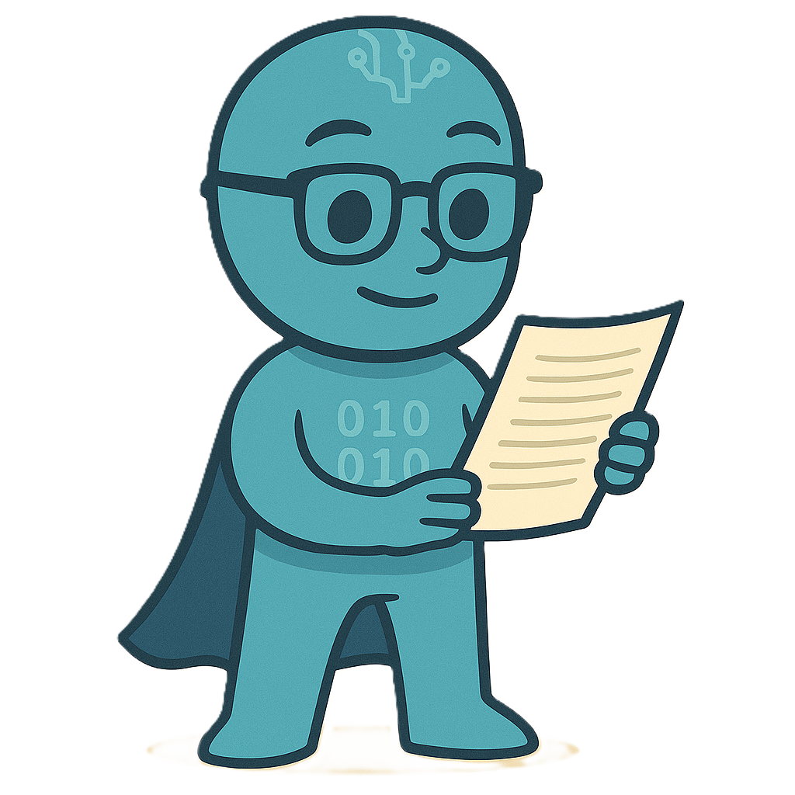
Exploring AI Tools: How to Stay Safe and Compliant
✅ You Can:
Explore AI tools on the web for personal experimentation
Try GenAI solutions to understand what they can do
Identify business needs that AI might help meet
Use AI to draft, summarise, or spark ideas — then refine
Bring promising uses to Digital Innovation for support
⚠️ To Stay Compliant:
Never input personal, confidential, or sensitive data
Don’t rely on AI for final outputs without checking and editing
Be transparent if AI helped — own the outcome
Pause and ask if the use case involves risk, judgement, or people
Remember: curiosity is good — care is essential
Notes:
"This is probably the most important slide in today’s session. Because we’re not here to block you from using AI — we’re here to help you use it well.“
"The GenAI Policy doesn’t ban tools. It guides how we use them safely, and makes sure we protect people’s data, avoid reputational risk, and stay on the right side of compliance.“
"If you want to try ChatGPT, Claude, Gemini, or even some of the newer players — that’s fine. Just don’t enter personal data, don’t publish the outputs without review, and don’t let the AI drive the bus.“
"We want you to be exploring — because that’s how we discover opportunities. If you find something useful, come talk to us. We can look at how to pilot it properly, get governance in place, and turn it into a supported solution.“
"This is about responsible curiosity. If we get that balance right, we don’t just avoid risks — we unlock real value."

Slide 18
How to Use GenAI Effectively (and Responsibly)
🧠 Great Ways to Start:
Drafting emails or letters (then edit for tone and accuracy)
Summarising meeting notes (from your own typed text)
Creating first-draft ideas for reports, blogs, or presentations
Exploring tone/style variations — formal vs. friendly
Brainstorming options: titles, taglines, names for projects
Creating custom prompts to test tools against work needs
⚠️ Keep in Mind:
Never enter real names, case data, or personal identifiers
Always review and correct output — you own the result
If it’s good, tell us — we might be able to make it official!
Notes:
"So how do you actually use GenAI well?“
"Start with low-risk, creative, exploratory uses — the kinds of things where a wrong answer isn’t a problem, and where you’d always be editing or adapting it anyway.“
"You might use it to draft a tricky email, brainstorm names for a campaign, or suggest ways to reword a message. It’s like a very fast, slightly weird colleague who’s never short on ideas — but needs a bit of managing!“
"If you're thinking, ‘This would be amazing if it were approved and supported’, that’s your cue to tell us. That’s exactly how we turn experiments into solutions.“
"The key message is: use AI as a tool, not a truth machine. Be creative, be curious, but stay in control."

Slide 19
Be Curious. Be Responsible. Be in Touch.
🔍 Be Curious
Try different AI tools. Experiment safely.
Is Claude better than Copilot for coding tasks? Is ChatGPT better than LLAMA at emails?
Explore how AI might help you work smarter.
Think about how GenAI could support your team or service.
🧭 Be Responsible
Follow the GenAI policy — protect people and data.
Review, edit, and disclose AI-generated content.
Ask for help when you’re not sure.
💬 Be in Touch
Found something promising? Tell us!
We can help turn ideas into supported tools.
This is a shared journey — we want your voice in it.
Notes:
"This is the essence of our approach to AI. It’s not about saying no — it’s about saying yes, the right way."
"Be curious — try things out, see what’s possible. AI is moving fast, and some of the best ideas are going to come from the people using it in the real world."
"Be responsible — treat AI like any other powerful tool. Understand what it can do, and what it shouldn’t do. Protect privacy, review the output, and own your work."
"Be in touch — we want to hear from you. If you’ve found a great tool, or a task you think AI could help with, or you’ve got a brilliant use case — let us know. That’s how we move from exploration to delivery."
"This is a team effort. Let’s build something smart, safe, and genuinely useful — together."

Slide 20
Where Could AI or IA Help You?
What tasks in your team are boring, repetitive, or take too long?
Let us know what gets in your way. Your ideas help us build smarter tools.
Notes:
"Okay — now it’s your turn."
"We’d love you to take a moment and think about your work — not just what you do day to day, but why you do it. What’s the purpose behind your role? Who are you trying to help? What are the things that slow you down or distract from that?"
"In your role, there’s probably a task that nags at you — something repetitive, something fiddly, something that steals time away from more meaningful work.
Maybe it’s chasing updates.
Maybe it’s formatting the same template for the tenth time.
Maybe it’s retyping information between systems.
Or maybe it’s something small but constant — like writing the same sort of response again and again."
"We’re not looking for huge, dramatic answers. We're looking for those little signals — the 'there must be a better way' moments."
"So I’d like you to take a moment now and pop your ideas into the word cloud.
One word. Two words. A short phrase. Keep it simple.
Something that makes you sigh.
Something you’d love a digital helper to assist with."
"And don’t worry about getting it perfect — you’re not committing to a project or making a request.
You're planting a seed.
Something we, as the Digital Innovation team, might be able to turn into a small solution that saves time across the board."
[pause to let people type — you can comment gently if words start appearing]
"Ah, yes — 'notes'. That one comes up a lot.
'Tracking spreadsheets' — yep, I hear that one in every department.
Keep them coming — this is really helpful for us, and it might spark something for you too."
"We’ll leave this up while we move into our closing — but thank you for sharing. These small moments add up to big improvements."

Slide 21
Your Questions
Ask anything about AI, IA, tools, or next steps.
Notes:
"Thanks for all the ideas you’ve shared — these word clouds are always fascinating, and honestly, they help shape what we work on next."
"We’ve also had the Q&A feature open throughout the session — so let’s take a few minutes to look at your questions."
"If something’s come to mind now — go ahead and type it in. There’s no such thing as a silly question when it comes to this stuff."
"We might not get to everything right now, but I’ll follow up where needed, and if it sparks a great idea — even better."

Slide 22
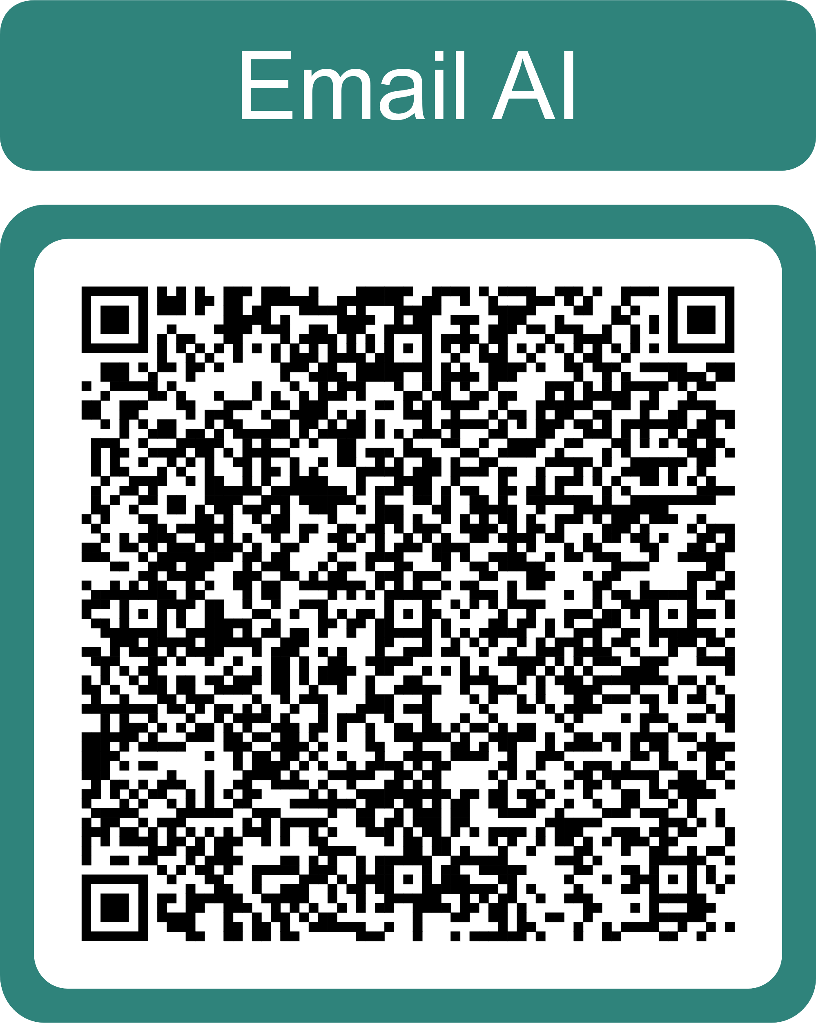
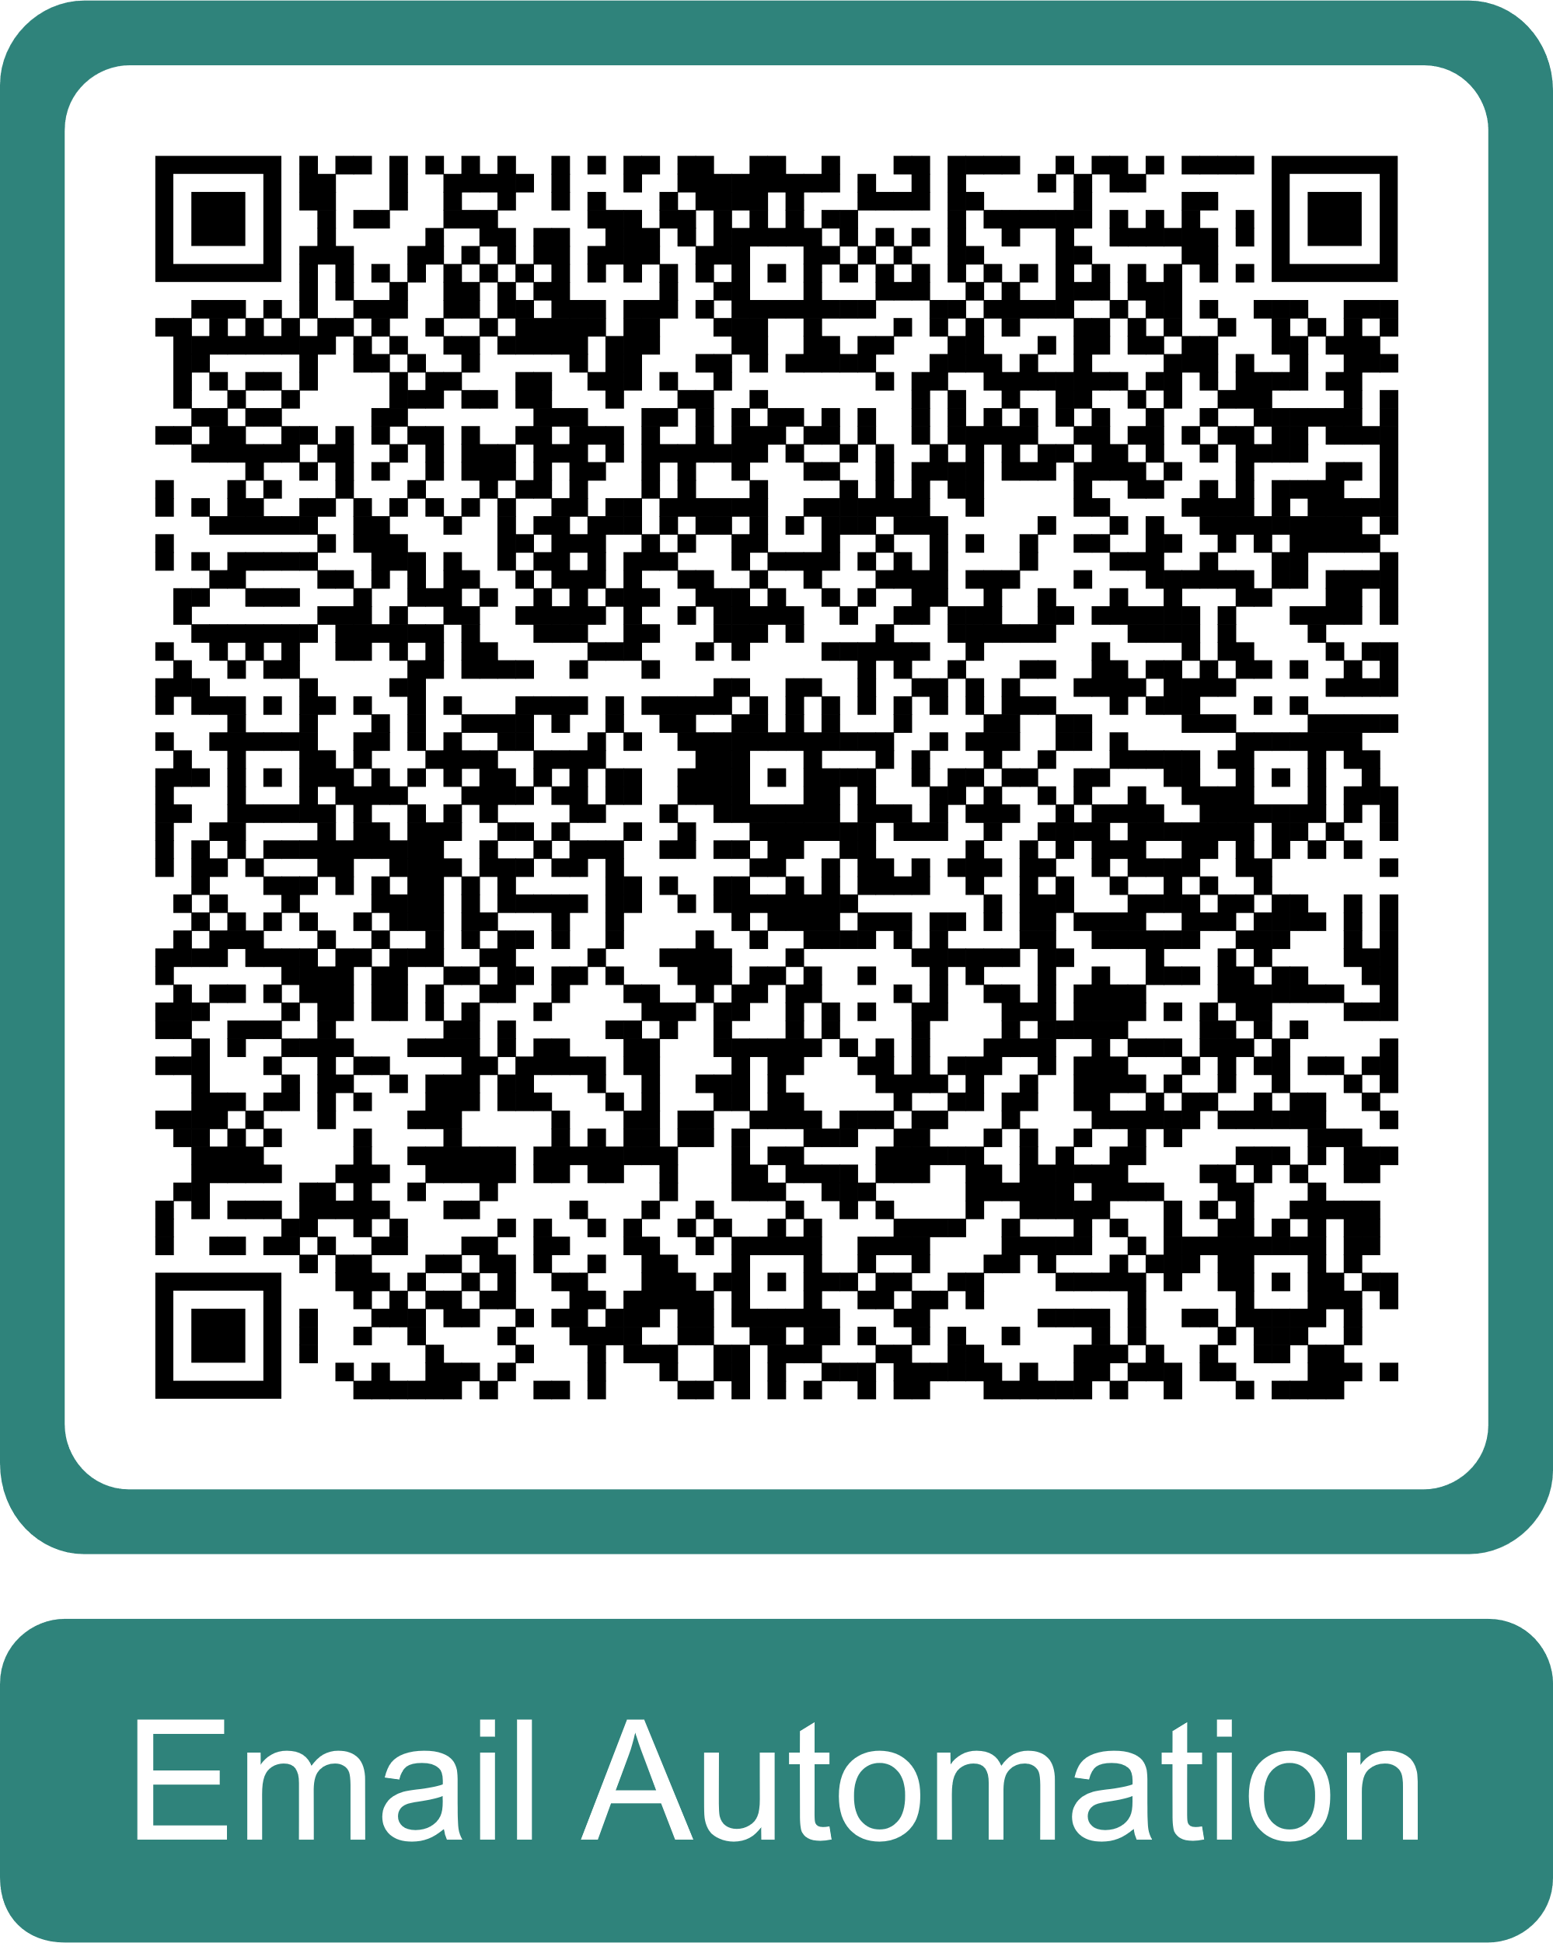
Thanks for Coming — Let’s Keep Talking
🙏 Thank You
Thanks for your time, ideas, and questions today
We hope you leave with something useful — and a bit of curiosity too
📣 Stay in Touch
💬 Have an idea? Want to chat?
→ Email: Try one of the QR codes to the right
→ Otherwise:
Artificial.Intelligence@westmorlandandfurness.gov.uk
Automation.Team@westmorlandandfurness.gov.uk
→ Contact the Digital Innovation team
✅ Your Next Step
Think about one task in your service that could be smarter
Try a GenAI tool — safely — and see what it can do
Talk to us if you think it’s worth exploring together
Notes:
"Thank you again for spending this time with us. I hope we’ve demystified a few things, given you some ideas, and opened up the possibility that these tools aren’t just buzzwords — they’re helpers, if we use them right."
"Please keep the conversation going. Whether you’ve got an idea, a tool you’ve found, or even just a hunch that something could be done better — let us know. That’s what we’re here for."
"Try something. Share it. And if it looks promising, we’ll work with you to make it safe, supported, and sustainable."
"Thanks again – I’ll be here if you want to talk more!”

Slide 23
