Slide 1

Abuse at work is not ok!

Slide 2
Sharon McCubbin
Senior Health, Safety and Wellbeing Manager, Corporate Health and Safety

Slide 3
The HSE reports in 2023/24 there were 642,000 incidents of violence at work.
These comprised 290,000 assaults (of which 35% resulted in physical injury) and 352,000 threats.
Highest risk occupations are those in front facing enforcement, health, social care and public service roles.

Slide 4
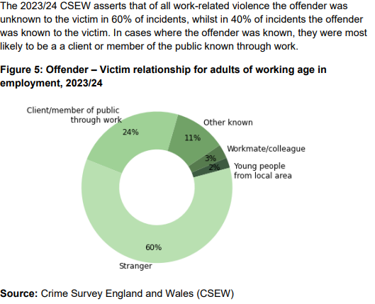
Offender/ Victim Statistics
Text with bullet points
  At different levels
Notes:
The overall risk to a person at work of work related violence across all occupations was 1.1%
Whilst the majority of injuries sustained in a violent incident are classified as minor injuries, a proportion is of a more serious nature that may cause longer term physical and psychological harm to the individuals involved.
All stats line up with other surveys such as RIDDOR data and Labour force Surveys undertaken nationally

Slide 5

Responsibilities and key steps to reduce risks
Who is responsible?
Are we planning ahead to reduce the risks?
    Have we written risk assessments and developed
    safe working procedures
    Do we know who our challenging customers may be?
    Are our working locations set up with safety in mind?
    When shouldn’t we work alone?
    Do we have the right skills and training?
Are we following safe working procedures?
Do we have the right communication methods in place?
Are we practicing how we would respond to an emergency?
Are we reporting and investigating incidents properly?
Notes:
Who is responsible? - Basically we all are – Employers have legal duties to identify and manage risks and we as employees have duties ourselves to work in line with what training we are given and to help keep ourselves and other safe – Managers of teams need to ensure they have risk assessments and safe working procedures in place.
Are we planning to reduce the risks? Awareness of Council’s Safety Procedures – Published on the Intranet, understanding our roles/ activities and involving those that are doing the job,
Risk Assessments and developing safe ways to work
Do we know who our challenging customers may be? Flagging systems for known risks, preparations for potential new customers, sharing information on a need to know basis
Are working locations safe? Panic alarms, signage, room set up, places to exit to, visible to others
When shouldn’t we we work alone? Certain working situations may be too high risk for one person not to be supported in the event of emergency
Employee/ manager training
Are we following safe working procedures?
Do we have the right communication methods in place?
Are we practicing how we would respond to an emergency?
Regular drills of emergency procedures, do they work?
Acting - Reporting of incidents through the correct channels
Are we reporting and investigating incidents properly?

Slide 6
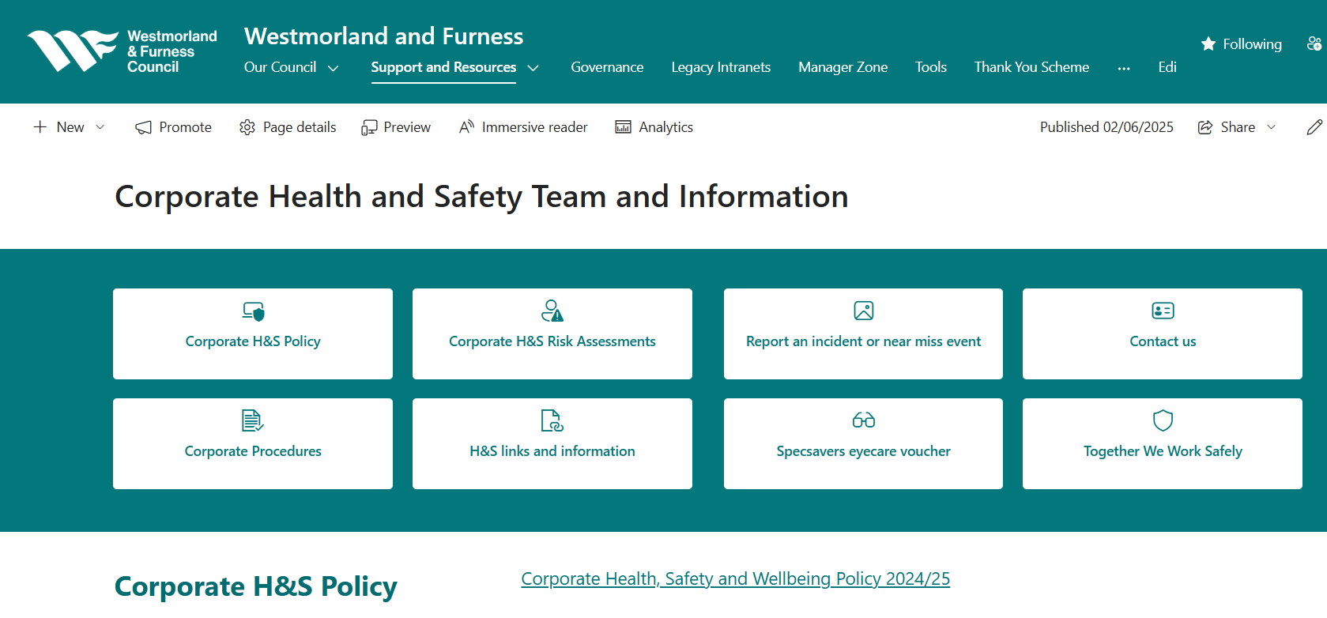
More information
Text with bullet points
  At different levels
Notes:
Violence at Work Handout
Personal Safety Tips leaflet

Slide 7
Leona Noble
Service Manager, Customer Services

Slide 8
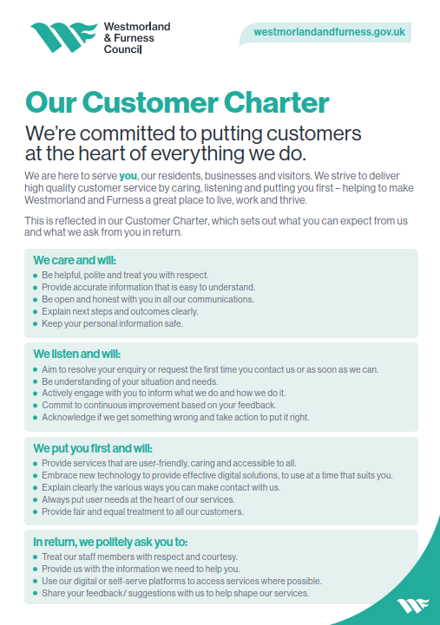
Customer Charter
The Customer Charter is our single page promise to our residents, businesses and visitors setting expectations on how we will treat them and in return how we expect to be treated.
Setting customer expectations can help us reduce customer complaints. The Charter will be used in other ways such as:
A golden thread across all of our customer facing services
A tool to allow us to promote putting the customer at the heart of everything we do
A document which can be used and reviewed during surveys and consultations.

Slide 9

Trauma Informed Practice
Why Trauma Informed Practice?
Trauma affects mental, physical, emotional and social wellbeing.
Many accessing or working in services have experienced trauma.
A trauma-informed approach focuses on
What happened to you?' not 'What’s wrong with you?’
What We've Done So Far:
Strategic action plan and self-assessment completed
Investment to start the journey
Cross-service Steering Group established
275+ staff trained in trauma awareness
Customer Services leading with building walkthroughs, inclusive language and lived experience input

Slide 10
Key Principles of Trauma Informed Practice
Safety
Choice
Cultural Awareness
Collaboration
Trust
Empowerment

Slide 11
Customer Services are leading by example…
Basic awareness training completed by managers and team leaders
Developing bitesize trauma training for frontline staff
Conducting building walkthroughs to improve accessibility and physical safety
Actively improving language in recruitment, case notes and other service level documents
Sharing best practice across services through the Steering Group

Slide 12

How Staff Can Get Involved
Attend trauma-informed training sessions when they are available
Use inclusive, kind language and practices
Join walkthroughs or team reflections
Share ideas and feedback
Help create safe, compassionate and inclusive services
“Together, we’re building a Council where everyone—residents and staff—can feel safe, supported and understood.”

Slide 13
Complaints and Unreasonable Customer Policy
Westmorland and Furness Council is committed to promoting equality of opportunity and diversity, and to challenging discrimination. Staff working for the Council and Elected Members have a right to undertake their work free from all types of discrimination, abuse, and harassment.
The council has a duty to protect the safety and welfare of its staff and Elected Members. We therefore shall not tolerate what we consider to be unacceptable behaviour by unreasonable or unreasonably persistent customers.
There is more detail in the Council’s Corporate Complaints and Compliments around dealing with unreasonable customers, what we define as unreasonable behaviour, and when and how we can invoke the Unreasonable Customer Policy.
Key points
Always contact your line manager for support and to discuss any incidents of potentially unreasonable, or persistently vexatious, behaviour.
The policy can only be invoked by a senior manager, with input from legal service and the relevant senior leadership.
Customers must always receive fair warning and communication of any actions taken, and any aspects of the policy being considered, and on what basis.
A record must be kept of any customers subject to the policy and why, and this should be shared with the complaints team to keep a register.

Slide 14
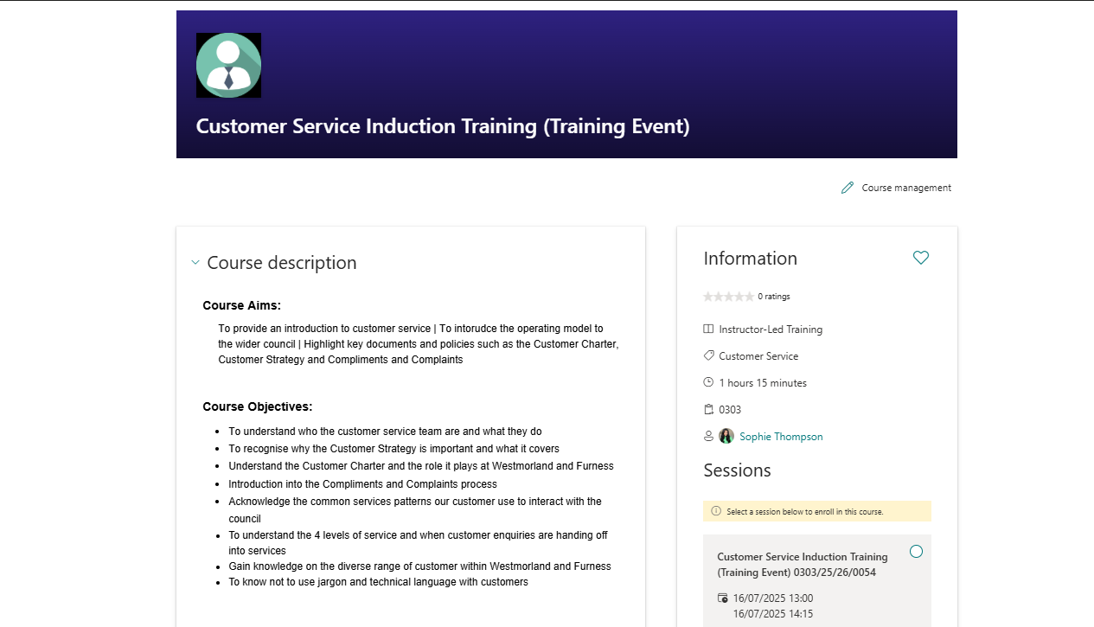
Customer Service training

Slide 15
Managing challenging behaviour
(scenario)

Slide 16
Scenario Part 1 – Traffic Enforcement:
Initial encounter
A traffic enforcement officer is issuing a Penalty Charge Notice (PCN) to a vehicle parked illegally on double yellow lines near a school.
As they are documenting the offence, the vehicle owner approaches, shouting aggressively and accusing the officer of "targeting" them.
The individual is visibly angry, swearing loudly, and steps into the officer’s personal space, pointing and yelling.

Slide 17
Scenario Part 2
The following day
The unhappy individual presents in person at the main reception, very angry that they received a PCN and are now furious that they have been unable to make the payment.
They are shouting about the council, systems and inability to speak to someone on the phone. They are very annoyed that they have had to take time out of their busy day to come into an office to sort this debacle out.

Slide 18
Scenario Part 1 Questions:
What are the immediate steps to de-escalate and protect yourself?
What support should be in place?
What actions are required after a challenging incident?
What is the formal response process following the threat?
Are there any other considerations?

Slide 19
Reflective Questions & Answers
1. What are the immediate steps to de-escalate and protect yourself?
  Stay calm, listen, speak slowly and professionally.
  Maintain a safe physical distance
  Avoid confrontation and do not respond emotionally
  Move toward a safer area or call a colleague/supervisor for support.
2. What support should be in place?
  Risk Assessment
  Safe working practice
  Body cam for Parking Enforcement officer
  Panic Alarm for reception staff
3. What actions are required after a violent threat is made?
  Withdraw from the situation immediately
  Contact supervisor to de-brief and consider Employee Support via Employee Assistance Programme or Occupational Health
  Make a factual incident report
  Lessons learned and sharing
  Other considerations such as referral for support for the customer?
4. What is the formal response process following the threat?
  log an incident report and notify senior manager.
  If threats continue. senior manager may consider restricting contact or issuing warning letters [Unreasonable Customer Policy – Sanctions Section], or police involvement and
  possible legal action.
  Review risk assessment and safe working practice

Slide 20
Thank you

