Slide 1
Being part of a successful Council –
Good Governance
Linda Jones Chief Legal and Monitoring Officer

Slide 2
“In Local Government there is no substitute for doing boring really well. Only when you have a solid foundation can you innovate”
Max Caller
Lead Inspector – Northamptonshire County Council Best Value inspection

Slide 3
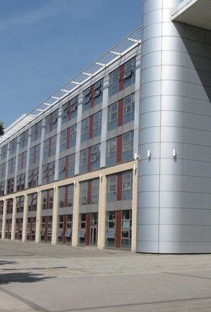
Corporate Governance Inspection of Doncaster MBC
“Good governance is about running things properly. It is the means by which a public authority shows it is taking decisions for the good of the people of the area in a fair, equitable and open way…..
It is fundamental to showing public money is well spent. Without good governance councils will struggle to improve services when they perform poorly”.

Slide 4

What is Governance ?
It’s the Law, the rules, structures, processes, transparency, standards, culture, accountability and compliance.
Its not just about our Constitution although It is a fundamental building block of good governance. It is much more!
As an officer you work within the legal bounds set by the Council’s constitution, the rules and procedures and agreed processes and the formal decision making framework.
Think of us as a statutory corporation a Legal entity comprising elected councillors
Constitution – Rules –Procedures- Codes of Conduct
We make our own decisions (within the law)
We control our own finances (but with referendums on increases of 2/3% or more council tax increases)
Government cannot force to act in a certain way unless there is a power to do so. E.g. SOS can take appoint someone to do a local plan if one not done for a while.
The Governance and decision making Framework that we work towards….

Slide 5
What is Good Governance – what arrangements should we have in place?
The Financial Control Environment
Chief Finance Officer & s151
Ethical framework
CIPFA Financial Management Code from April 2020
Finance Procedure Rules, finance systems and procedures
Medium Term Financial Plan and annual budgets
Treasury Management Strategy and Plans
Contract Procedure Rules and Procurement Strategy
Internal and External Audit
Audit Committee

Slide 6
Delivering Good Governance in Local Government
Joint CIPFA/Solace document, all local authorities required to follow.
Principle A -Behaving with integrity, demonstrating strong commitment to ethical values, and respecting the rule of law
Principle B - Ensuring openness and comprehensive stakeholder engagement
Principle C - Defining outcomes in terms of sustainable economic, social, and environmental benefits
Principle D- Determining the interventions necessary to optimise the achievement of the intended outcomes
Principle E - Developing the entity’s capacity, including the capability of its leadership and the individuals within it
Principle F -Managing risks and performance through robust internal control and strong public financial management
Principle G - Implementing good practices in transparency, reporting, and audit to deliver effective accountability

Slide 8
Local Code of Corporate Governance
Follows CIPFA/SOLACE Guidance – 7 principles
Describes arrangements WF has/will put in place
Chief Legal & MO reports annually (publicly) on compliance with Code and effectiveness of governance arrangements along with any planned changes – forms basis of the Annual Governance Statement
Lead Cabinet Member for Governance is the Deputy Leader Cllr Jarvis

Slide 9
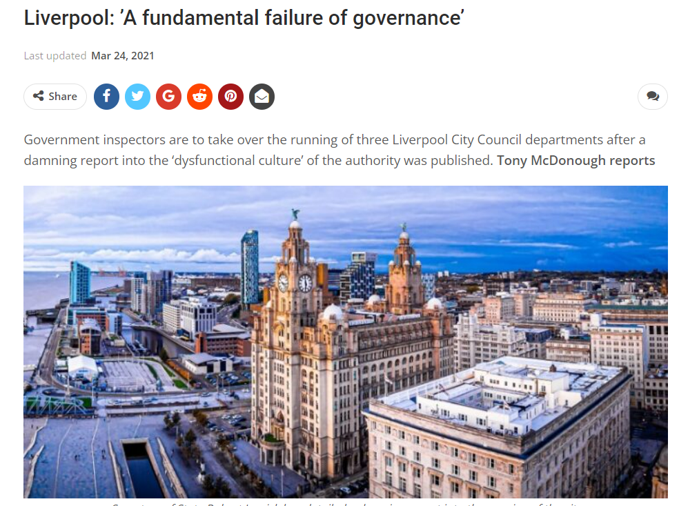
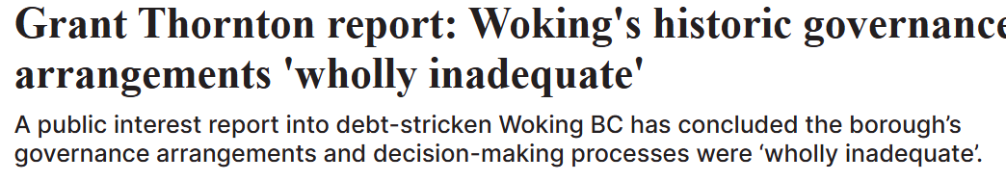
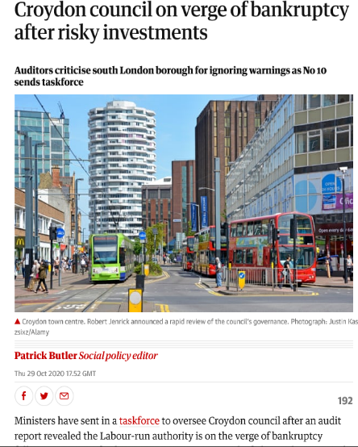
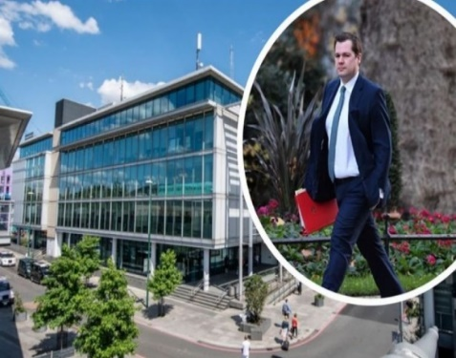
Why does Good Governance matter ?
When it goes wrong:
2020 Government Guidance on statutory inspection and intervention.
S114 notice: Northamptonshire CC,
London Borough Croydon
Financial losses: Nottinghamshire & Croyden
Robin Hood Energy, Bristol CC and Bristol Energy, Woking
Liverpool – Commissioners

Slide 10
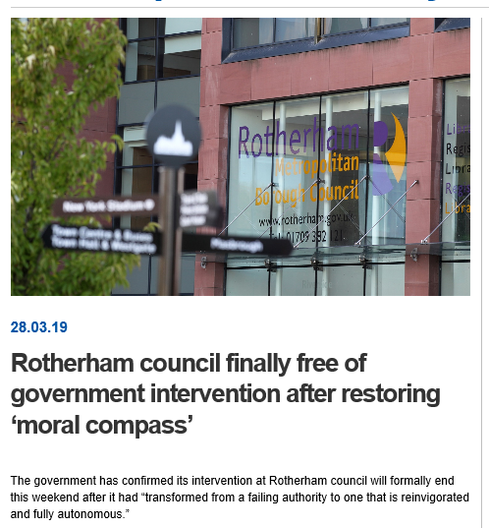
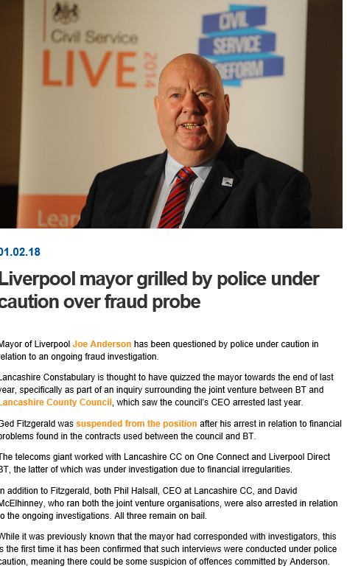
When it goes wrong
Reputational loss: Liverpool CC and arrest of Mayor – PR and confidence in the Council
Judicial Review – reputational
Government Intervention Part 1 Local Government Act 1999 e.g.
Rotherham / Doncaster / LB Tower Hamlets/ Northamptonshire/ Woking / Thurrock
Commissioners – take over the role of officers and members
In Liverpool the Governance Issues were – Behaviours – Scrutiny – Training – Elections – Members Remuneration and SRAs

Slide 11
Liverpool Report
9.9. The more fundamental issue that was observed was how scrutiny was treated by the leadership of the Regeneration Directorate. The Inspection Team observed examples of Officers that suggested taking decisions to Cabinet and asking for delegated authority was unnecessary red tape that slowed the process down. Officers within Regeneration also challenged what counted as a key decision and there was no culture of going back to Cabinet when a deal Cabinet had signed off was substantially changed even if the new deal went beyond the bounds of the original delegated authority. On a number of occasions Cabinet reports and DAR’s were retrofitted at the end of the deal process – they were treated as a piece of paper that needed to be on a file. When DAR’s were produced, they were done at speed based on verbal instructions, putting pressure on legal and finance teams to sign matters off without due consideration and diminishing their ability to be LCC’s gate keepers.
When legal and finance teams had the ability to challenge, they were often ignored by the Regeneration team and/or unsupported by senior officers when the issues they raised were challenged by the Mayor. There was evidence that lawyers often had to sense, and spell-check documents and Officers reminded that they would be published. Further, DARs often had little substance or justification for proposals put forward making it hard for Members to ask questions or challenge. Overall, it was not clear to the Inspection Team, that in all cases, DARs cleared by legal, and finance were the versions sent to the centre.

Slide 12
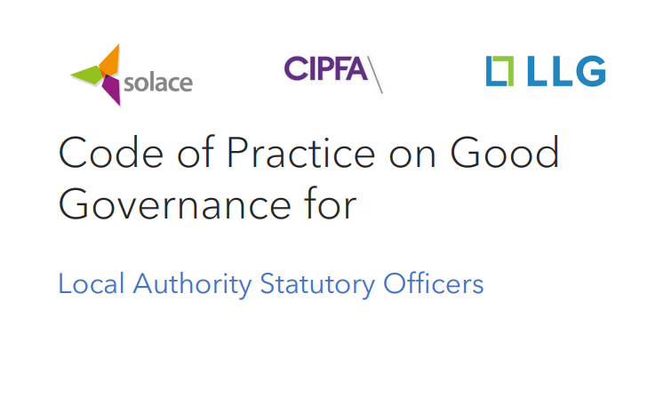
Key Officers charged with Governance
The Golden Triangle
What are we doing in Westmorland and Furness Council?
Weekly meetings between:
  the Head of Paid Service, ( section 4 LG & HA 1989) Power to report on number of staff and coordination function
  the Section 151 Officer and ( s151 LGA 1972) Duty to ensure proper administration of financial affairs, Power to report on finance and accounting
  the Chief Legal and Monitoring Officer Power to report to Council and Executive if I consider anything to be illegal, maladministration or breach of the statutory code ( s5/ 5A, LG &HA 1989) Power to investigate any such breaches role in ensuring we don’t fall foul ( reports and decision making )
Often referred to collectively as the governance ‘Golden Triangle’ The golden triangle is critical in living and breathing good governance within local authorities, but governance is everyone’s business. It is a way of life and is threaded through the seven Nolan Principles. By not living it, we’re just paying lip service to it.
Through working together, the roles ensure good administrative, financial and ethical governance of a local authority.
In 2025 the Council adopted the LLG/CIPFA/Solace Code of Practice on Good Governance for Local Authority Statutory Officers

Slide 13
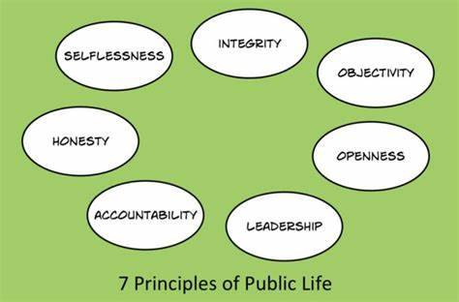
Nolan principles of public life
Selflessness
Integrity
Objectivity
Accountability
Openness
Honesty
Leadership

Slide 14
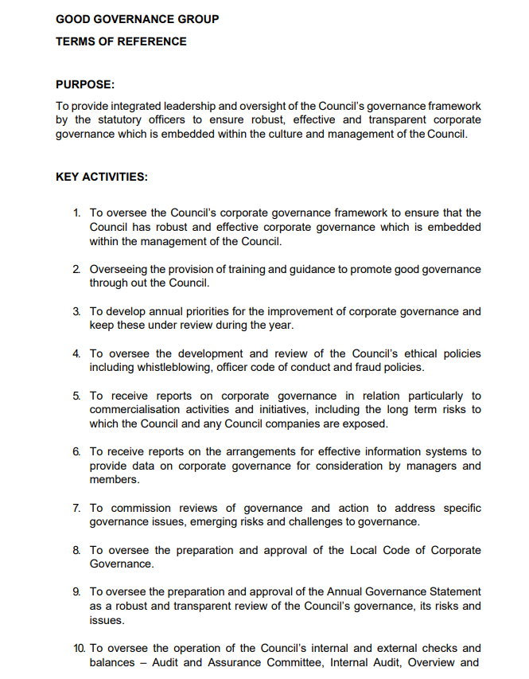
Good Governance Group
What are we doing in Westmorland and
Furness Council?
Established June 2023
Meets at least 4 times a year
Membership: core membership is Gold Triangle or Deputies - the Head of Paid Service, Director of Finance and Monitoring Officer, the Head of Internal Audit and SIRO. Other Statutory Officers and their Deputies/ CMT are also invited to join the meeting
Purpose:
  To provide integrated leadership and oversight of the Council’s governance framework by the Golden Triangle to ensure robust, effective and transparent corporate governance which is embedded within the culture and management of the Council.
GGG has received reports on e.g. officer gifts and hospitality, contracts register, instruction of external lawyers, Covid Inquiry, transparency
All Constitutional amendment reports also go to GGG before proceeding to Constitutional Working Group

Slide 15
How is this relevant to me?
All officers, whatever your job, have a role in ensuring good governance
Good governance is essential to an effective council and excellent services
Read the current AGS and the Action Plan and understand how it affects you and your team
Flag any issues of concern and be proactive with ideas and improvements

Slide 16
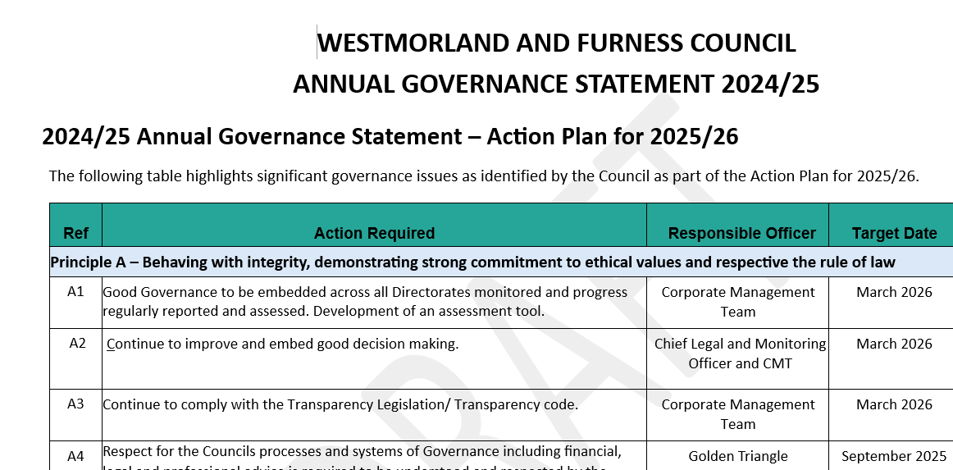
Annual Governance Statement 24/5 Action Plan for 25/26
Draft AGS 24/25 agreed by Audit Committee 09 June 25
Action Plan 25/26 highlights significant governance issues and target dates for delivery of these.
Actions link to external Audit reports & recommendations.
We all have a part to play in delivering the Action Plan
Officer working group monitors delivery:
  Head of Internal audit
  Head of risk
  Deputy S.151 Officer
  Chief Legal and Monitoring Officer

Slide 17
The Annual Governance Statement
Each of the seven principles is considered and progress assessed
Plus, a specific consideration of the ongoing impact of LGR/legacy issues
Signed off by the Leader and the Chief Executive
Includes a Conclusion and Action Plan

Slide 18


Our AGS 24/25 demonstrates that as a Council we have …
Experienced internal audit team consider robustness of internal controls
Anti bribery, fraud and corruption policies
Internal audit / external audit – properly considers audit findings / recommendations
Constitution, schemes of delegation, Director’s Local Scheme of Authorisation, Leader’s Scheme of Delegation, members & officer protocols.
Strong approach to corporate & operational risk management
Policies and Processes Declarations of interest / gifts and hospitality –for officers & members
Employee & member engagement – staff & member surveys
Effective scrutiny and Audit including adoption of Scrutiny Protocol

Slide 19
Our AGS 24/25 demonstrates that as a Council we have…
We have a Council Plan, vision and delivery framework and performance and risk frameworks A robust performance management system – services and projects- measured against outcomes which are the best use of resources, comply with our best value duty and VFM.
Member Development Strategy & training programme in place
Agreed a Delivery Framework for 24/25 based on 10 mission statements, building on our Council Plan; 25/6 16 Priority Programme E.G Culture is one of the workstreams
Informed decision making
A developing draft Consultation & engagement strategy
People Plan
HR policies
Whistleblowing
Health and Safety
Equity diversity and inclusion
Agreed Capital strategy, asset management strategy, carbon management strategy and community asset transfer policy – all geared to ensuring we maximise VFM across assets

Slide 20
Our AGS 24/25 demonstrates that as a Council we have…
Compliance with relevant laws and regulations , internal policies and procedures and expenditure is lawful
Finance Procedure rules, finance systems and procedures
Contract Procedure Rules and Procurement Strategy
Codes of Conduct for standards of behaviour for members and officers and Protocols
Medium Term Financial Plan and annual budgets
Adherence to budget policy framework
A sound decision making framework, delegations, decision making in partnerships, information provided to decision makers and robust quality of data
Treasury Management Strategy and Plans
A commitment to openness and acting in the public interest
Value for money – contracting and procurement and decision-making

Slide 21
Culture eats Governance for breakfast
If the culture of an organisation does not support and reinforce good governance, then the most detailed constitution and the most robust procedures in the world are meaningless.
The report in March from the Committee on Standards in Public Life suggested that a common characteristic of bodies responsible for a major failure is an overly defensive organisational culture. Addressing early warning signs, and creating a culture to speak up about concerns, as well as learning from mistakes need to be valued by everyone in the organisation, it is, after all, the personal duty to the taxpayer to get things right.

Slide 22
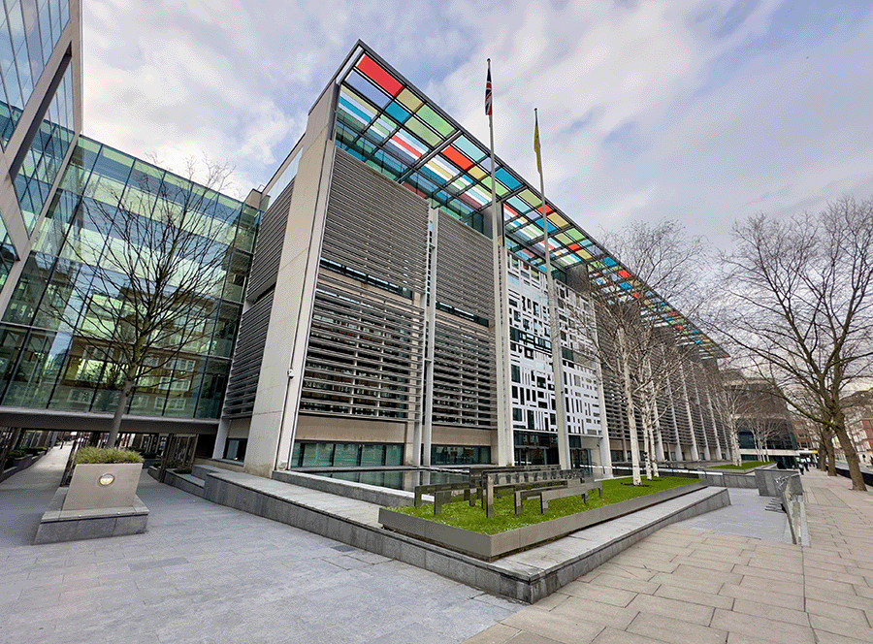
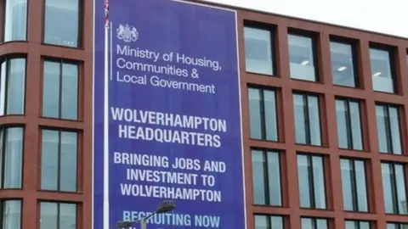
GOVERNANCE FAILINGS : CULTURE
MHCLG “ addressing cultural and governance failings in local authorities lessons learned from recent interventions” June 2020
lack of effective political and/or corporate leadership, including an overreliance on interim statutory officers
a lack of corporate capacity, resulting in a lack of strategic vision and direction, and inadequate internal processes
poor and inappropriate councillor conduct
conflict and distrust among and between councillors and senior officers
the absence of effective scrutiny, transparency and public consultation, including inadequate protections for whistle-blowers
a lack of awareness and acceptance of the need for improvement; and insufficient capacity to achieve the change required

Slide 23
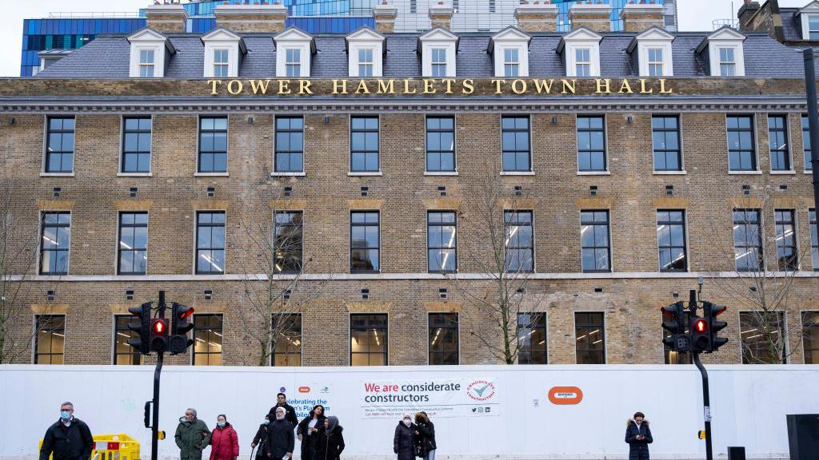
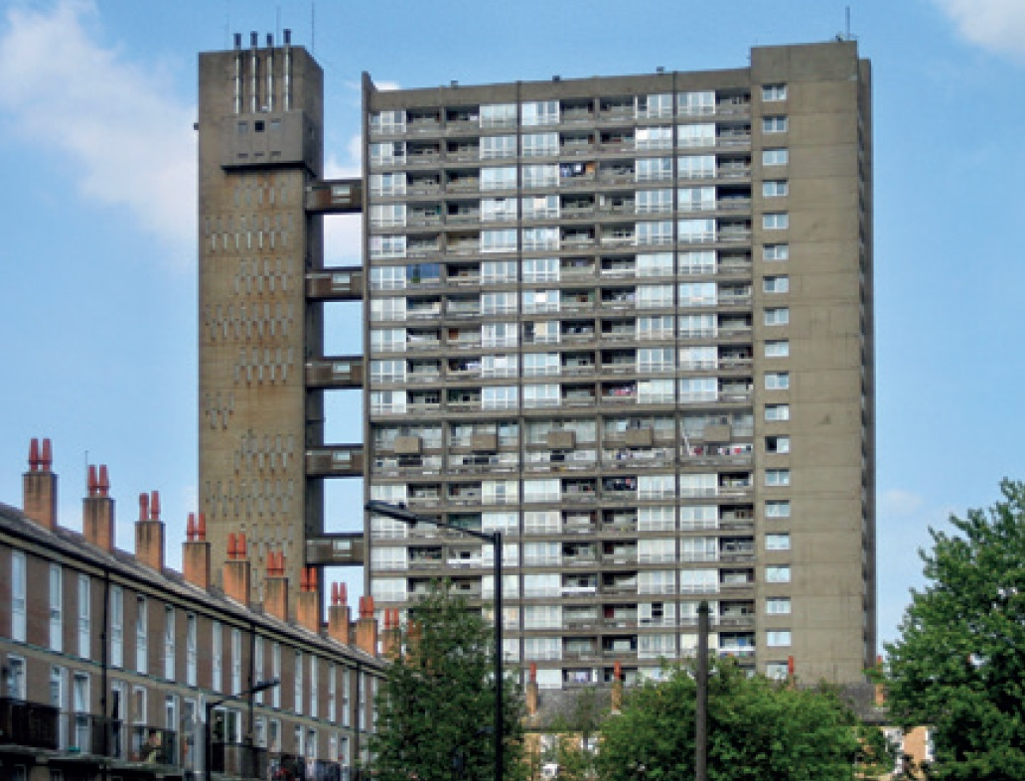
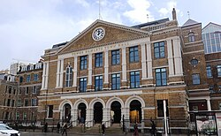
GOVERNANCE FAILINGS: Tower Hamlets
“Tower Hamlets, at the point of intervention all 3 statutory officer roles (Head of Paid Service, s151 Officer and Monitoring Officer) were held on an interim basis and recruitment to these posts on a permanent basis was not being planned. In Northamptonshire, all executive directors were replaced, and in some posts more than once, in the 5 years prior to the intervention. Vacancies were often filled by internal candidates on temporary promotion, who were unable to identify or offer a new perspective on challenges. The statutory inspection team found “there was no sense that the group worked together as a team, seeking to share and jointly solve the Council’s problems”.

Slide 24
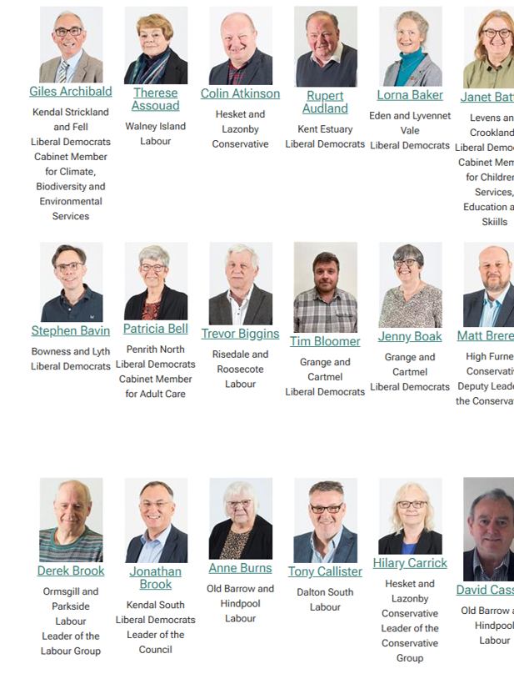
Members
Members determine the strategy and provide leadership
Support the corporate aims and objectives
Promote the residents interests
Promote and maintain high standards of conduct
Follow members code/ rules and procedure avoid conflicts of interest.
Support not undermine officers
Maintain confidentiality
Raise concerns through the line management
structure to CEO
Dec of interest / gifts and hospitality - probity

Slide 25
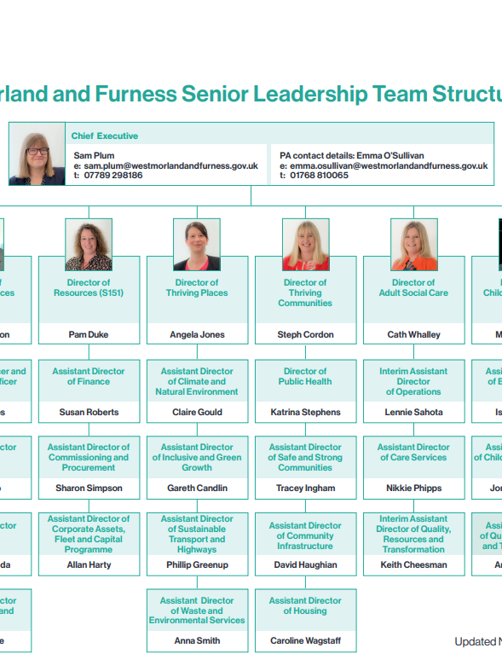
Officers
Advise on Policy and Strategy
Provide professions technical and admin support and advice
Implement decisions
Apolitical
Service the Council as a whole
Promote and maintain high standards of conduct
Follow council rules and procedures.
Declarations of interest/ gifts and hospitality – probity

Slide 26

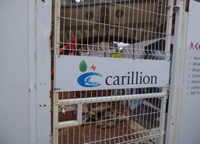
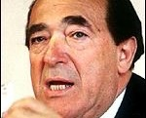

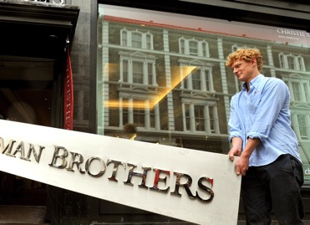
Not just a local authority consideration….

Slide 27

Any feedback, questions or suggestions for other mini pods on governance topics – please contact Linda.Jones@westmorlandandfurness.gov.uk

