Slide 1

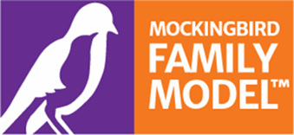
Carer Supporting Carers: the Mockingbird Model of Foster Care in Cumbria
Presented by Jayne McGarry, Mockingbird Hub Liaison worker, Westmorland & Furness

Slide 2


What is Mockingbird?
Led by the Fostering Network, the fostering model
is based on the concept of extended family.
It creates a constellation of 6 to 10 ‘satellite’
fostering families who are supported by an experienced ‘hub home’ foster.
This support could include:
  monthly social events for families, providing peer interaction and support for caregivers, children and young people
  unlimited access to social support and mentoring for satellite carers
  planned and emergency respite care 24/7, including daycare and overnight stays.
The model nurtures the relationships between children, young people and foster families supporting them to build a resilient and caring community.

Slide 3
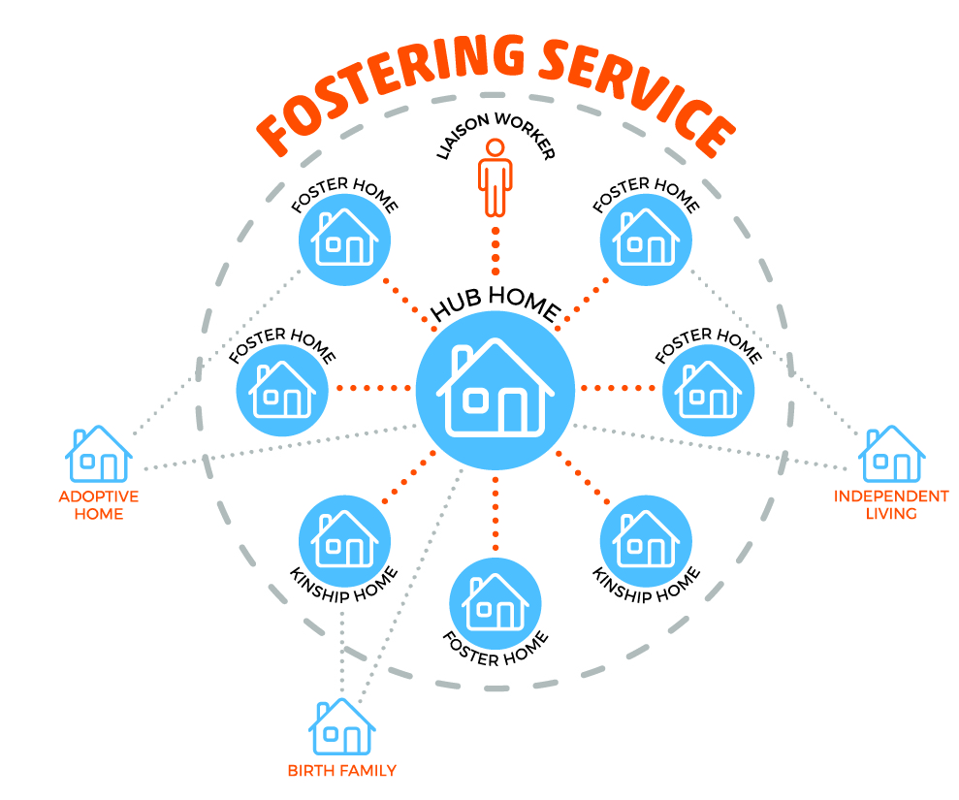
The Mockingbird Constellation
Structure:
6-10 satellite families
6-18 looked after children
Key elements:
Peer guidance and support
Socials
Training and development
Sleepovers
Support to permanence
Siblings and birth family
Key roles:
Hub home carer
Liaison Worker
Satellite carer

Slide 4
Roles in Mockingbird
Hub Home Carer:
Responsibilities: Provide support, training, and respite care to satellite families.
Skills: Experienced foster carer with strong communication and organizational skills.
Satellite Foster Carer:
Responsibilities: Participate in constellation activities, access support, and contribute to the network.
Skills: Open to sharing experiences and learning from others.
Liaison Worker:
Responsibilities: Act as a link between the hub home, satellite families, and the fostering service.
Skills: Strong communication and organizational skills.

Slide 5
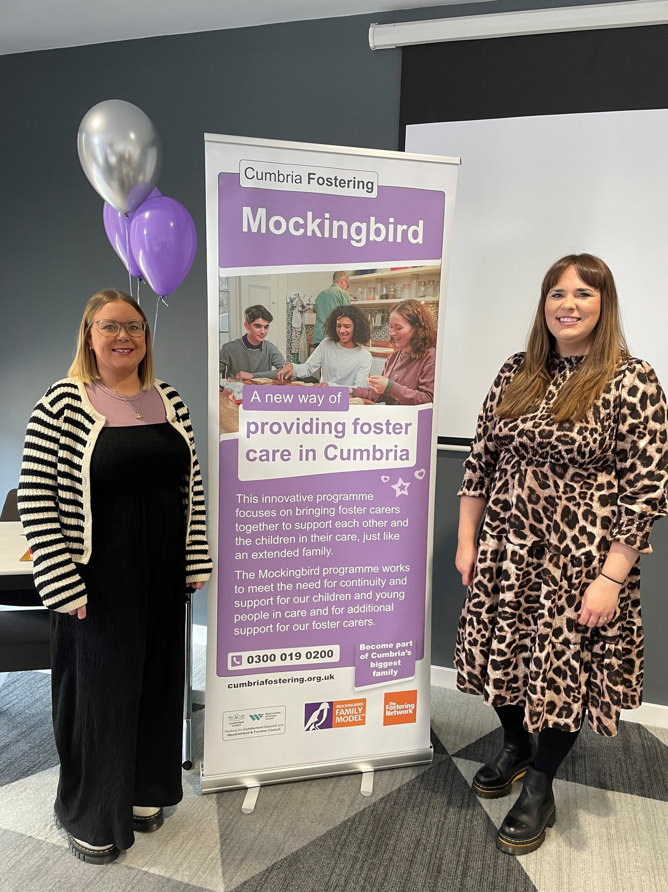
Meet our Mockingbird hub carers in Westmorland& Furness
In October 2024 Cumbria Fostering launched their first Mockingbird ‘constellations’ in Cumberland and Westmorland & Furness
As well as offering vital support and guidance, the hub home carers organise activities such as coffee mornings, parties, sleepovers for the children, respite breaks for foster carers, and other social events.
Grace said: “Becoming a foster carer can be challenging but this new programme focuses on bringing foster carers together to support each other and the children in their care.”

Slide 6

Benefits for our fostering families
Reduced Isolation: Peer support from hub carers and satellite carers helps foster families feel less isolated.
Early Intervention and Support: The hub home provides support to prevent breakdowns and address challenges early.
Enhanced Communication: Improved communication between carers, social workers, and other professionals.

Slide 7

Benefits for children
Social Activities and Relationships: the constellation fosters social connections and opportunities for children.
Support for Sibling Groups: the model helps sibling groups who are not placed in the same home maintain connections.
Improved Stability the consistent and familiar network provides children with a greater sense of belonging and security.

Slide 8
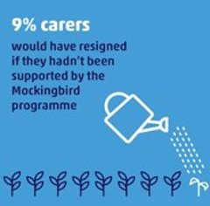
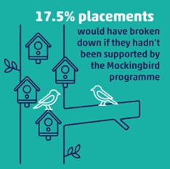
The impact of Mockingbird:
A network of strong and authentic relationships able to replicate the support offered by an extended family
A strong, robust and resilient structure able to support children, young people and fostering families. Improves daily experience and supports through times of crisis and transition.
Improved placement stability, retention, sibling and birth family contact, skills and confidence, sleepover support, peer support, experience for children and young people.

Slide 9
Any questions?

Slide 10


How to contact us
How to contact us
Call 0300 0190 200 or register online fosterwithus.org.uk
Support our campaigns
@cumbriafosteringandadoption
@cumbriafoster

