Slide 1

ICT Programme Update
Staff Expo Tuesday 10 June 2025
Stefan Sabuda, Assistant Director - ICT
Paul Robinson, Director Enabler Services

Slide 2
What’s happening in ICT?

Slide 3
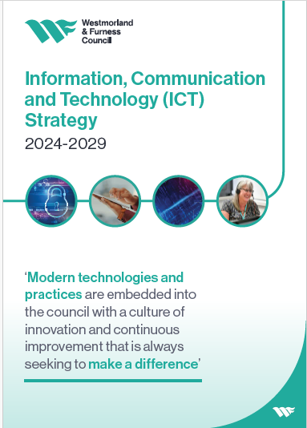
ICT Strategy and vision
ICT Strategy - Vision:
“Utilise technology to deliver better outcomes for the Council and it’s communities by driving digital change and innovation based on a foundation of inclusive, secure and connected ICT infrastructure to underpin a high-quality ICT service as a key Council Enabler.”

Slide 4
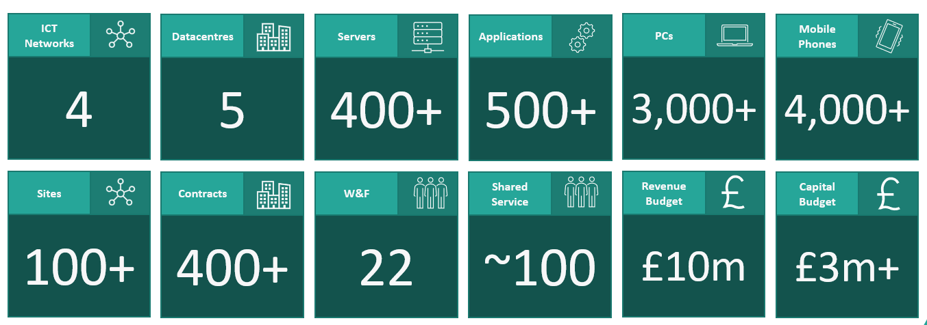
Context
We have a complex ICT legacy following Local Government Reorganisation
A lot of ICT work was carried over from Local Government Reorganisation
W&F ICT Service inherited legacy technical debt from previous authorities
ICT Strategy and delivery plan agreed by Cabinet in April 2024

Slide 5
ICT Service Work Breakdown
ICT Service
BAU
Projects
Service provision
  (incl incident, requests, outages)
ICT Service activities
  18 (in-service activities)
Audits
  Over 50 internal and external audit requirements
Procurement & Contract Management
Annual system upgrades & updates
28 Programme/ Projects
  15 – ICT Improvement Programme
  7 – ICT Service Priority
  6 – Disaggregation (System) Programme

Slide 6
A Single ICT Programme of Work

Slide 7
Invisible
Visible
W&F Technology Programme 2024 – 2029 (Q4 2024/25)
Strategy & Culture
ICT Strategy
ICT Delivery Programme
Customer Strategy
Data & Intelligence Strategy
Culture
& Learning
Building skills and capacity across the organisation
W&F ICT Service Stabilisation & Improvement
Hosted Service Oversight and Management
Governance
SIRO in place and operating
Development of a Technical Design Authority for W&F
Baselining – W&F Enterprise Architecture
Integration of district ICT functions
Service Planning & Performance (KPI’s)
Service Management Arrangements
Performance Monitoring
Programme of Activity to ensure security and governance requirements are met
Consolidation of Service Documents Policies & procedures
Service Growth & Development
Recruitment, induction and training of additional 26 staff
Safe Change Mgmt
ICT Service
- Corporate
Data, Digital and Technology Board
Programme of Aggregation
Programme of Disaggregation
Development of Programme for systems
System Disaggns including: Childrens social care; Finance ; Payroll.
Prioritisation & Dependencies critical
e.g.
- Revenues & Benefits
- Income Mgmt
- Planning
- GIS
Westmorland & Furness Technical Infrastructure Development & Legacy Technical Debt
Development of Programme for systems and contracts
Planning for ICT Service Disaggregation
Planning for ICT Contract Disaggregation
Microsoft Tenancy Migration
Data Centres
Penrith move
W&F future
Service Improvement Programme
100 plus staff to disaggregate
750 plus contracts
e.g.
HR & Payroll
Finance E5
Telephony
GIS
Liquid Logic
(Adults & Controcc)
Development of a Programme of Infrastructure Improvements
e.g.
Liquid Logic
(Children)
Programme of W&F Directorate Priority Activity
Change & Delivery Programme
ICT Asks
Buildings
Voreda House
County Hall to SLH
The Coro
Barrow Forum, TH
Redhills
e.g. Windows Server Migration
Cyber Security &
PSN Compliance
Development of Programme of systems and projects

Slide 8
Invisible
Visible
W&F Technology Programme 2024 – 2029 (Q1 2025/26)
Strategy & Culture
ICT Strategy
ICT Delivery Programme
Customer Strategy
Data & Intelligence Strategy
Culture
& Learning
Building skills and capacity across the organisation
W&F ICT Service Stabilisation & Improvement
Hosted Service Oversight and Management
Governance
SIRO in place and operating
Development of a Technical Design Authority for W&F
Baselining – W&F Enterprise Architecture
Integration of district ICT functions
Service Planning & Performance (KPI’s)
Service Management Arrangements
Performance Monitoring
Programme of Activity to ensure security and governance requirements are met
Consolidation of Service Documents Policies & procedures
Service Growth & Development
Recruitment, induction and training of additional staff
Safe Change Mgmt
ICT Service
- Corporate
Data, Digital and Technology Board
Programme of Aggregation
Programme of Disaggregation
Development of Programme for systems
System Disaggn 2025/26 including: Legal; Finance ; Payroll.
Prioritisation & Dependencies critical
e.g.
- Revenues & Benefits
- Income Mgmt
- Planning
- GIS
Westmorland & Furness Technical Infrastructure Development
Development of Programme for systems and contracts
Planning for ICT Service Disaggregation
Planning for ICT Contract Disaggregation
Microsoft Tenancy Migration
Data Centre
Service Improvement Programme
100 plus staff to disaggregate
750 plus contracts
e.g.
HR & Payroll
Finance e5
Telephony
-GIS
Development of a Programme of Infrastructure Improvements
2025/26 Annual Plan
Tier4-6 “We wills” eg
Care Leavers Hub
Civica Flare
StudyBugs Attendance
MS Project PMO
Liquid Logic
(Adults & Controcc)
(Childrens)
Single Telephony
Single Website
Programme of W&F Directorate Priority Activity
2025/26 Annual Plan
16 Priority Asks eg
Waste
GIS
Data (Fabric)
CRM
Child Res Home
2 x AI Pilots
e.g. Windows Server Migration
e.g. 2024/25 PSN Compliance
Development of Programme of systems and projects
Buildings
County Hall
Redhills
Barrow
Devolution and MSA

Slide 9
BAU – ICT Service activities
Service Area | Activity
Contract management | Anti-virus
Contract management | Printers
Contract management | Mail Meter
Contract management | Local Land Property Gazetteer
Contract management | Moblie Iron
Contract management | Back up & DR contract for SLDC & Eden
Contract management | Enterprise EDMS
Upgrade/ Updates | Rev & Bens Ingress
Upgrade/ Updates | Rev & Ben Pro Server
Upgrade/ Updates | SQL 2012 decommissioning
Upgrade/ Updates | GIS Authorisation Change
Upgrade/ Updates | PSN Firewall Replacement
Service request | Canal Head Network Link
Upgrade/ Updates | Upgrade Remote Site APS
Upgrade/ Updates | Small Site Firewall Replacement
Upgrade/ Updates | Exchange 2016 decommissioning
Upgrade/ Updates | Upgrade One Site for MPSL Network - SLDC
Service request | Barrow Town Hall & Forum

Slide 10
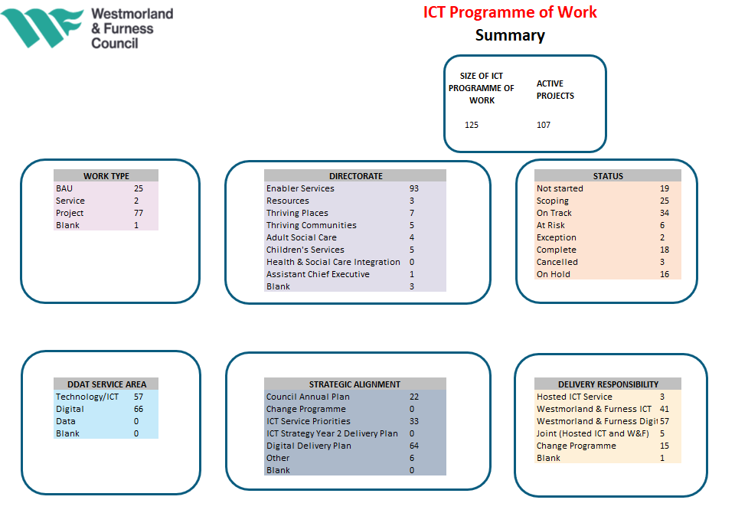
ICT Programme of Work
What is the ICT Programme of Work?
The ICT Programme of work is not a single programme, it is the ICT Portfolio and how we capture all the ICT Programmes, Projects and work activities. This includes programmes and projects from the Councils Annual Plan, ICT Service Priorities and other ICT requests from within Westmorland and Furness.
It is a joint programme of work which captures and track programmes and project. This includes all:
  W&F ICT
  W&F Digital
  ICT Hosted Service
  Data?
ICT PMO are working to make this ICT Programme of Work visible across Westmorland and Furness.

Slide 11
What are the delivery priorities for the ICT Improvement Programme in 2025/26?
Standardise our ICT tools and interfaces to provide a consistent and intuitive ICT experience for all users.
Progress the development of our ICT infrastructure into a single, robust, and scalable system
Prioritise the development and implementation of business systems that are critical to our organisation’s strategic goals.
The ICT Improvement Programme is made up of 3 Programmes

Slide 12
1. Standardise our ICT tools and interfaces
SharePoint migration (on-prem)
Telephony - Skype for Business decommission
ICT Service Management System
Hardware refresh (Mobile & Laptop)
Printers
Why?
Consistent user experience
  Staff survey responses
Support future ICT service provisions and project
Centralised ICT Support model

Slide 13
2. Progress the development of our ICT infrastructure
Data Centre
Westmorland & Furness Tenancy
Why?
Single Westmorland and Furness Infrastructure
  Host all future ICT systems
Staff on one ICT environment
Enable collaboration within the organisation
NB: Both projects are very complex and could be programmes within their own right

Slide 14
3. Prioritise development & implementation of business systems
Geographical Information System (GIS)
Development Management System (DMS)
Digital Platform /Customer Relationship Management (CRM)
Fabric
Placemaker
In-Cab Tech
Revenue & Benefits
Income Management
Legacy Ledgers
Why?
Projects/Systems that enables the organisation services to meet their deliverables

Slide 15
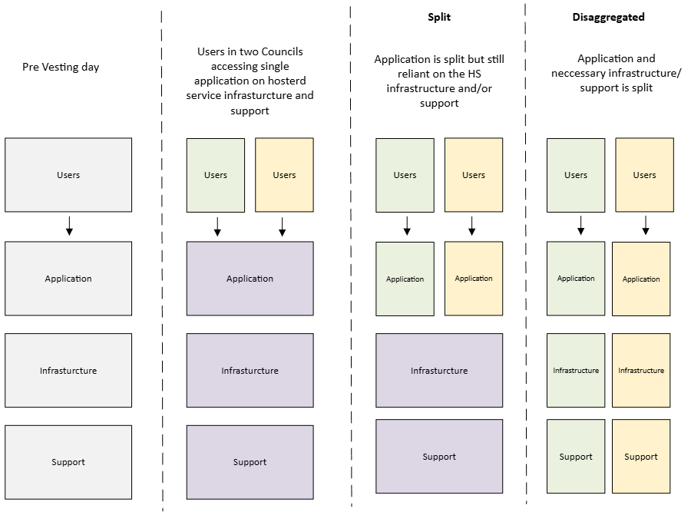
The approach to ‘split’ and ‘disaggregate’ the technology

Slide 16
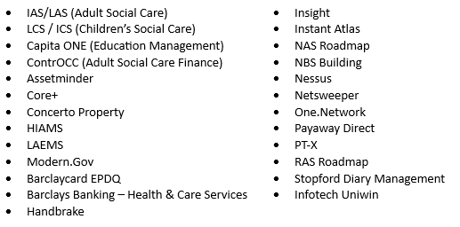
25 x Former County Applications / Systems identified as 2024/25 priorities
- Split achieved and stable as a W&F separate instance

Slide 17
58 x Former County Hosted Applications / Systems not yet split
E5 (Finance System) | ELMS2
iTrent | Equisys Timemaster (Orica)
Civica | FSSNet
Cognos | Funding Information System
Condeco (Room Booking System) | Gas Maps
eOPAS / eSafety | GGP
Cygnum | GoPay
Access Legal | HIKVision CCTV
Advert Booking | ICT Procurement Website
AP Forensics / NXG | IQUANTA
Archie-M | MapInfo
AtriumProperty | Koha
AutoTurn | Observer (OTL)
BrightSign BrightAuthor | ParkMap
Calm & CalmView | Paxton Net2
CASPAR | PeopleSafe formerly Skyguard
ServiceNOW | Planning Application Comment
Chipside | Planning Cumbria Website
Cinolla | Signable
LMS365 & EUM | SingleView/TF2 Focus Family
Community Learning App | Stopford RAFTS
Cycomms | Tactical Signs
Curriculum Surveyor | Time Master
DataMap | Trading Standards (APP) Civica
DEF MasterGov | UTC
Dietplan6 Pro | Vital (OTL)
eLibrary | WHD
eProcurement | Learn365 (LMS)
Single Contact Form (Cumbria Safeguarding Hub) | Early Help Forms (Cumbria Safeguarding Hub)
2025/26
WAF Priorities

Slide 18
2025/26 W&F priority asks for Systems disaggregation
Finance system e5
HR & Payroll migration & decommission
Legal Case Management
Health and Safety
Occ Health System
Working with the Hosted ICT Service, Cumberland to agree strategy and resourcing for each system on case by case basis

Slide 19
ICT
Critical path
Very complex and under regular review

Slide 20
ICT Programme and Project Deliverables
ICT Improvement Programme
Disaggregation System Programme
1 - Ongoing programme/project
2 – External vendor
3 – Hosted ICT Service
Skype for Business¹ ²
HR & Payroll migration & decommission¹ ² ³
ICT Health Check 2025 ³
Window 11 rollout ³
Remote Desktop Services (RDS) Replacement
Surface Hub upgrade and replacement
Tenancy Hardening/ Standardisation¹ ²
SharePoint On-prem migration (Eden/SLDC) ²
Tenancy Discovery, Design & Configuration¹ ² ³
Penrith Data Centre replacement and relocation
W&F Future Data Centre¹ ² ³
DMS Management System¹ ²
PlaceMaker ¹ ²
Finance E5 Disaggregation¹ ² ³
Redhills ³
Legacy Ledgers¹ ²
Fabric¹ ²
W&F GIS ²
CRM¹
Revs and Bens¹
In-Cab Tech¹
Legal Case Management ³
Health and Safety ³
Occ Health System ³
Income Management¹
Standardisation of ICT Equipment
Server 2012
PSTN Line decommission
ITSM Tool ¹ ³

Slide 21
25/26 ICT Priority Projects
Project | Why?
Skype for Business | SQL 2012 end of life July 2025 SfB end of life October 2025 Successor for single W&F Tenancy
HR & Payroll Decommission | Enabling all functionality in one central systems Legacy Employment data to be transferred Reduce support, maintenance, cost and complexity
IT Health Check | Security/vulnerabilities Successor for PSN/ CoCo
Window 11 rollout | Windows 10 end of life October 2025 Office 2016 end of life October 2025 Direct Access being decommissioned Refresh devices on Window 11
RDS
Surface Hub | Window 10 end of life October 2025 Device refresh (end of life)
Tenancy Hardening | Security Successor for single W&F Tenancy
SharePoint On-prem (Eden/SLDC) | Successor for single W&F Tenancy Security
Tenancy Discovery, Design & Configuration | Resolves collaboration issues within W&F Successor for the user migrations Successor for Business Systems including Fabric, CRM, In-Cab technology Predecessor for the ICT Service disaggregation
Penrith DC replacement and relocation | Warranties expire January 2026 Successor for Future use of Penrith Town Hall.
Project | Why?
Data Centre | Establishing a single W&F infrastructure Predecessor & Successor for the ICT Service disaggregation Successor for Business system including Fabric
DMS Management System | Successor for IT Health Check and PSN Accreditation (mitigating a high vulnerability) Successor for Local Plan Programme
e5 Disaggregation | 31st December 2025 Audits and Costs
Redhills | Expecting the “building” to be completed qtr 2 2025/26 Deliverable from 2024/25 now 2025/26
Legacy Ledger | Due 31st March 2026 – Audit requirements Security (IT Health check)

Slide 22
Impact on Council 2025/26 Annual Plan
Fabric
Data & insight delivery
GIS
Westmorland and Furness Local Plan
Data & insight delivery
Digital Platform/CRM
Customer improvement programme
Revs and Bens
Contracts expires
In-Cab Tech
Single Waste Service
Legal Case Management
Disaggregation System Programme
Health and Safety
Disaggregation System Programme
Occ Health System
Disaggregation System Programme
Income Management
IT Health Check?
AI and Digital
ITT planned to be released on 6th May 2025
Contract expires
ICT Improvement Programme
Standardisation of ICT Equipment
Organisation Culture

Slide 23
Challenges

Slide 24

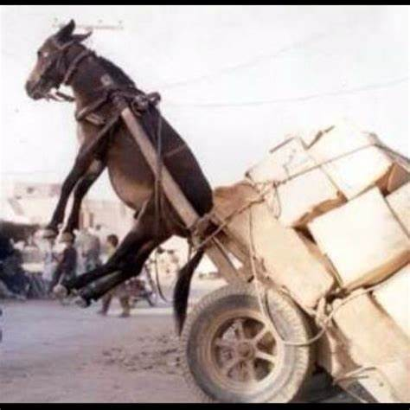
The risk of not prioritising
The Dangers of Not Prioritizing (Priority Series 1/5) — Next Levels Coaching
“It can be common that you feel like you have a never-ending river of responsibilities. You put in what feels like a productive work session, but cannot quite seem to make a dent in your pile. Learning to prioritise your most important work will allow you to make meaningful progress in your work and maintain wellbeing in your life”
Choosing not to prioritise comes with dangers :-
Everything becomes important
We get overwhelmed with too many asks and choices
We engage in multi tasking by trying to do it all
We live in reaction mode
Burnout, team conflict and personal wellbeing impacted.
We must maintain a ‘one team’ – ‘once and together approach’ to avoid these risks.
Prioritisation and sequencing is key

Slide 25
Risks & Challenges being managed
Expectations on ICT
  Stabilisation ongoing but expecting to transform in parallel
  Resourcing strategy is key to delivery
    But its not all about capacity!
  Legacy technical debt and ICT ‘foundations’ must be implemented prior to any significant transformation.
Too much technical changes at once is HIGH risk
  Technical change will bring business changes and risk. This amount of change risks the whole organisation.
  Significant interdependencies and risks to manage
  Sequencing is crucial
  Service Readiness is crucial – these are not “just ICT project”
    Example – CRM and Revs & Bens happening at the same time.
Unknown / Unclear requests for ICT from services
  We only know what we know – learnt from 2024/25 ‘unknowns’
  Headlines ICT asks still require detail expanded and planned
Budget
  Known costs for disaggregation will ‘hit’ in future
  Additional ask costs being scoped and require funding clarity
  Current programme expectations will require investment.
  ICT Strategy and Operating Model alignment
    Centralised Contracts, budget, support, roles
  Operating Model not embedded yet
  Some former district models still have ICT embedded in services not currently under ICT management / influence.
Hosted ICT Service Disaggregation
  Disaggregation process well underway – timing and sequencing is crucial
  Close working with our Cumberland colleagues vital for joint strategy and decision making.
ICT Service Ways of Working – ‘The W&F Way’
  An ambitious and high-profile programme
  Significant updates requested to CMT, Cabinet PH, DAG, Programme Board, PAG , Scrutiny. Resource intensive
  Existing team and new colleagues blending
  Hosted Service staff disaggregation ongoing
  Embedding the ‘W&F ways of working’.
  This is a challenging programme and we MUST maintain a one team approach, ensure support, wellbeing and appreciation of our valued teams.

Slide 26
What’s Next in 25/26?
Continued recruitment into the ICT Service
Make the ICT programme of work visible to all staff and Members
  Regular updates to be provided & communicated
  Provide assurance & visibility that progress in ICT is being made
Accelerating the progress of the ICT programme of work
  Support from third parties to deliver specific pieces of work
Deliver significant changes to the organisation’s ICT
  Building the foundations of the future ICT
  Working towards moving all staff into one ICT network
  Work towards a ‘one device’ strategy for the provision of ICT equipment.

Slide 27
What’s Next in 25/26?
We are listening to feedback on the ICT Service
  e.g. staff survey
Continue to review priorities
  Regular engagement with services
ICT will be more visible
Upping the cyber security presence
  Engagement with partners
  Enhancing our cyber defences
  Communication to staff and Members
Making ICT fit for purpose for all staff and Members!

Slide 28
Questions and discussion

