Slide 1


Our Journey to Net Zero
Staff Expo 2025
Allan Harty
Assistant Director, Corporate Assets, Fleet and Capital Programme
Claire Gould
Assistant Director, Climate and Natural Environment

Slide 2
What is Net Zero?
The UK's "Net Zero" target means achieving a balance where the amount of greenhouse gas emissions produced by the UK are equal to or less than the amount removed from the atmosphere. This commitment, enshrined in UK law, aims to reduce net greenhouse gas emissions by 100% by 2050 compared to 1990 levels.

Slide 3
Our Council Plan Priorities: Climate
Ecologically Aware:
Providing leadership in the drive to become carbon net zero.
“We care about the climate and the impact climate change is having on everyone. Westmorland and Furness Council is working hard to ensure that the area we serve becomes carbon net zero by 2037, and our organisation, as soon as possible.
We will address biodiversity loss by encouraging better land management, habitat creation, tree planting and net biodiversity gain in new housing developments”.

Slide 4
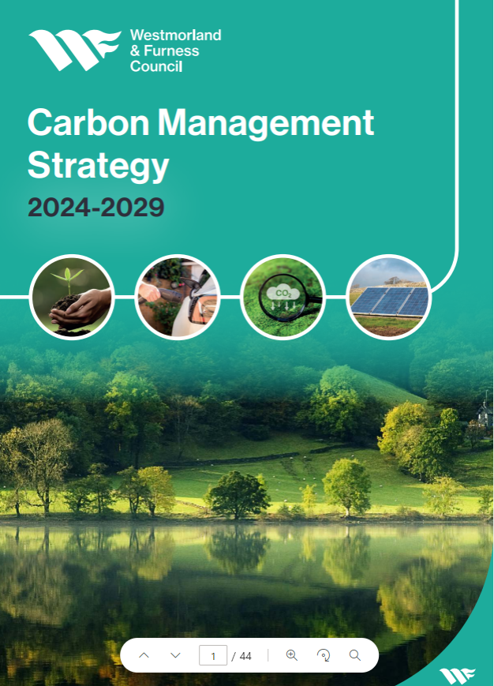
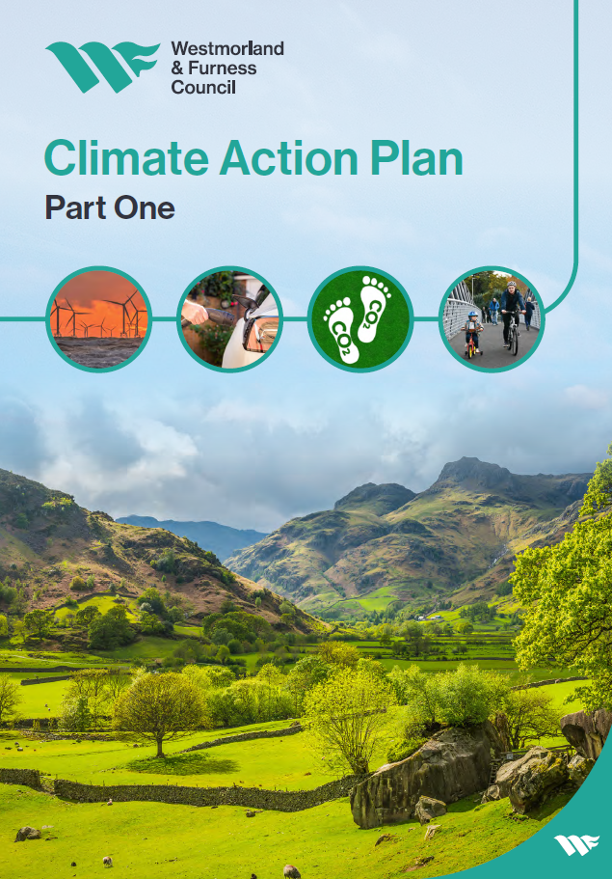
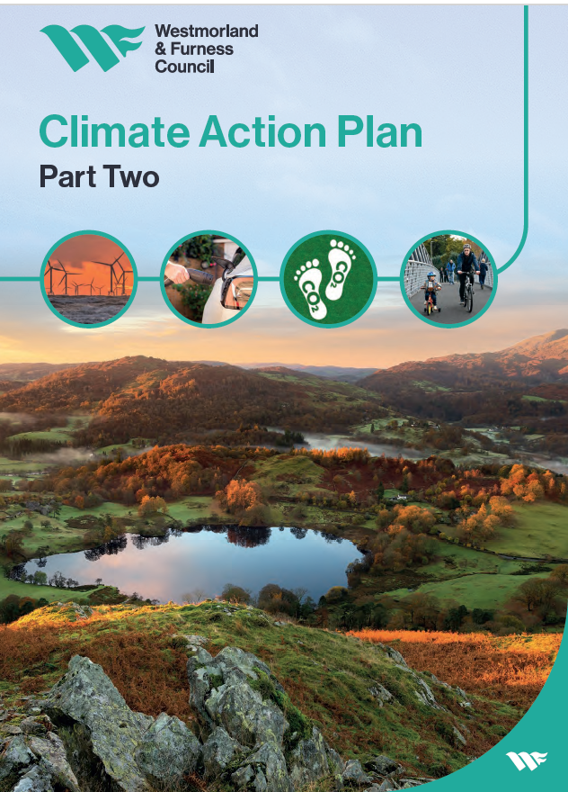
Our strategies and plans for carbon and climate

Slide 5
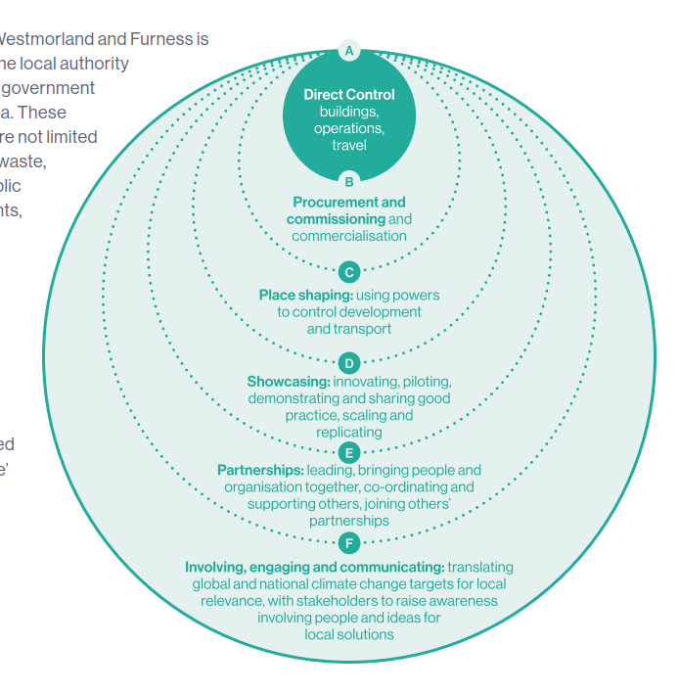
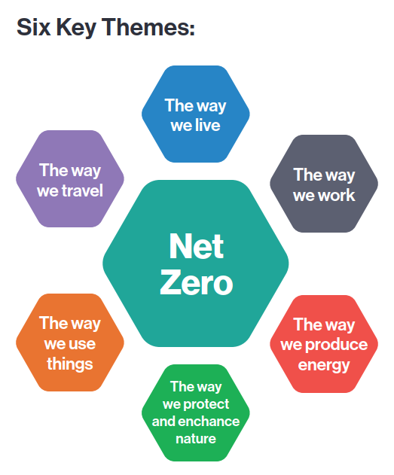
Our scope of influence

Slide 6
Our Commitment:
3 Scope Approach
The council has categorised all emissions into:
Scope 1
Direct emissions
Scope 2
Indirect emissions from purchased energy
Scope 3
Other indirect emissions from the supply chain
To achieve a net zero Westmorland and Furness for scope 1 and 2 emissions by 2037

Slide 7
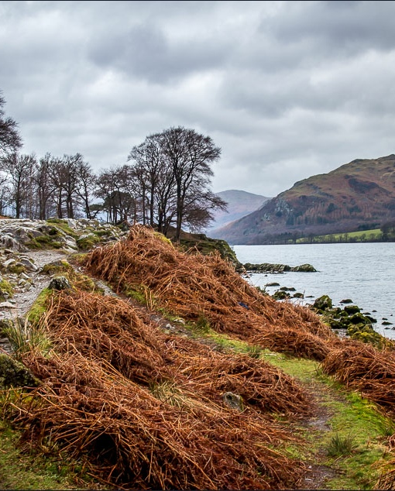
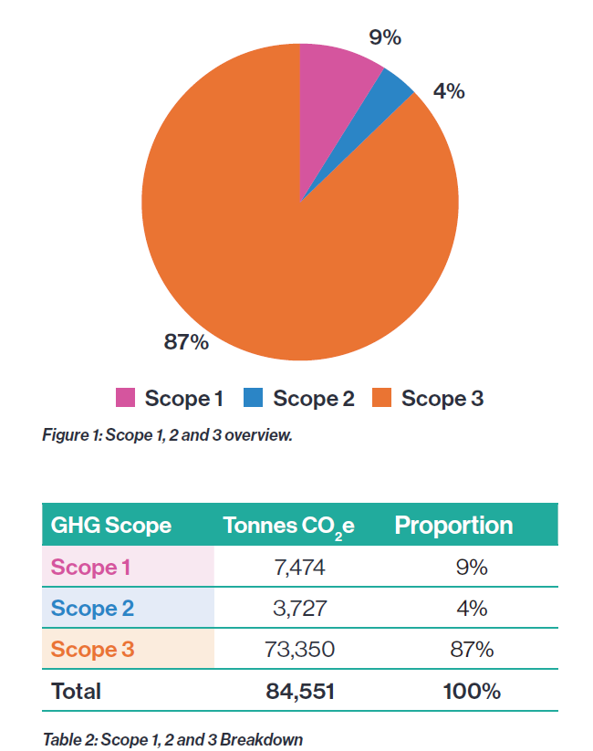
Carbon Baseline Scope 1, 2 and 3
The council produces 84,551 tCO2e greenhouse gas emissions at Scope 1,2 and 3 - equivalent to 9,543 UK household’s annual carbon emissions or flying 2,528,816 air miles.

Slide 8
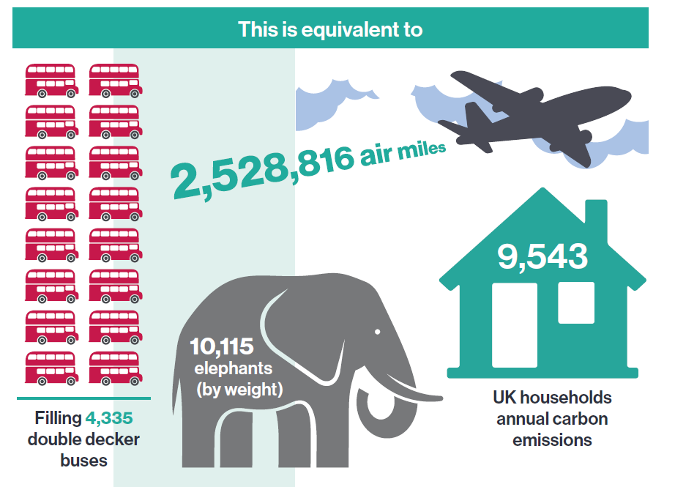
Carbon Baseline Study
We are one of only a small number of local authorities in the country to measure not only Scope 1 and 2 emissions but also Scope 3 emissions for its operational services.

Slide 9
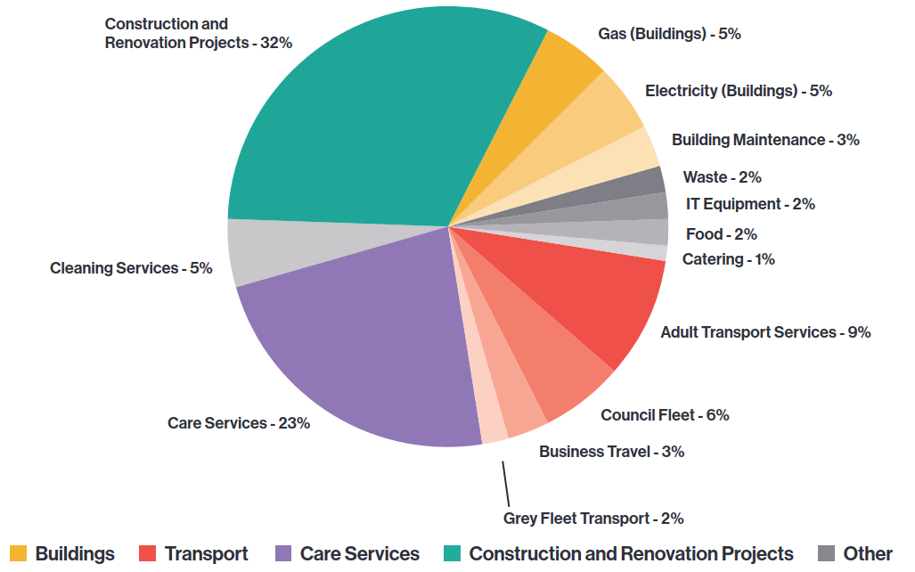
Where do our emissions come from?
The chart below shows the distribution of emissions across the organisation.

Slide 10
2024: Our first year in the journey to net zero…
…and we’re already award winners!!

Slide 11

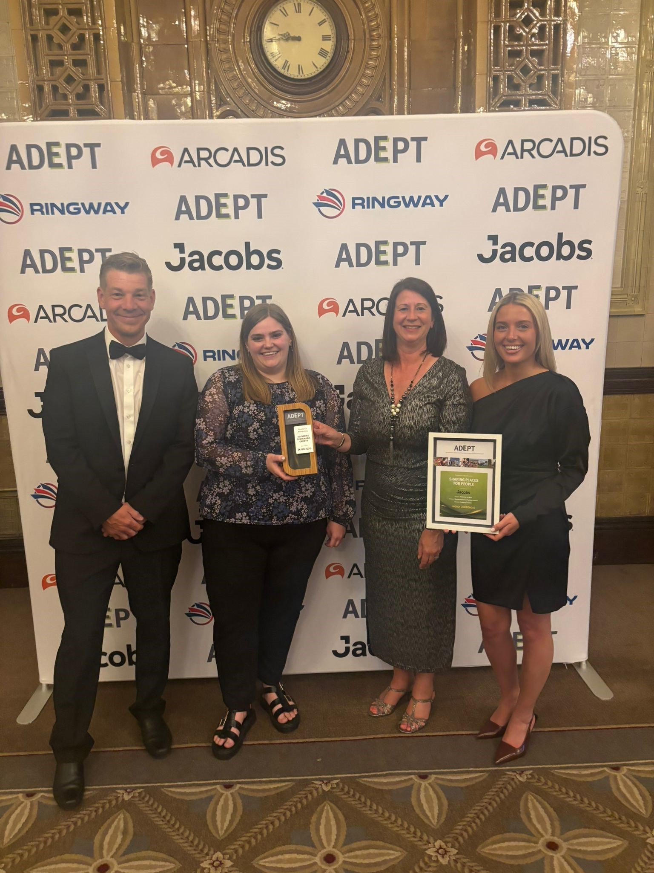
Award Success (to date!)
Runner up: APSE award for ‘Supporting Innovation’ with Voreda House
Shortlisted: LGC Award for our first year in our net zero journey (winners announced tomorrow!)
Shortlisted: UK Green Business Awards for
  Green building project of the year (Voreda House)
  Renewable Energy project of the year (Solar Farm)
  Net Zero Strategy of the year
  (winners again announced…. Tomorrow!)
  WINNERS! For our first year to net zero submission:
  Green Energy Awards
  ADEPT Awards

Slide 12
Funding Awarded – Buildings Decarbonisation
Funding Source | Value | Project | Stage | Estimated emissions saving¹ (tCO₂e/year) | Completion date
Low Carbon Skills Fund | £0.367m | Heat Decarbonisation Plans and Condition Surveys for all council-maintained schools | Survey | - | April 2025
Swimming Pool Support Fund | £0.331m | Installation of triple glazing and solar PV at Appleby and Penrith Leisure Centres | Build | 61.2 | December 2025
Public Sector Decarbonisation Fund | £1.75m | Installation of Air Source Heat Pumps at Appleby Leisure Centre and Kendal Market Hall and install of ASHPs and solar PV at Kendal Leisure Centre and South Lakeland House | Design & Build | 291.8 | August 2026
SPARK fund | £0.075m | Design, planning and grid upgrade costs for Barrow Leisure Centre decarbonisation works | Design | 349.2 | December 2025

Slide 13
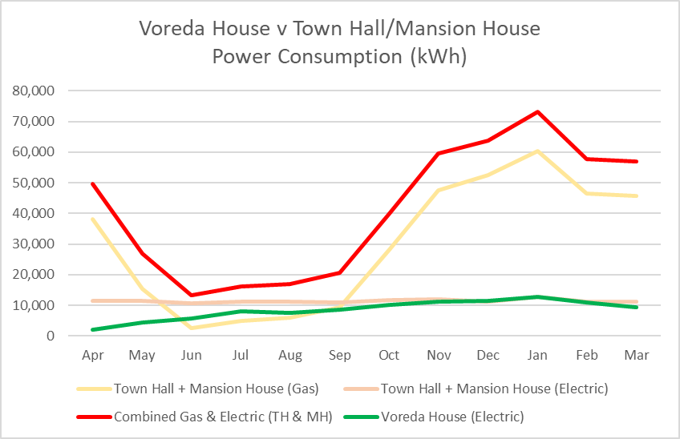

Buildings – UK First: Voreda House
Voreda House is the UK’s first council office building to achieve Passivhaus EnerPHit accreditation following the retrofit of an ageing office building.

Slide 14
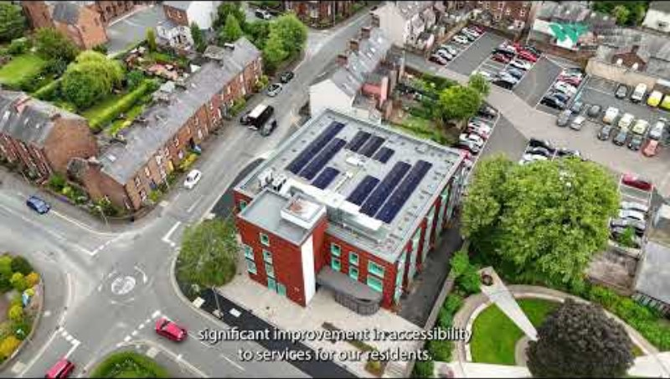

Slide 15

Sustainable Buildings Strategy
A new strategy will:
Provide guidance on appropriate sustainability measures for new construction, refurbishment, and building maintenance projects.
Offer clear and consistent approach to sustainable outcomes for council projects.
Cover operational Energy & Carbon, Embodied Carbon, Water & Waste, Biodiversity & Habitat, Climate Change & Adaptation, Transport, Health & Safety, Wellbeing & Social Value, Certification Schemes.
It will demonstrate leadership in addressing climate change and decarbonisation within local government developments showcasing a pragmatic approach to the ‘art of the possible’ to other sectors to learn from.
The Sustainable Buildings Strategy will be considered by Cabinet in September.

Slide 16
Buildings – Lighting Replacement Strategy
Energy efficient lighting upgrades for our buildings
LED lighting replacement project at Westmorland Shopping Centre car park is estimated to save 42 tonnes of CO2 equivalent annually

Slide 17
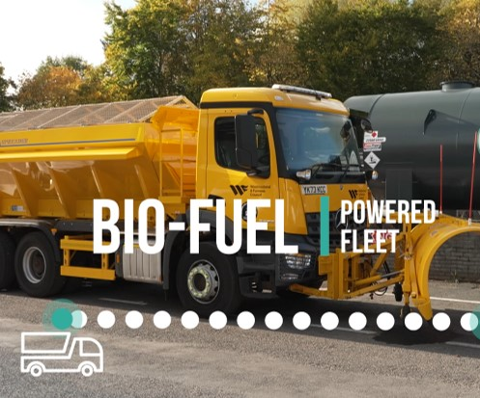
Transport Workstreams
The ‘Fleet Decarbonisation and Replacement Strategy’ will be be considered by Cabinet in September, consisting :
Fleet Baseline Report
Stakeholder engagement Report
Decarbonisation Strategy
Replacement Strategy
Implementation Plan
Ongoing Decarbonisation Workstreams
HVO Fuel Pilot
Start: Jan-25
End: Jul-25
The Skirsgill Depot has been chosen for a trial of HVO fuel, for use with Highways Fleet vehicles. A large fuel bowser for fleet vehicles to use has been installed at approx. £20,000-30,000.
Feedback so far is good and internal and external comms releases have been positively received.
EV Replacement & Infrastructure
Pool cars: Nov-25
EV infrastructure: ’25 onwards
Permission has been granted to procure a new fleet of 16 self-charging hybrid and 4 fully electric pool cars, expected to be deployed by November 2025.
PLUS installing EV charging points at multiple depots.
Employee Car Scheme
Kick off: Jul-25
Approval has been granted to implement an employee vehicle leasing salary sacrifice scheme which is anticipated to be in place by July 2025.
The scheme will cover all vehicle types with enhanced benefits weighted towards EV’s.
Telematics and Driver Training
Training: Jan-25
Telematics: ‘25-’27
Safe and fuel-efficient driving training will be delivered commencing January 2025, focusing initially on the HVO pilot drivers.
The team are seeking to standardise telematics across the fleet and gather fuel consumption data to present on a dashboard.

Slide 18
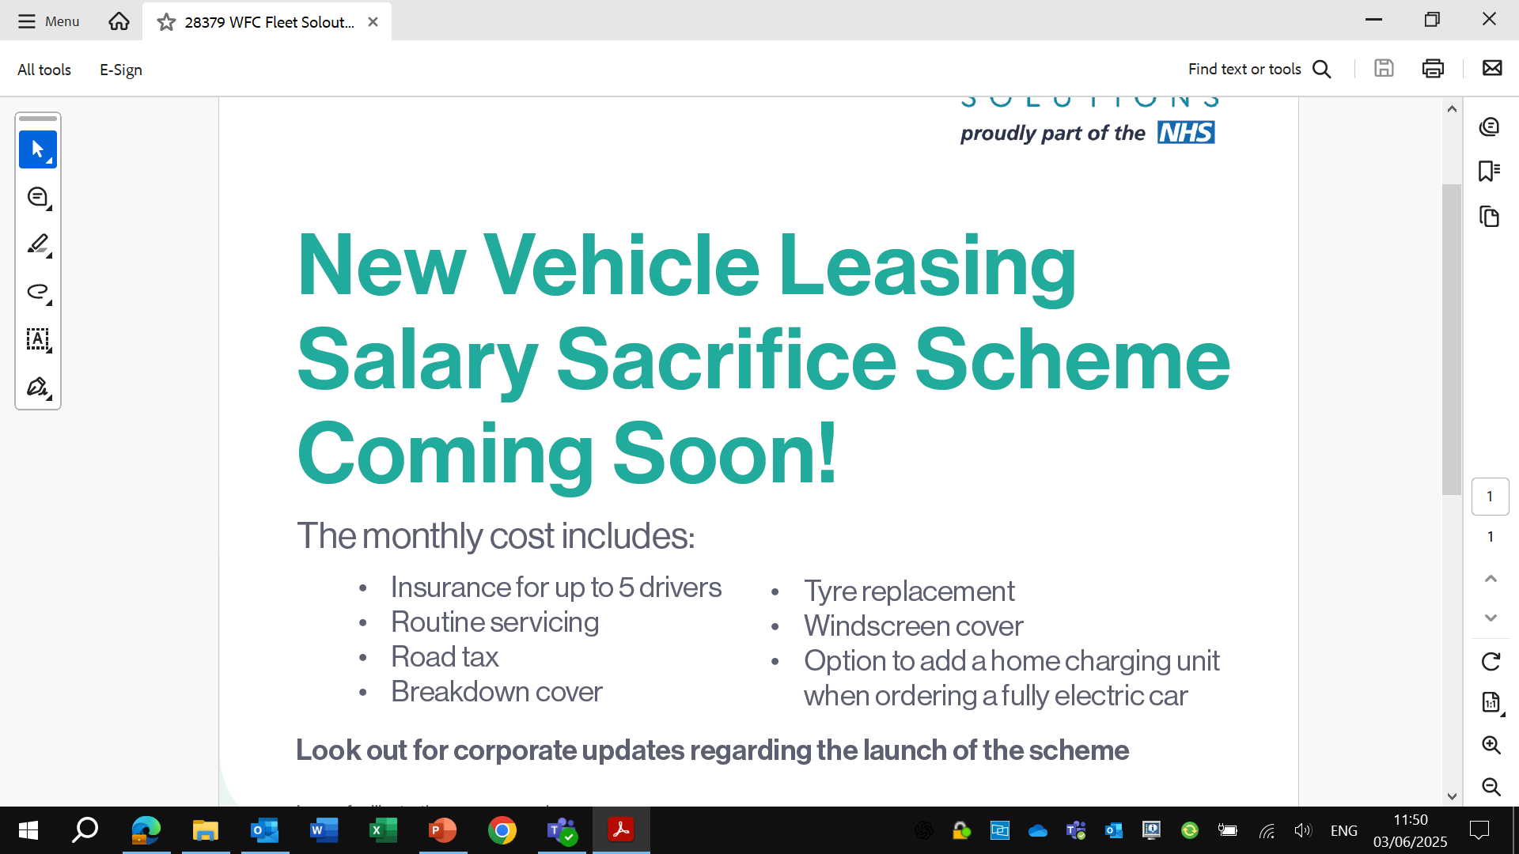
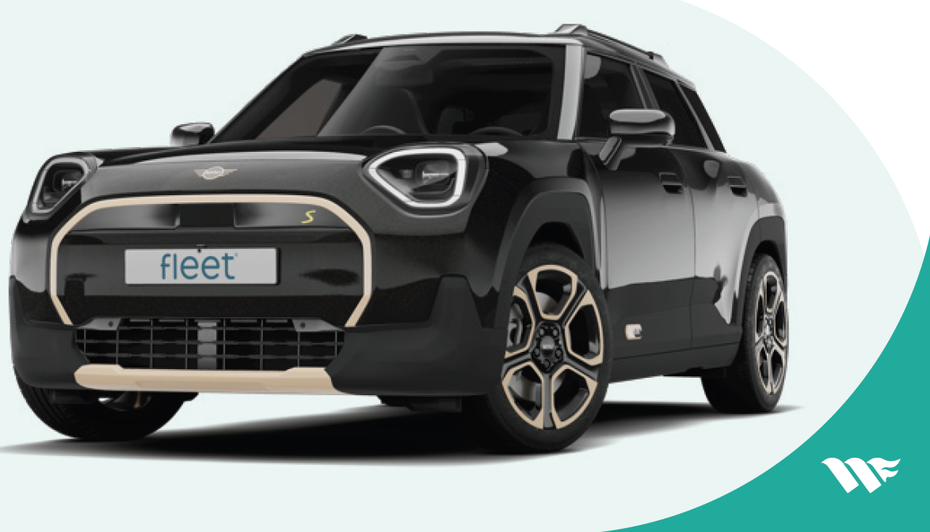

Slide 19
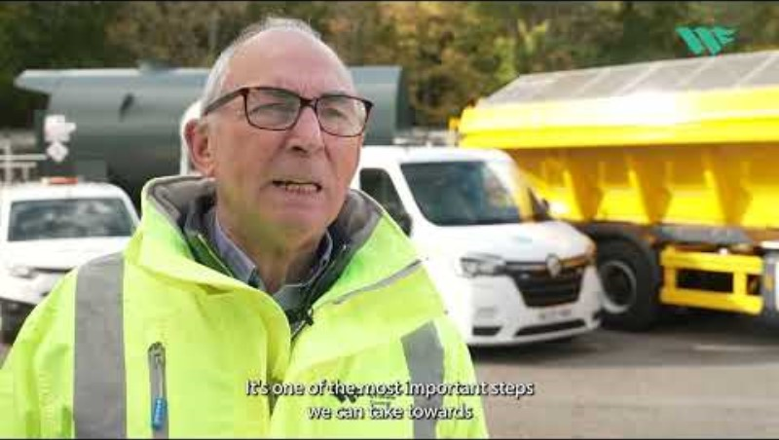

Slide 20
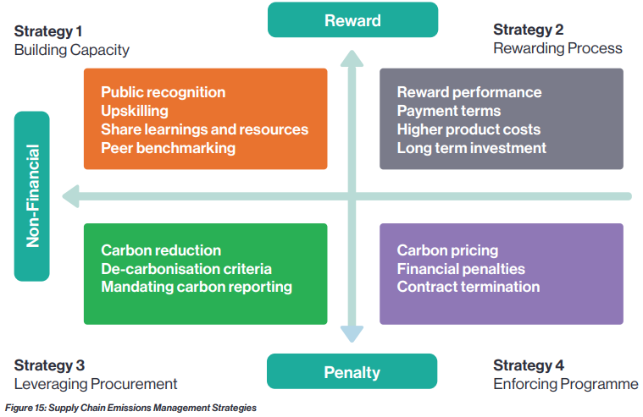
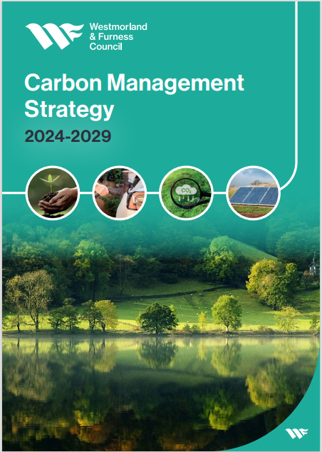
Supply Chain Emission Management: Leveraging Procurement
The Carbon Management Strategy breaks down our efforts to reduce our supply chain carbon emissions into four strategies, with the decarbonisation team focusing on workstream three:
Building Capacity
Rewarding Progress
Leveraging Procurement
Enforcing Performance

Slide 21
Supply Chain Emission Management: Leveraging Procurement (continued)
Through collaboration with procurement colleagues, the decarbonisation team are embedding decarbonisation clauses into our major contracts:
Surface Treatment & Core Surfacing Contracts
We've embedded new climate requirements into these two major contracts worth £100M over 4-6 years (10-15% of annual capital spend)
Contractors have committed to a 20-27.5% carbon reduction over 6 years
Annual carbon reduction plans with mandatory reviews
Focus on work optimisation, electric fleets, and low-carbon materials
Capital Works Framework
All bidders provided carbon reduction plans with measurable targets
Carbon calculations now mandatory as a Key Performance Indicator
Monitoring and reporting requirements built into all framework projects
Supplier Engagement
Hosted framework event with 80+ suppliers (July 31st)
Shared tendering approaches and carbon calculation methods

Slide 22
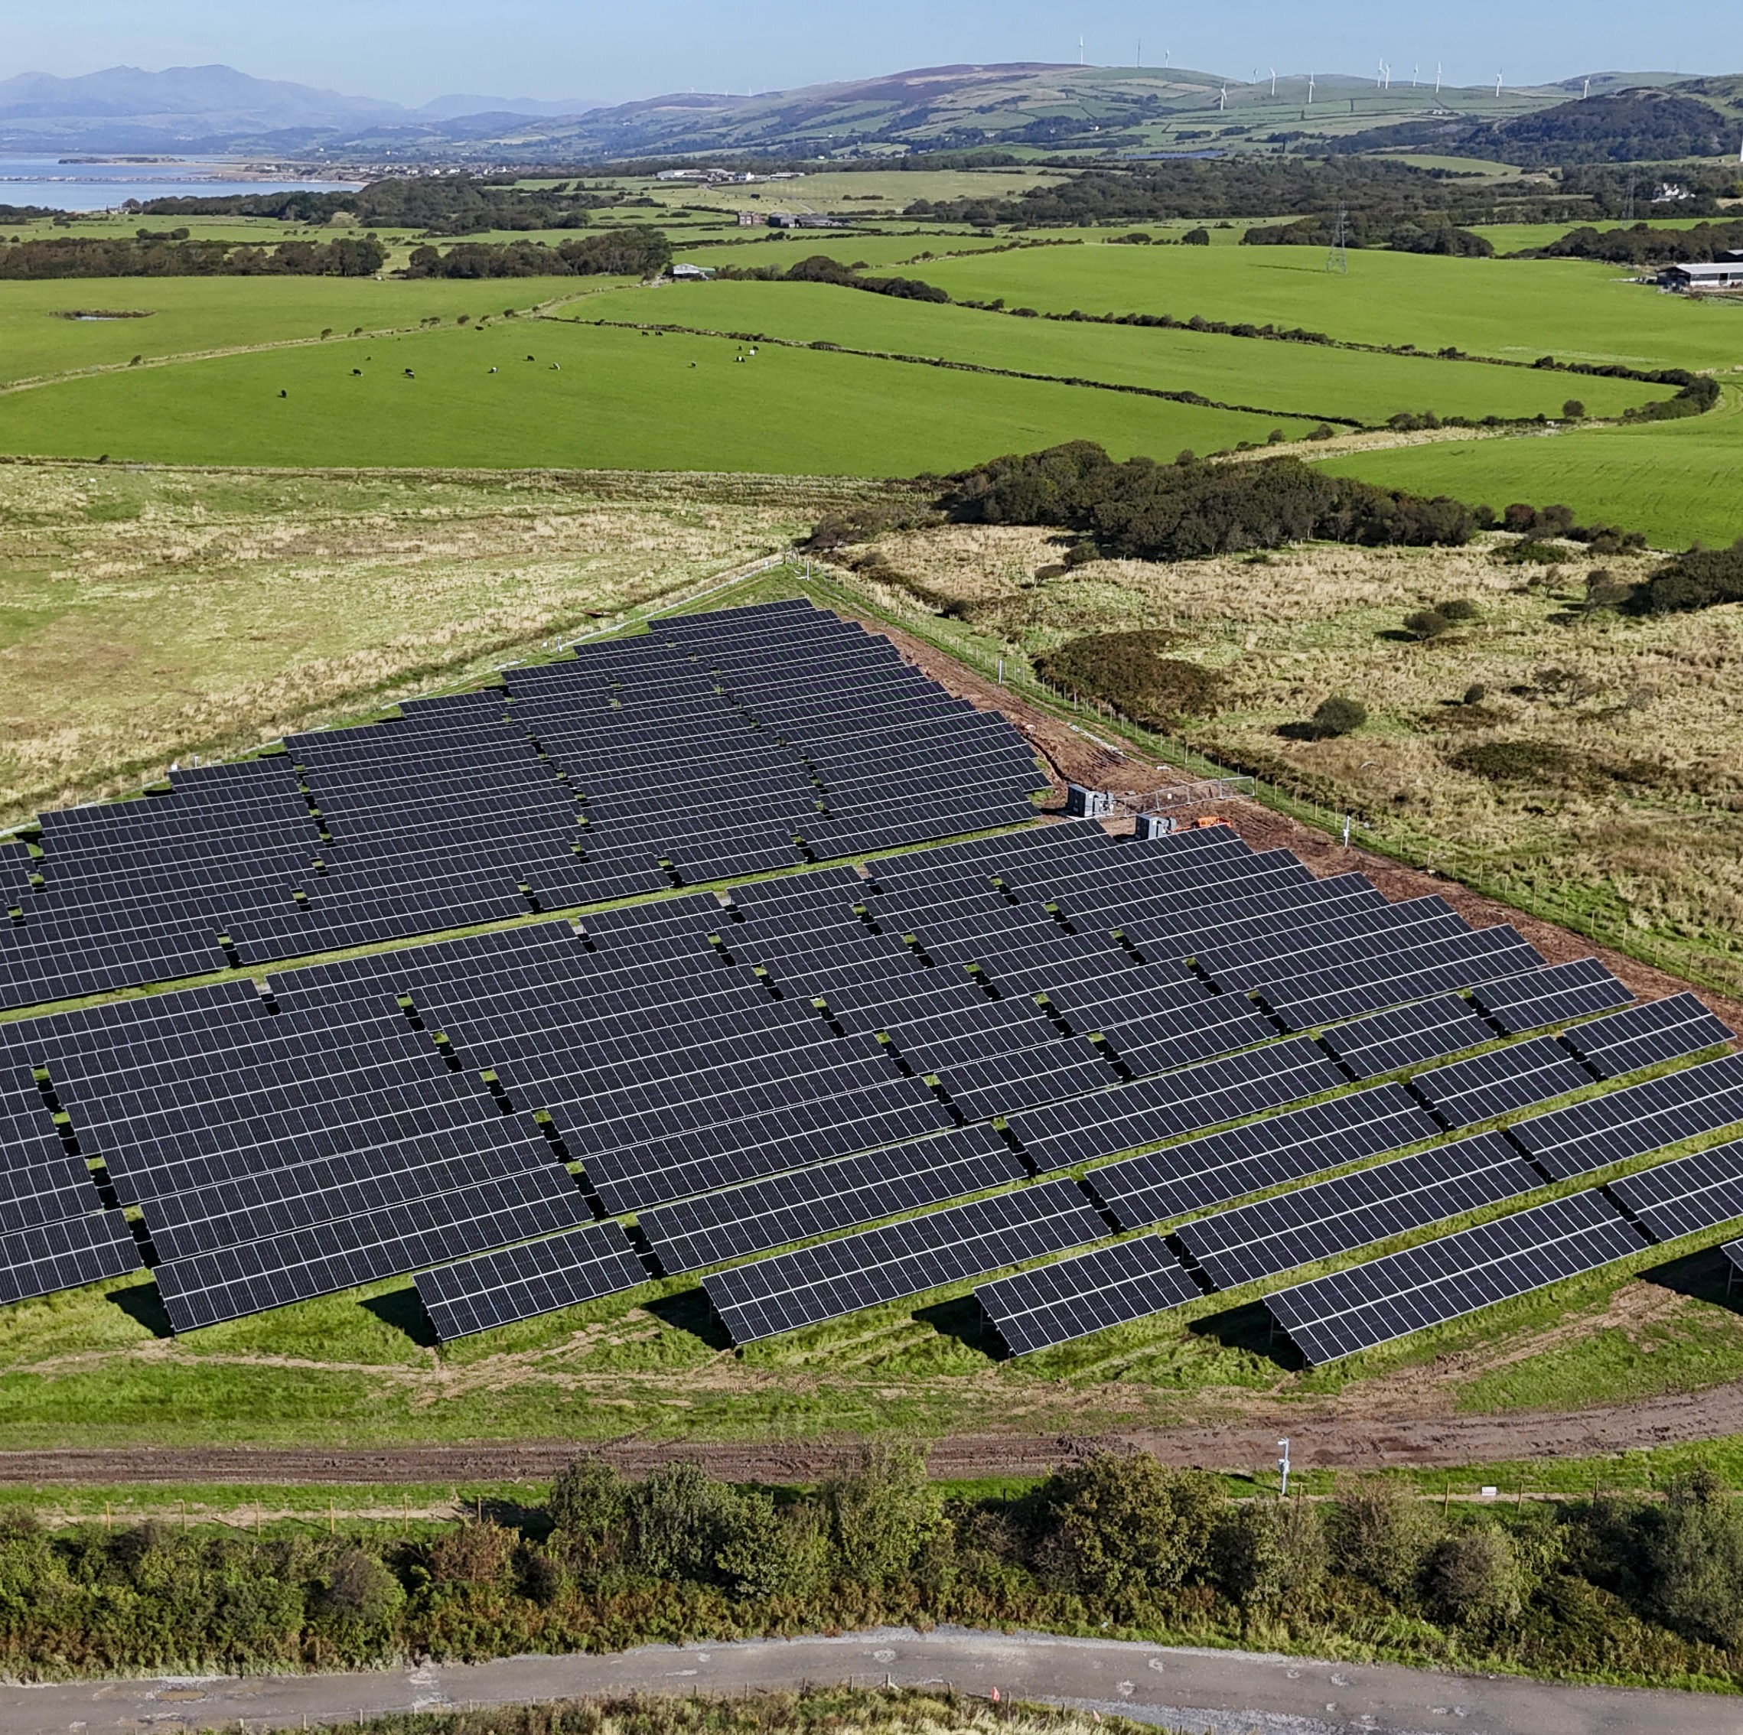
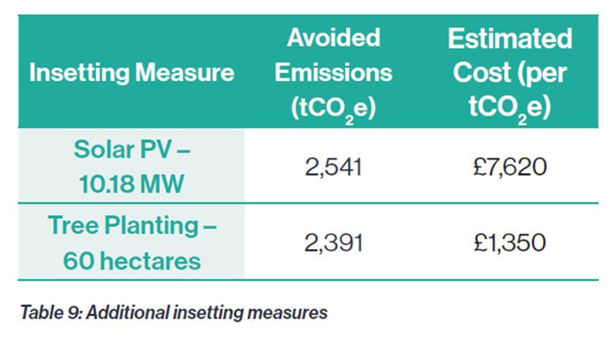
Residual Emissions
The Carbon Management Strategy guides the council towards a Scope 1 and 2 net zero carbon position by 2037 and Scope 3 emissions as soon as possible.
Implementing the Buildings and Transport Emissions Reduction measures leaves a shortfall of 5,658 tCO2e of residual emissions by the end of the programme.
Utilising ‘insetting’ through development of renewable energy and tree planting on Council land is the proposed strategy to address residual carbon emissions.
Sandscale Solar Farm: The 3,700 solar panels at our 2MW solar farm, on council owned land in Barrow, are expected to save around 507 tonnes of carbon dioxide equivalent annually and generate enough electricity to power our five leisure centres, or approximately 730 homes per year.

Slide 23
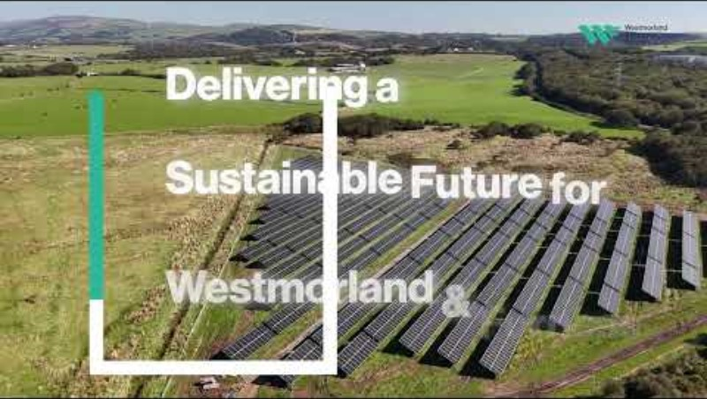

Slide 24
Emissions Trajectories & Forecast
301 tCO2e/annum
313 tCO2e/annum

Slide 25
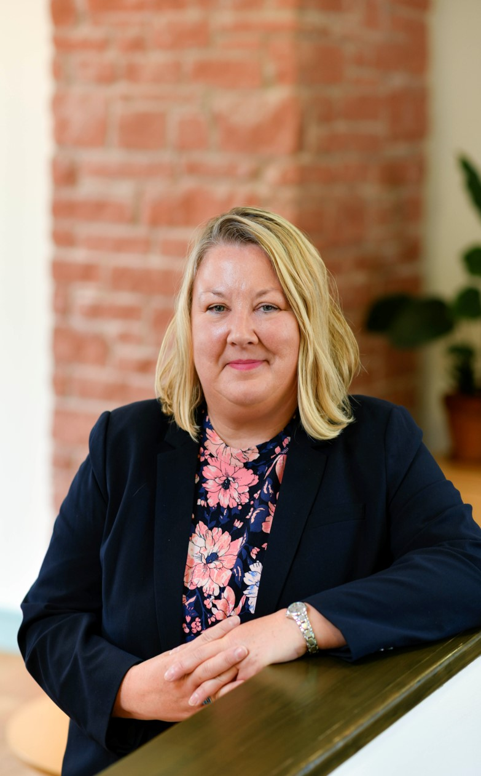
Claire Gould
Assistant Director of Climate & Natural Environment
Climate Change Policy
Carbon Reduction/Carbon Management
Biodiversity Net Gain and Ecology
Environment Funded Programmes, Projects & Partnerships
Flood and Coastal Risk Management
Natural Capital

Slide 26
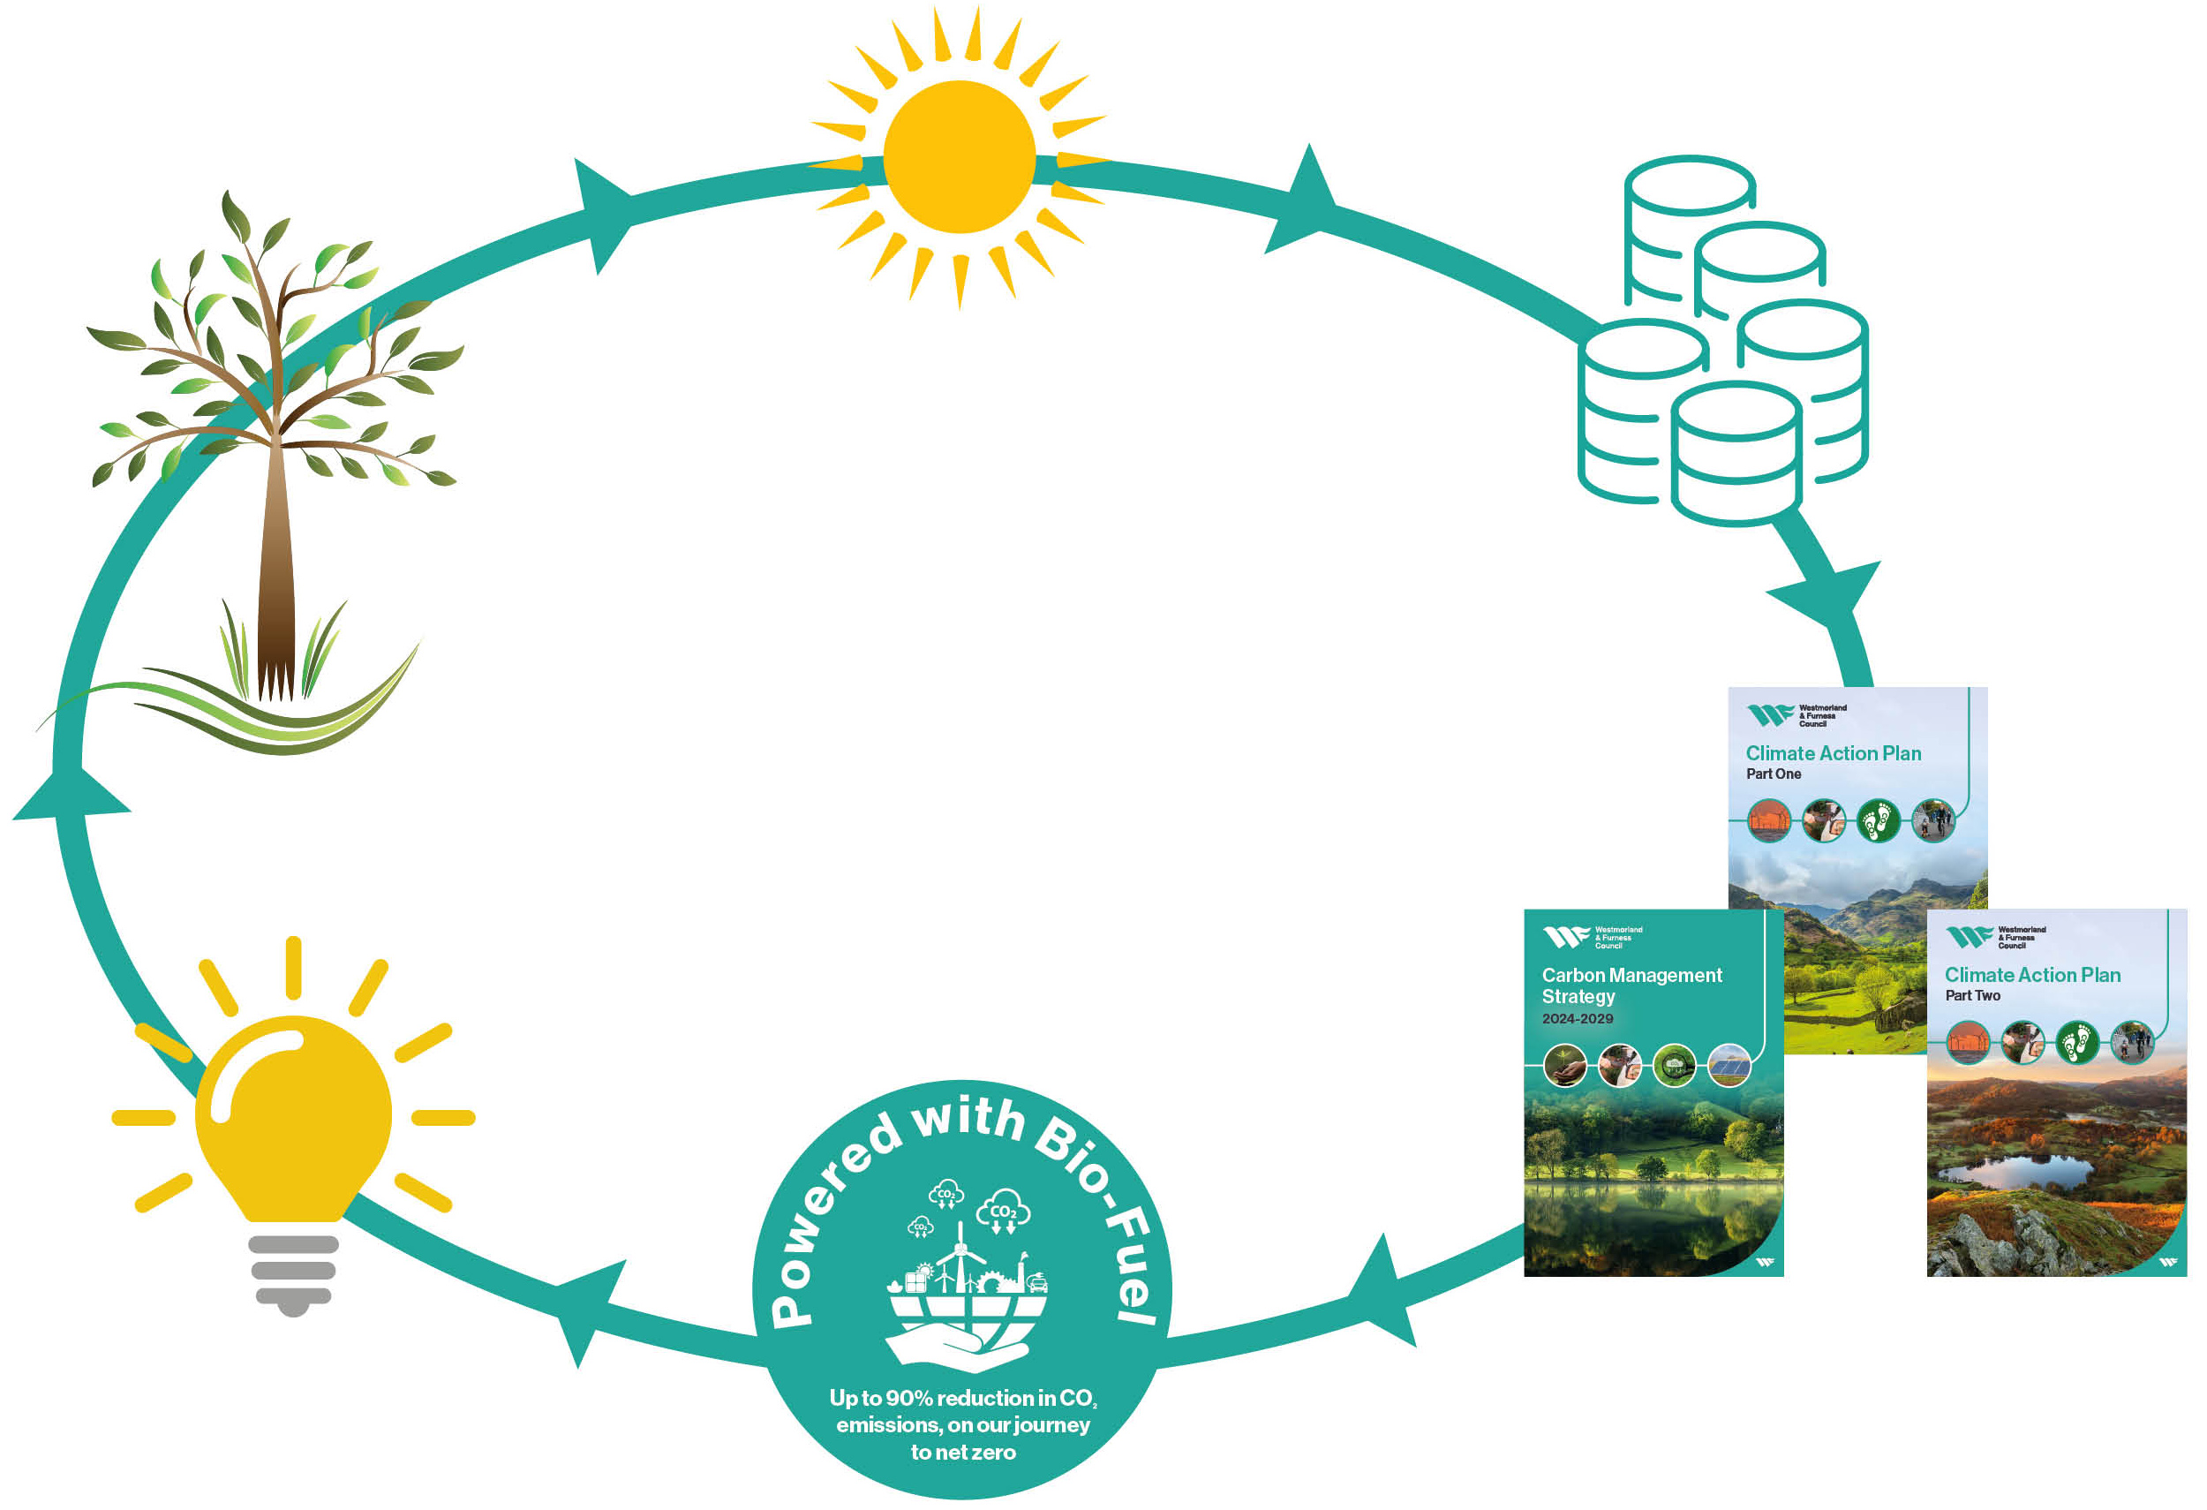
Our first year – building on our collective strengths

Slide 27

Climate and Nature Team
Climate and Environment Partnership Grants - £900k
Innovate UK Net Zero Living - £150k Rural Net Zero – working with CAfS, local businesses and Cumbria Tourism – looking at Circular Economy
Greening Business Scheme – audits and grants to businesses in W&F to help reduce their emissions
Ecologist team have set up a process and are reviewing planning applications for BNG and other ecology needs
Land Assessment Commission – looking at what is the nature potential on our sites
LINC Funding - £350k for exploring options for setting up a habitat bank or brokerage service for linking landowners, developers and investors. And £100k for a landscape natural capital investment pilot by Ullswater CIC

Slide 28
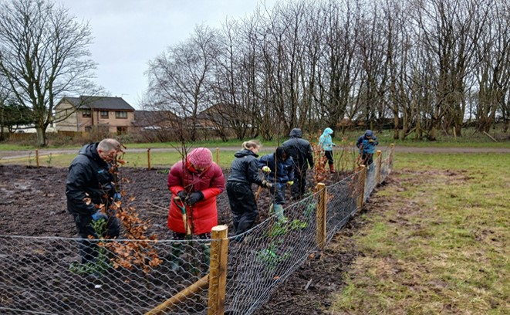

Climate and Nature Achievements
Tree planting
43,000 tress have been planted. (18% of our objective)
Carbon literacy training
325 officer trained in total since the legacy councils began CLT – 9% of officer. Aiming for Silver

Slide 29
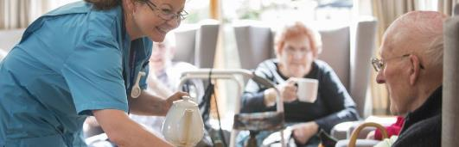
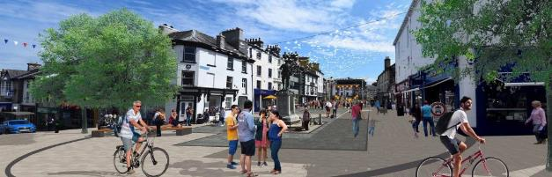
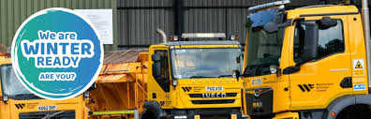
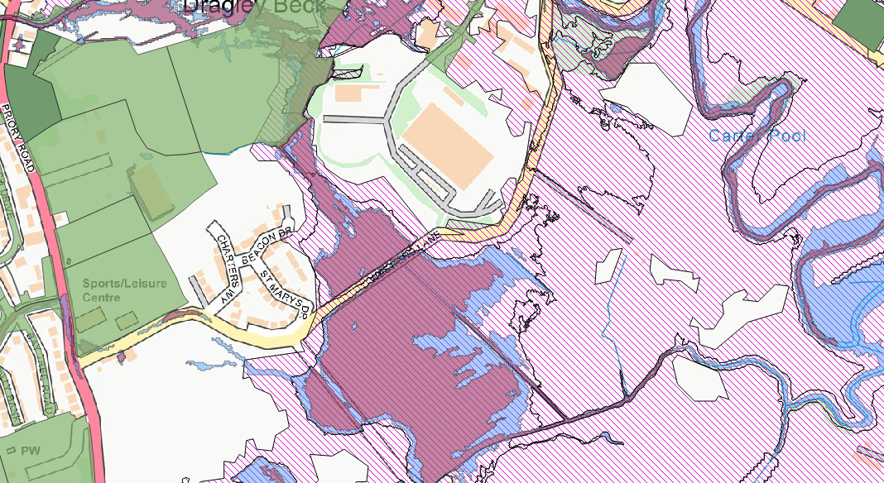
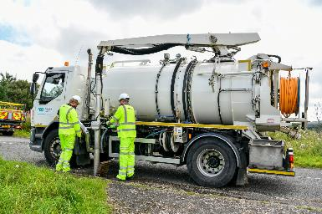
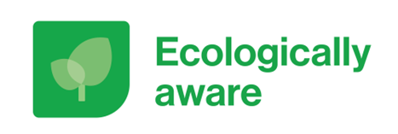

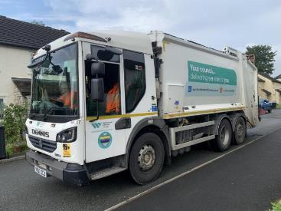
Council-wide approach
Aids to Daily Living Take Back event on 25 April in Penrith
Active travel and transport schemes
Planning and Housing Delivery
Sustainable Transport
Waste and Recycling
Health, Care and Wellbeing
Economic Development and Regeneration
Biodiversity and Nature
Assets, Fleet and Operations
Children and Young People

Slide 30





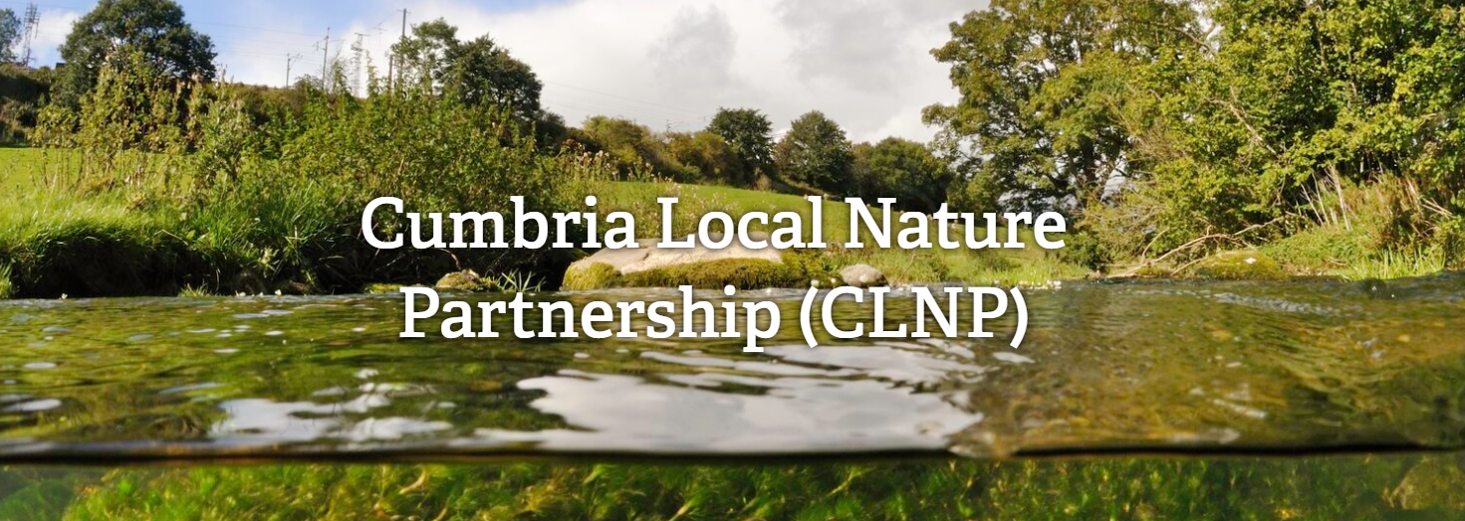



Collaboration

Slide 31
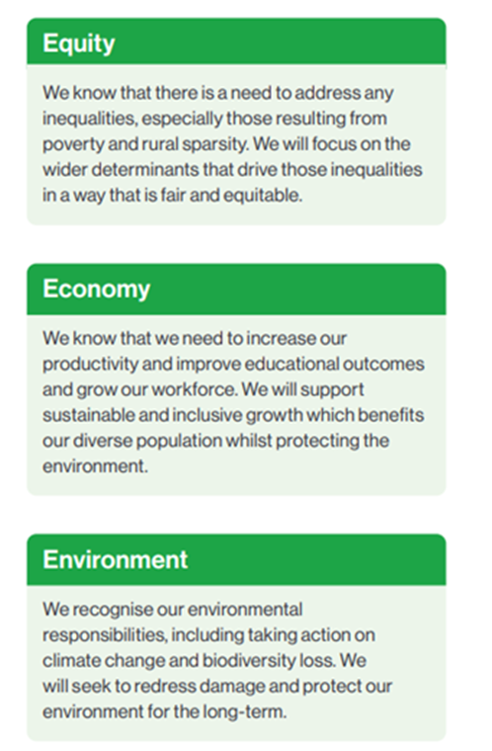
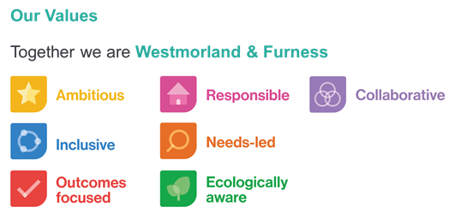
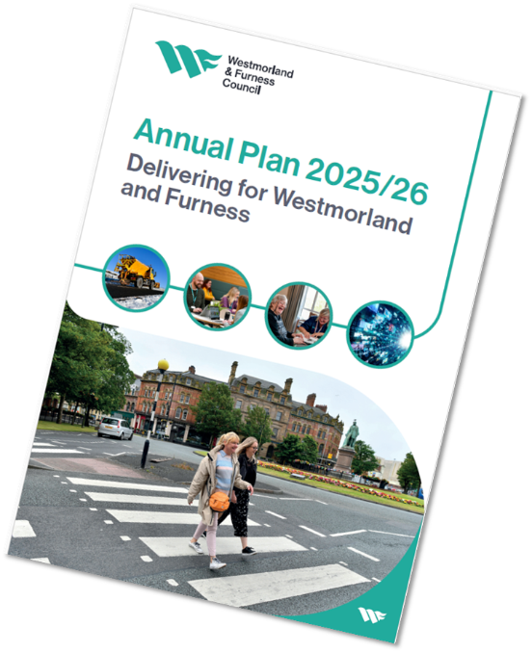
What are we doing with staff?
Our values

Slide 32
What does it mean to be Ecologically aware?
Climate
Biodiversity
Air
Water
Land
Ecologically Aware
It means considering our impact on the different aspects of the environment in everything we do.
Understanding how our behaviour (at work and personally) impacts the environment and committing to making changes to our behaviours for a sustainable future.
Notes:
Ecologically aware in the middle
Air, water, land,
Biodiversity
Climate

Slide 33

What does it mean for us?
  Leading by example, focus on embedding environment and sustainability into services and decision making
  Learning and development for e.g. Carbon Literacy Training, or Biodiversity Literacy Training (to be developed)
  Waste and recycling in our offices and buildings
  Energy Efficient buildings and systems (e.g. IT)
  Reducing our carbon footprint in travel choices - car share, hybrid meetings (where appropriate), train or bus, cycling and walking
  Considering the environment when developing strategies and policies
  Managing our assets, e.g. open spaces and verges
  Considering sustainability in procurement processes
  Measuring and celebrating successes
🚲
🎉
📑
🏢
💻
🌍
🎓

Slide 34
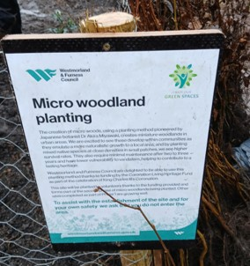
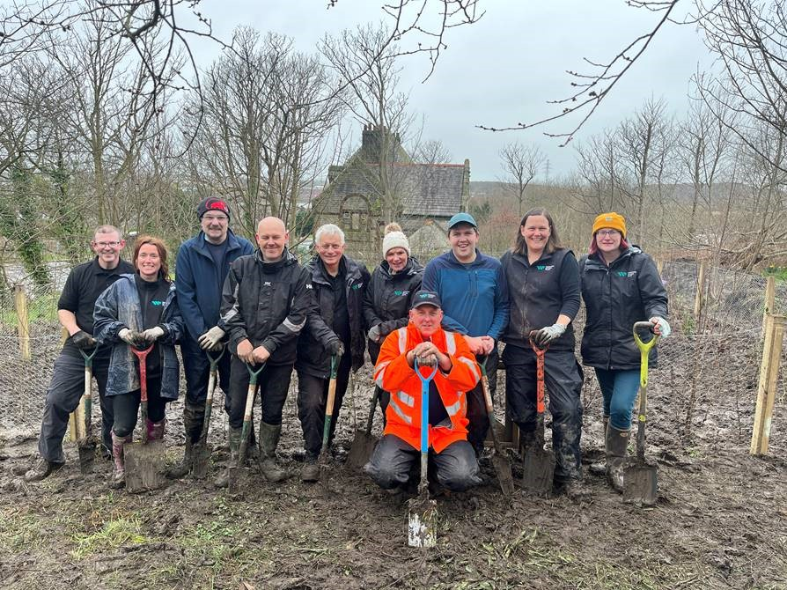
How do we bring the value to life?
Talk about climate, environment and nature
  The Climate and Nature team are here to enable other services to embed sustainability into their day to day
Culture programme
  Includes a focus on embedding the W&F Values, engaging with the workforce on what they mean to them and co-creating a narrative around each
Employer Supported Volunteering
  Scheme launched April 2025
  2 days paid time off to volunteer
  Promoting ecological opportunities
Internal staff programme
  Recently launched a Change Champion Action Group, working exclusively on ‘Being Ecologically Aware’
    developed from being a smaller group of individuals passionate about this, to now being something that they will be leading on across the organisation

Slide 35

Summary
Leadership
Partnership
Influence
Opportunity
Communities
Collaboration

Slide 36
We want to hear from you!
If you have any ideas to share please get in touch at:
ClimateAction@westmorlandandfurness.gov.uk

