Slide 1


Welcome to Work in the Visitor Economy
Sam Butcher - Westmorland & Furness Council
Rachel Tyson - Cumbria Tourism

Slide 2
Welcome to Work in the Visitor Economy
Aims to tackle both the high rates of economic inactivity and poor employment outcomes in some of our communities and significant staff shortages in our world-famous tourism sector
£132,701 funding from the Council through the UKSPF since 2023, with additional funding of £63,024 to extend into 2025/26
Delivered by Cumbria Tourism and partners
Highly commended at the ADEPT awards last month
Shortlisted for the Local Government Chronicle awards

Slide 3
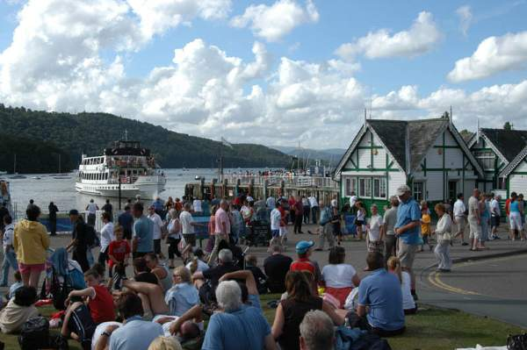

Visitor economy challenges
24 million visitors a year with £2.8 billion spend
Tourism directly supports around a quarter of all jobs
78% of visitor economy businesses struggling to recruit staff
43% forced to reduce opening hours, capacity or quality of visitor experience
Need to encourage the growth of a more diverse and inclusive workforce to support businesses, provide opportunities and retain and attract talent in our area

Slide 4
Welcome to Work in the Visitor Economy
https://www.youtube.com/watch?v=st1BNPiW1WI

Slide 5
Reasons the project is a success
Innovative approach to recruitment – a win win
Targets a number of cohorts – truly inclusive
Strong partnership working
364 supported to seek work
109 into employment in the Visitor Economy

Slide 6
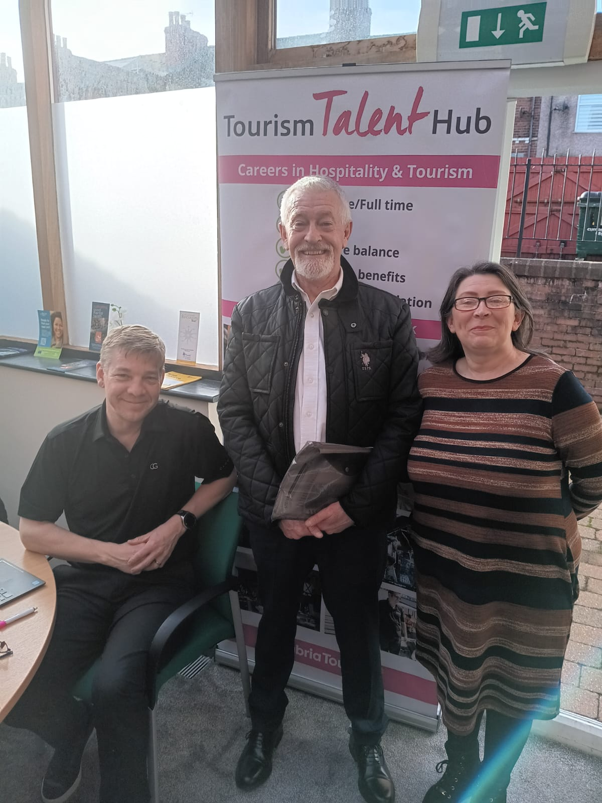
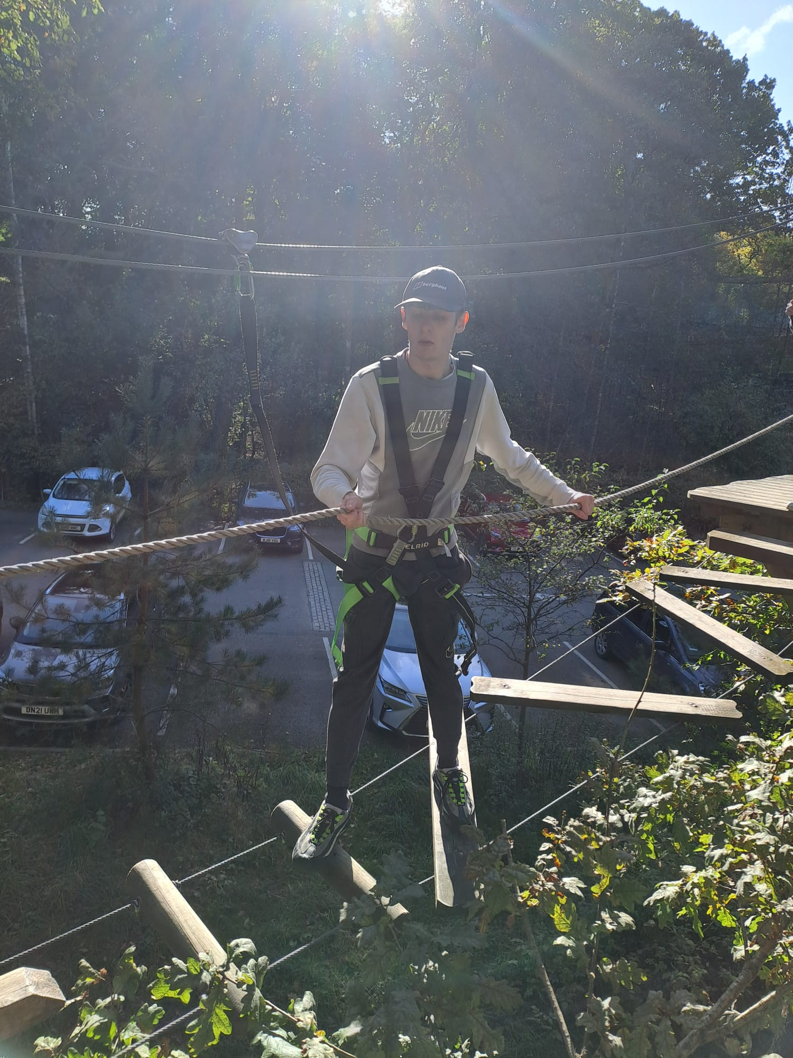
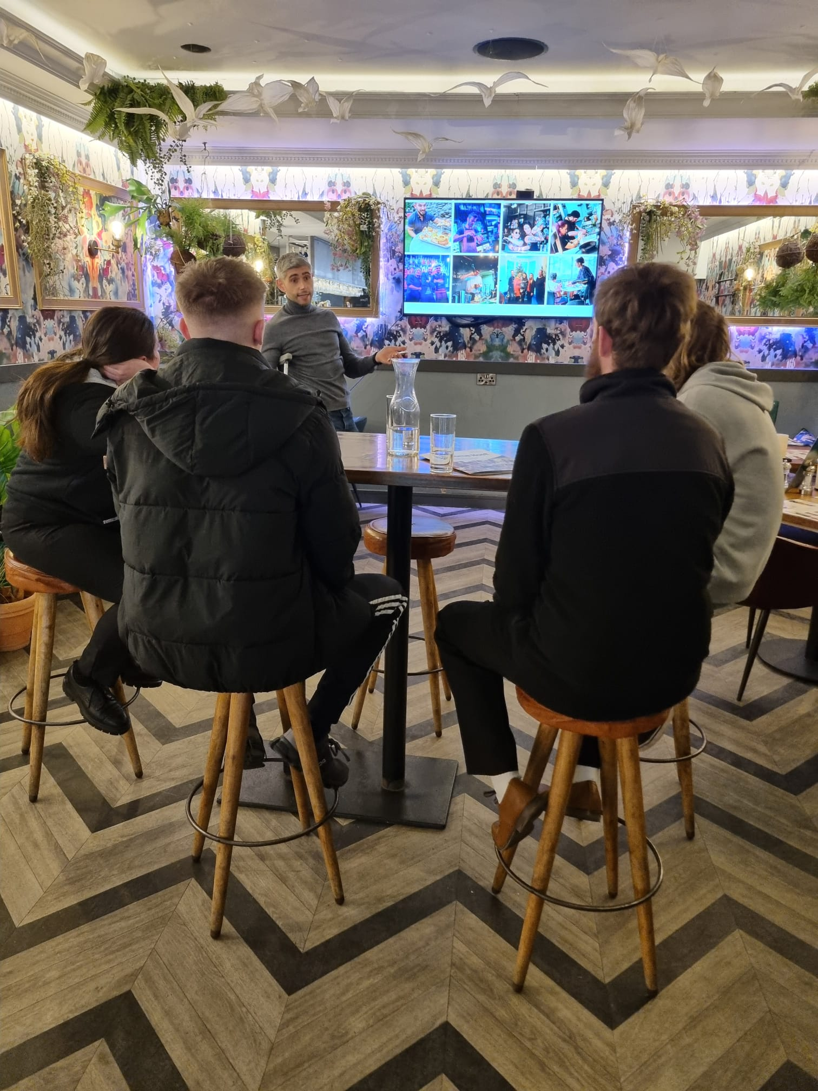
Declining working age population

Slide 7

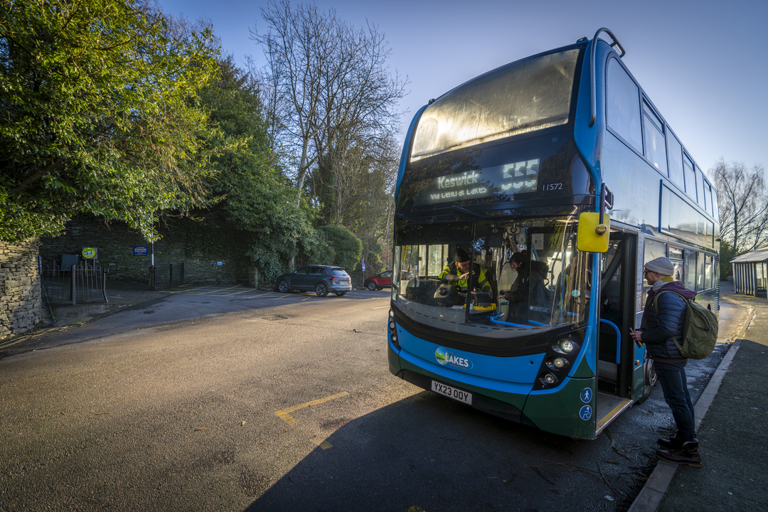
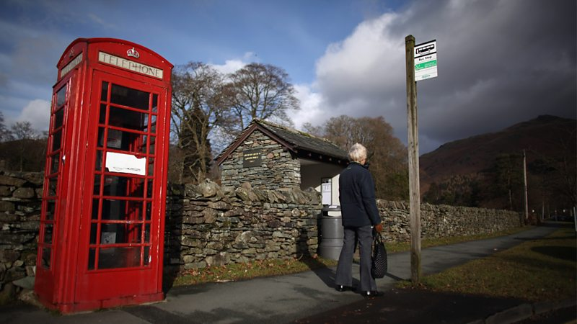
Travel distances and diverse rural geography

Slide 8
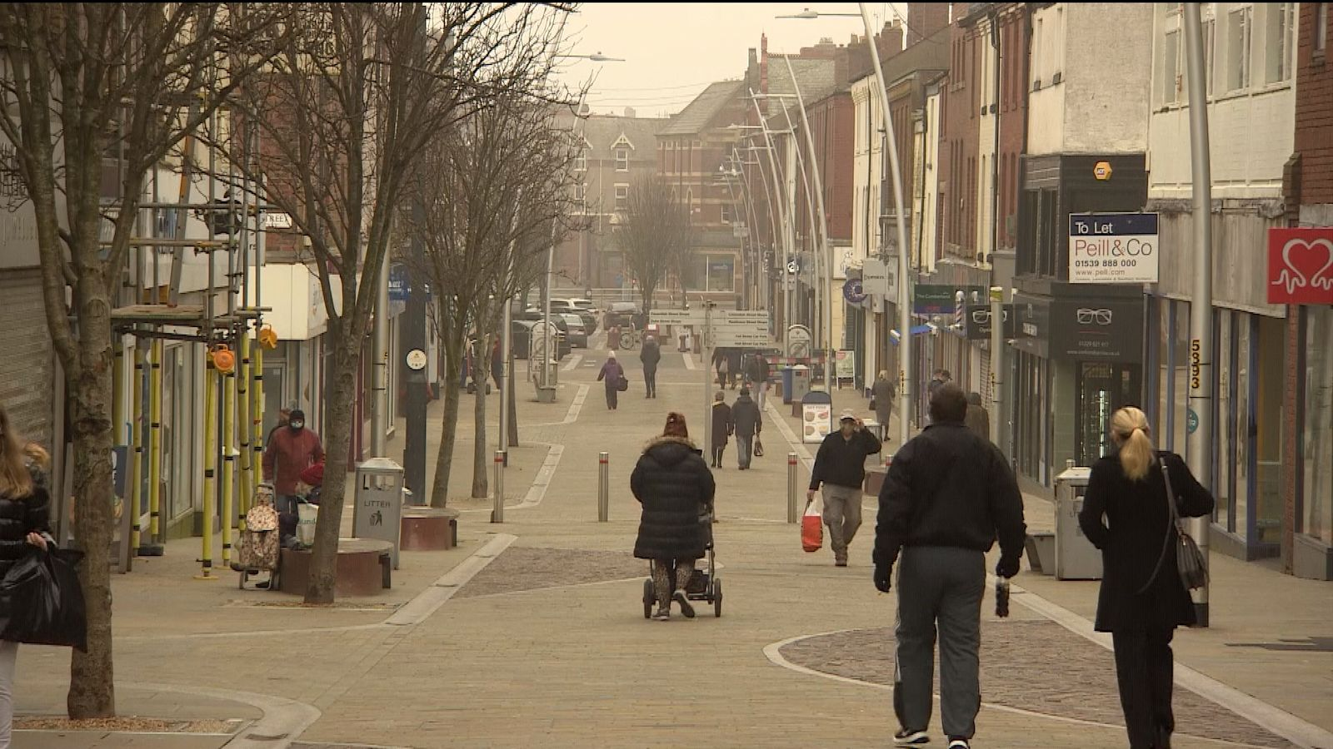
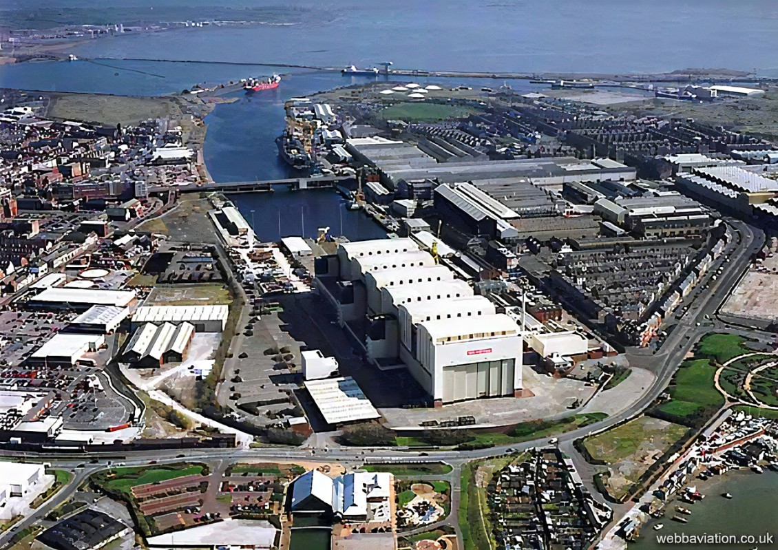
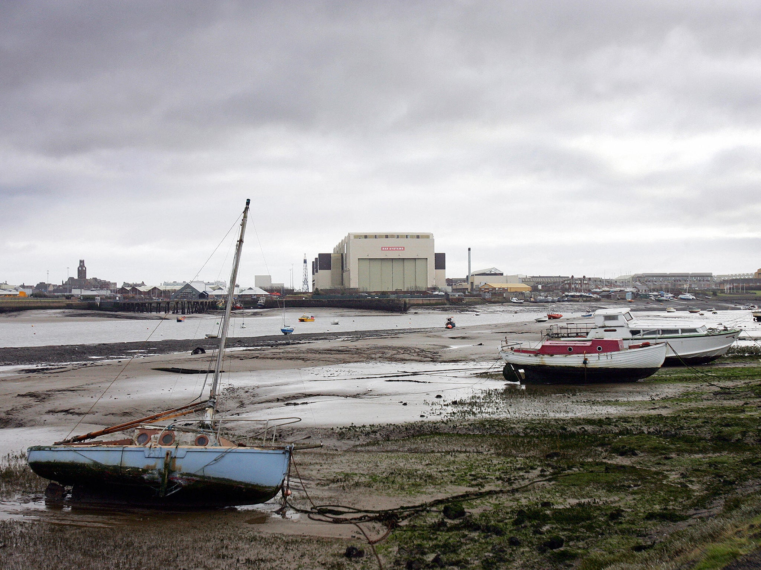
Inequality and deprivation

Slide 9
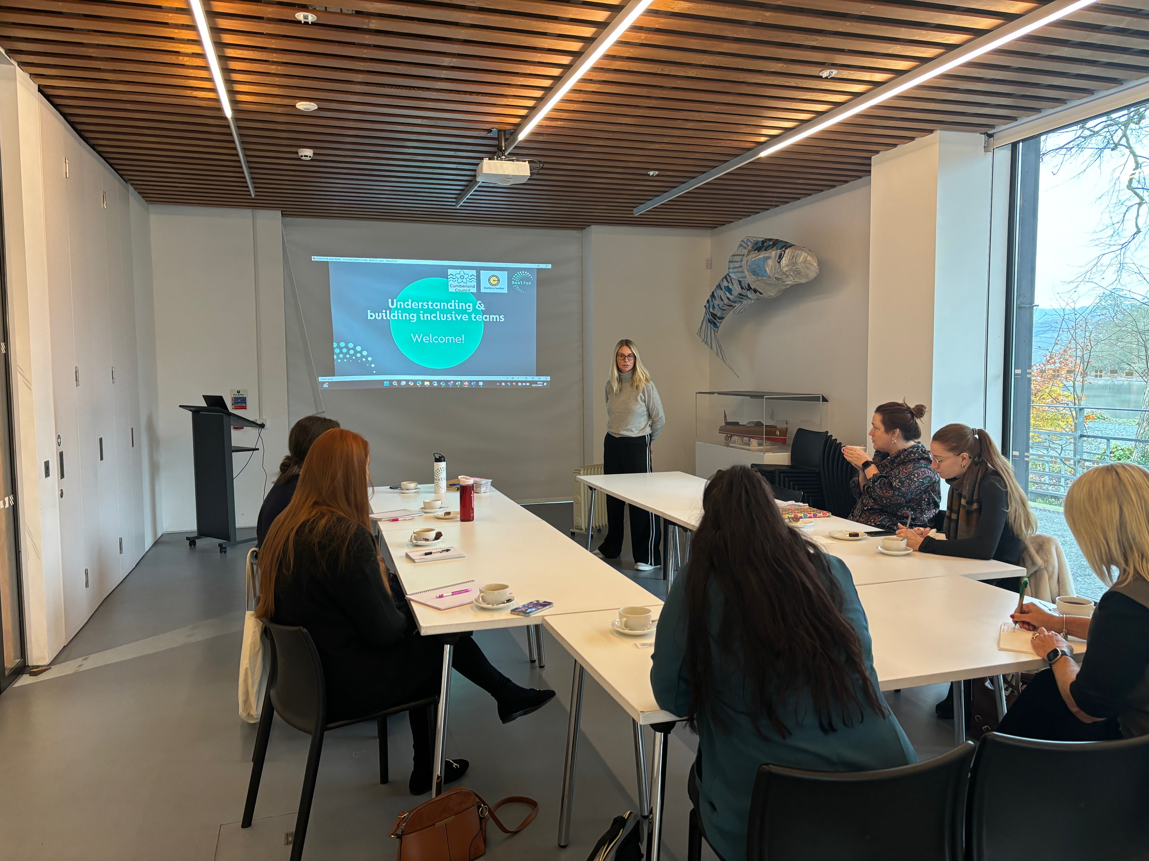

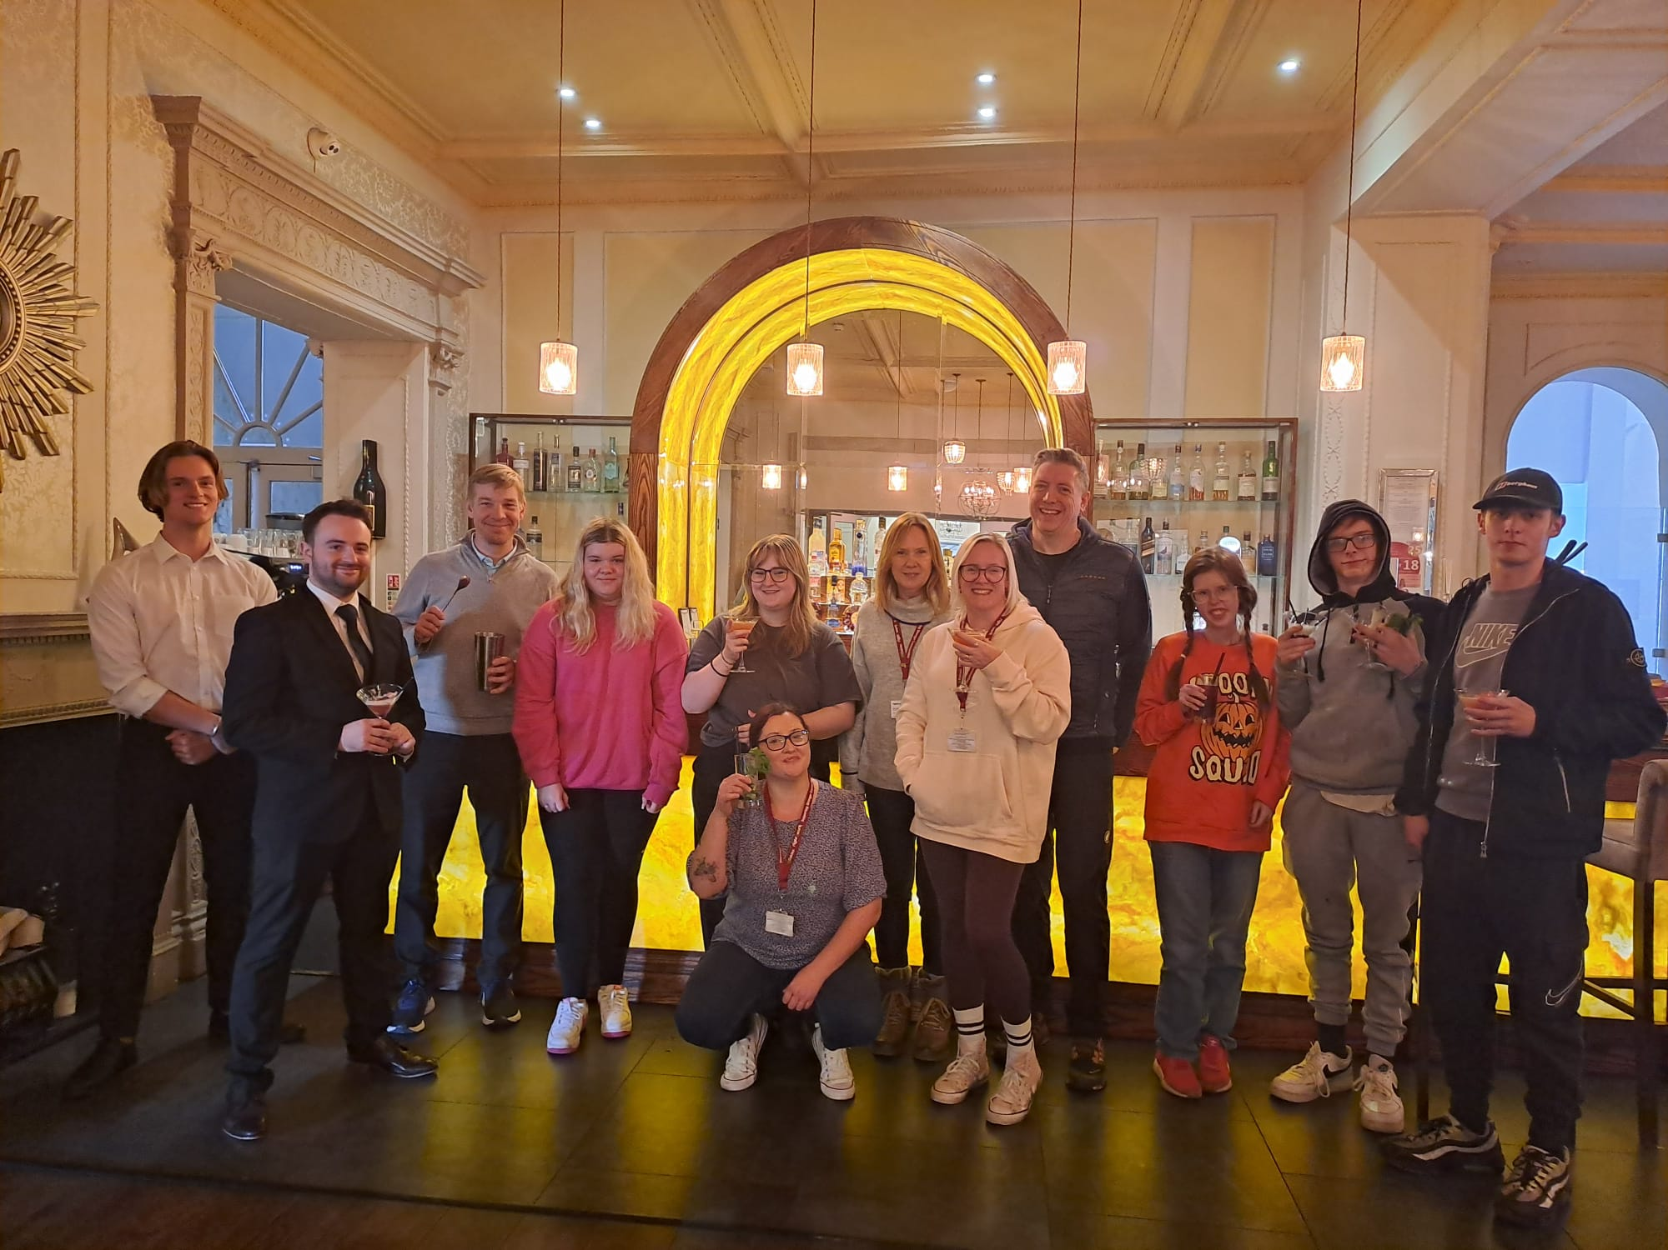
Diversity and inclusion

Slide 10

















Strong partnership working

Slide 11
Any questions?

